Slide 1
Methods in Social Research – Quantitative research
Ph.D. Programme in Global studies
Università degli studi di Urbino Carlo Bo
Tim Goedemé, PhD
tim.goedeme@spi.ox.ac.uk
Lecture 4 – 26/11/2020

Slide 2
Overview of the course
Introduction to quantitative research and social indicators
Survey data and total survey error, including sampling variance
Social indicators and policy indicators
Quantitative research techniques to identify drivers
Setting up your own research project

Slide 3
1. Identifying ‘drivers’ and ‘causes’ in social research
Lots of quantitative research is not just aimed at description and association, but at causation
Two possibilities: ‘causes of effects’ and ‘effects of causes’
The key trick that must be achieved: building a valid and convincing ‘counterfactual’ situation
‘Hard causes’ are often hard to identify

Slide 4
1. Identifying ‘drivers’ and ‘causes’ in social research
Three techniques discussed in this lecture:
Experiments
(Interlude: causes vs. ‘drivers’ and ‘determinants’)
Regression analysis (also applied in experiments)
Tax-benefit microsimulation

Slide 5
Experimental design
Typically an ‘experimental design’ is required for identifying causal relationships:
People are randomly assigned to groups (control and treatment/intervention group) => solves problem of selection bias
  Both observed and unobserved heterogeneity
Manipulate one or more factor in treatment group: however, be conscious about what ‘one factor’ is (e.g. ‘placebo effect’)
More sophisticated designs which test more variations
Independence assumption: if treatment is assigned randomly, then difference in outcome between treated and non-treated equals expected average causal effect
Field experiment vs. lab experiment

Slide 6
Experimental design
Risks and limitations of experimental designs include:
Random biased assignment to control and intervention groups (‘random bad luck’)
Only feasible for specific questions and specific interventions:
  Big policy changes, ethical issues
Often with specific sub-populations: strong internal validity, weak external validity
Assumption of constant effect: effect on each unit is equal to average causal effect
Stable-Unit-Treatment Value Assumption (SUTVA): non-interference of units (treatment of one unit does not affect outcome of other unit) (micro-meso-macro level) => external validity?
Many experiments are required before fully understanding mechanisms: good theories and other types of research are required (including qualitative research)
Feasible with effects of causes, not causes of effects

Slide 7
1. Identifying ‘drivers’ and ‘causes’ in social research
So what if experimental setup is not feasible or desirable?

Slide 8
1. Identifying ‘drivers’ and ‘causes’ in social research
If a study does not include random assignment, selection bias is probably a very important challenge for causal statements.
Given that random assignment is not always feasible (e.g. when studying causes of effects, or effects of causes happened in the past): lots of ‘quasi-experimental’ designs.
This usually involves panel data: multiple measurements on the same subjects spread out in time.
For effects of entire welfare states or big policies that include entire populations: comparative research

Slide 9
1. Identifying ‘drivers’ and ‘causes’ in social research
Key question is always: can one situation / unit of observation / group / group of countries be a good counterfactual for the other?
Counterfactuals in comparative research: what ‘could be’ if something would be different
  e.g. can one country be the counterfactual of another country?
  Can a country’s past be a counterfactual for the present or future?

Slide 10
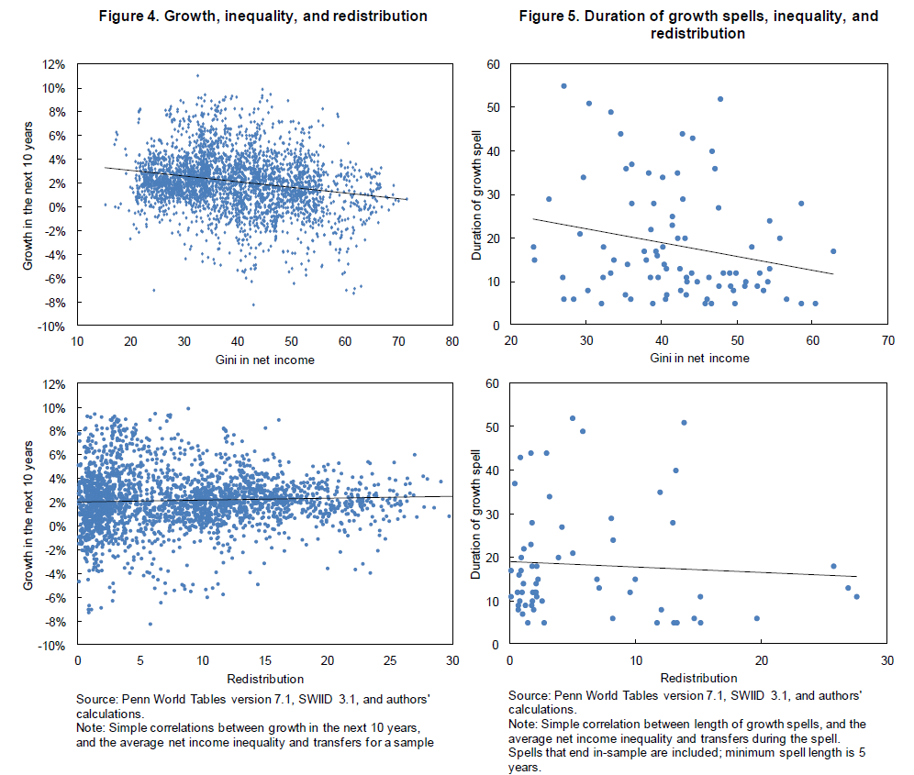
Source: Ostry, J. D., A. Berg, and C. G. Tsangarides. (2014), Redistribution, Inequality, and Growth, International Monetary Fund, Washington, D.C., p. 16

Slide 11
1. Identifying ‘drivers’ and ‘causes’ in social research
Important to always think about limitations
Many studies are required to arrive at solid conclusions, using different data and approaches
Yet, can build a ‘body of evidence’, which increases insight and maximises potential for better understanding causes of effects, or potential causes when experimental designs are not possible
Often less need for the Stable-Unit-Treatment Value Assumption (SUTVA): Allows for taking account of effect treatment of one unit has on the outcome of other unit

Slide 12
1. Identifying ‘drivers’ and ‘causes’ in social research
A driving factor / determinant: something which makes a clear contribution, even as an intermediate step in a causal link, but is not a ‘pure’ cause in itself
May be useful to understand for policy makers and helpful for designing policies, even if no direct causal link
Are an essential part of theory building, exploring likely causal mechanisms and also testing hypotheses.
For instance:
  Differences in demographic composition and poverty rates
  Differences in earnings distributions and inequality
  Association between education and willingness to vaccinate (“controlling” for other factors)

Slide 13
1. Identifying ‘drivers’ and ‘causes’ in social research
In what follows to very different techniques to analyse drivers/determinants, ‘causes’ and ‘effects’:
Regression analysis
Tax-benefit microsimulation
Both refer to a group of techniques, and both types of analysis can have an appropriate causal interpretation only in very specific setups, circumstances and under specific assumptions.

Slide 14
Regression analysis
studying how multiple ‘independent’ and ‘control’ variables are simultaneously associated with a dependent variable of interest
A massive amount of different regression techniques, from simple to very advanced
Should always fit the research question and purpose of the exercise as well as possible

Slide 15
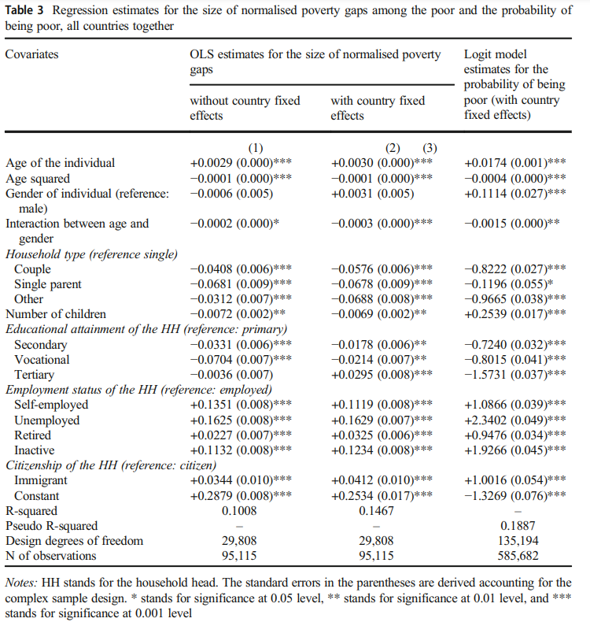
Kyzyma, I. (2020), 'How Poor Are the Poor? Looking beyond the Binary Measure of Income Poverty', The Journal of Economic Inequality, Vol. 18, pp. 525-49.
Regression coefficients
variables
intercept
R² = % of ‘explained variance’ compared to variance around the (unconditional) mean

Slide 16
Regression analysis
Interpretation
Regressions plot a line / fit an equation which minimizes the distance between the ‘predicted’ value and the original observations (i.e. the residuals)
Regressions can always be written in an equation. E.g. for the previous table (first regression):
  Normalised poverty gap = 0.2879+0.0029*age -0.0001*age² - 0.0006(females) – 0.0002*age(females)-0.0408(Couple)-0.0681(Single parent)-0.0072(Other)-0.0072*nchildren + …
  Normalised poverty gap = (poverty line - income)/poverty line
Coefficient>0 => the association with the dependent variable is positive (if one increases, so does the other); coefficient <0 => negative association (if one increases, the other decreases)
Interactions: variables are multiplied with each other.
  when there are good reasons to suspect that the association with one variable, depends on the value of another variable
  Association between reading books and IQ can be expected to be stronger for those who can read than for those who cannot: IQ = nbooks + ability to read + nbooks*ability to read

Slide 17
Regression analysis
Interpretation
Unless experimental setup/quasi-experimental design: coefficients indicate association, not causation => don’t write/read them as ‘effects of X on Y’.
(Pseudo) R squared is a ‘goodness-of-fit’ measure, varying between 0 (equation does not fit the data better than the mean) and 1 (the observations can be perfectly predicted by the equation)
In cross-sectional regressions related to human behaviour/situations, R² is often lower than 0.5. The significance of regression coefficients of individual variables is more telling in that case

Slide 18
Regression analysis
Check dependent variable
Check characteristics of model, number of observations and goodness-of-fit
What kind of relation is being estimated: correlation or causation? Which variables are considered ‘treatment variables’? Does this correspond to a (quasi-)experimental design?
Check the type of variables that are included: dummy, nominal, ordinal, continuous?
Check for interactions: if there is an interaction the variable has to be interpreted in conjunction with the interaction
Write out the underlying equation to see what is exactly estimated
Are coefficients significant? Is the effect size substantial and does it make sense? (coefficients have to be compared to the variation of the variable in the dataset)
What have the authors done to validate the model? Do they describe how well it fits the data? Do they point to the limitations and potential bias in the estimated coefficients? Are sensitivity tests available and discussed?

Slide 19
Regression analysis
Regression analysis is a very common technique to study the association between variables
Very powerful technique which helps to gain insight into social phenomena, but most of the time cannot have a causal interpretation: association is not (necessarily) causation!
Simplification is required, with too complex models, interpretation becomes too complex as well (unless prediction is more important than interpretation)
There are an immense amount of regression-based techniques, with lots of different specifications
(There are also many other multivariate techniques, with different purposes (e.g. latent class analysis, factor analysis, cluster analysis, …))

Slide 20
Tax-benefit microsimulation
“Microsimulation is a term used to describe a wide variety of modelling techniques that all operate at the level of individual units (such as persons, firms or vehicles) to which a set of rules is applied to simulate changes in state or behaviour.” (Figari et al., 2014 => see text on Google Drive)
With tax-benefit microsimulation, the legislation, rules and regulations of tax liabilities and benefit entitlements are programmed in a software package.
This is subsequently applied to individuals and households, to compute the taxes and social contributions they have to pay and the social benefits they would receive, as well as their disposable income, given their characteristics, situation and various sources of income
This can be useful for:
  Imputing missing information in datasets (e.g. gross or net incomes)
  Ex-ante policy evaluations
  Ex-post policy evaluations
  Nowcasting and forecasting

Slide 21
Tax-benefit microsimulation
Two types: hypothetical household simulations vs. population-based simulations
Hypothetical household simulations, model family simulations or standard simulations use ‘hypothetical households’, defined by the researcher
Population-based simulations start from a sample or population data, and work with ‘real’ households
EUROMOD is the tax-benefit microsimulation model for Europe, same platform is also used for many other countries https://www.euromod.ac.uk/.

Slide 22
Tax-benefit microsimulation
1. Example of an ex-ante evaluation: a ‘simple’ child benefit reform in German
Cf. Hufkens, T., T. Goedemé, K. Gasior, et al. (2019), 'The Hypothetical Household Tool (HHoT) in EUROMOD: a New Instrument for Comparative Research on Tax-Benefit Policies in Europe', International Journal of Microsimulation, Vol. 12, pp. 68-85.
We combine
hypothetical household simulations to see how the policies interact in concrete cases,
population-based simulations on EU-SILC to assess the distributive effects in the population (in this case poverty)

Slide 23
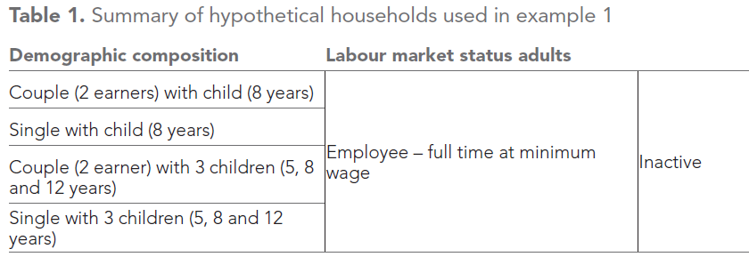
Tax-benefit microsimulation
Children in single-parent families in Germany have a relatively high poverty risk
We reform the existing child benefit system: currently the amount/child increases with the number of children.
We replace this with a system of equal amounts/child, independently of the number of children, but with much higher benefits for single-parent families
This is a ‘budget-neutral’ reform: the total volume of child benefits is not changed
Step 1: define the hypothetical households

Slide 24
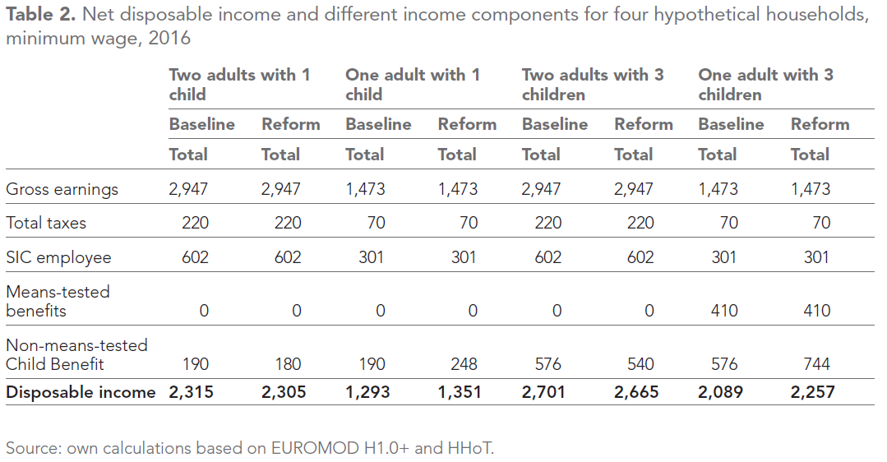
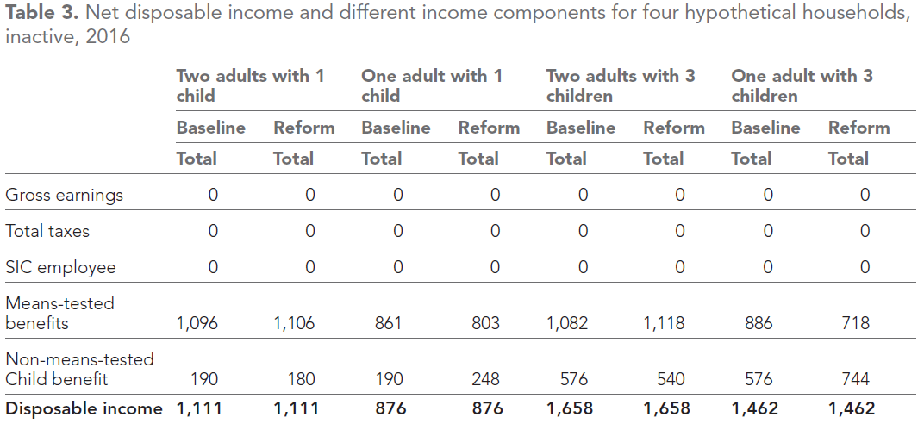
The means-test takes child benefits into account

Slide 25
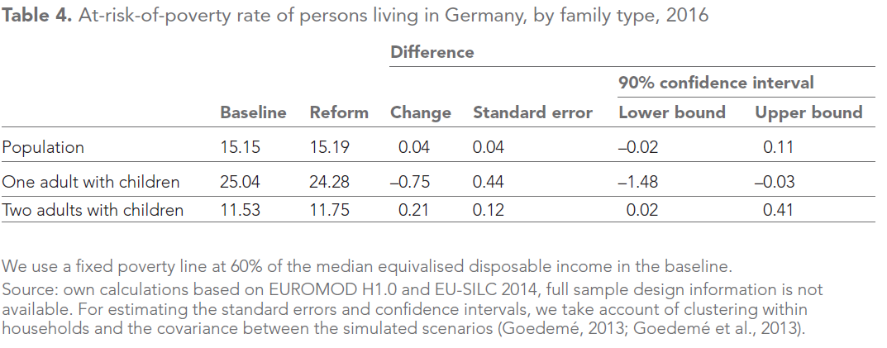
Tax-benefit microsimulation
This is an example of comparing two dependent samples: the units of observation are the same in the baseline and the reform scenario
Note: with 90% confidence level, the S.E. must be multiplied with 1.65 to compute the confidence bounds

Slide 26
Tax-benefit microsimulation
2. Example of an ‘ex-post’ simulation
Have tax-benefit reforms contributed to more, or less inequality?
Authors use the sample of one year, and then apply the tax-benefit system of another year, recomputing all income components
This way, other population characteristics stay fixed (employment, distribution of market incomes, demographic composition)
The result is the ‘pure’ effect of policy changes, with some assumptions (cf. below)
Decoster, A., S. Perelman, D. Vandelannoote, et al. (2018), Which way the pendulum swings? Equity and efficiency of 26 years of tax-benefit reforms in Belgium, Herman Deleeck Centre for Social Policy, Antwerp.

Slide 27
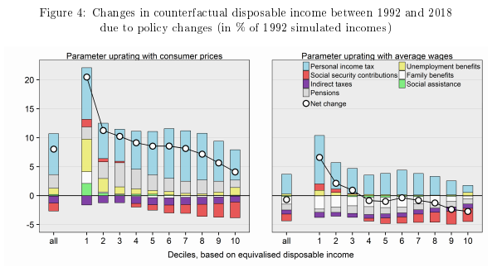
Tax-benefit microsimulation
How much better off are were people living in Belgium under the 2018 system compared to the 1992 tax-benefit system?
Source: Decoster et al., 2018

Slide 28
Tax-benefit microsimulation
Hypothetical household simulations
Strengths
Easy to interpret
Show in detail how policies interact with each other
Can be used to construct policy (input) indicators which are not dependent on the composition of the population
Limitations
Cannot be used to extrapolate to total effects in the population (population-based microsims required)
Representative for the tax-benefit system?
  Hard to aggregate effects across hypothetical households
  Only when effect is relatively similar across households, or when a large number of households is simulated
Often illustrative rather than conclusive, except when similar findings can be expected for other household types
A good selection of characteristics of the hypothetical households is key

Slide 29
Tax-benefit microsimulation
Population-based microsimulations
Strengths
Full heterogeneity of population => beyond ‘average effects’, and representative of population
Ex ante evaluations (effects of causes) + ex-post evaluations (causes of effects)
Analysis of singular cases (i.e. specific events, e.g. what was the inequality impact of the great recession?
Counterfactual for same persons (cf. ‘fundamental problem of causality’)
Interactions between policies + interactions between individuals to some extent taken into account: weaker SUTVA assumption required

Slide 30
Tax-benefit microsimulation
Limitations
Data quality
  measurement error, missing variables (e.g. wealth, contribution record), representativeness, sample size…
  Sampling & non-sampling errors are important!
  Mismatch with existing administrative aggregate data
Quality simulation model:
  Not all policies simulated (lack of data & complexity, e.g. pensions)
  Non-take up and tax evasion not adequately modelled
  Discretionary and local measures not adequately modelled

Slide 31
Tax-benefit microsimulation
Limitations
First-order effects: direct effect (“morning-after effect”)
Second-order effects: behavioural changes
  Labour supply models
  Models of consumption (e.g. estimate effect on VAT)
  Demographic effects, …
  (Reweighting vs. simulation)
‘Third-order’: general equilibrium (inflation, labour demand, …)
=> Second, and third order effect may substantially change conclusion! In other words the ‘pure policy effect’ identified above, is only the direct effect.

Slide 32
Conclusion
Without (successful) random assignment, an identification of the effects of causes is very hard
Experiments are a very powerful tool to identify effects of causes, with a high level of internal validity
External validity is often limited, and often many experiments as well as lots of other types of research (and theory) are required to fully understand the causal mechanism
Experiments are not always feasible or desirable, and can be applied only in case of specific research questions

Slide 33
Conclusion
Regression techniques are a powerful tool to analyse and understand the association between variables
Coefficients can only have a causal interpretation if observations on that variable were randomly assigned to a control and treatment group
Quasi-experimental designs try to ‘mimic’ this random assignment or try to find a convincing ‘counterfactual’ in other ways
Most often, this allows for identifying ‘drivers’ rather than point to causes
  But these ‘drivers’ and ‘determinants’ are often important pieces of the puzzle
  And this group of techniques has a much broader range of applications, including studying causes of effects, rather than just effects of causes

Slide 34
Conclusion
Tax-benefit microsimulation: two types
A very powerful tool for ex-ante and ex-post policy evaluations
Can be used for building counterfactuals in a very different way

Slide 35
2. Setting up your own research project
Steps when doing survey data analysis
Tips, tricks and tools
Q & A

Slide 36
2. Setting up your own research project
Define research topic
Read and identify interesting research question
  Exciting and interesting
  Relevant
  Within abilities and feasible within timeline
  Research nearly always takes more time than anticipated
What would the ideal data and research setup look like to answer the question in a valid and reliable way?
  Is generalisation required?
  Is it a descriptive, correlation or causal question?
  What kind of qualitative and quantitative information is required? What would be the most convincing way of proving your point/finding out what you want to know?
  Is it a question that can be answered with real-world data and methods?
  Is the research question of adequate size for one research project?
  How should it be broken down into steps/research projects?
  Repeat process to identify one project and the ideal data and methods

Slide 37
2. Setting up your own research project
Identify real-life data and research strategy
  Data and research strategy are connected
  Make sure research question, data and research strategy match (iterative process!)
  Do the data exist already? Of sufficient quality (check papers that use the data!)? Do they include the variables you need? Should you collect your own data?
  Explore options for accessing existing data
  Try to think now already about what kind of numbers, tables and graphs would be required / be most informative for answering the research question
  Update your methodological knowledge and make sure you fully understand the required research technique
Starting the project
  Identify, contact and, if necessary apply for approval from Ethical committees
  Get in touch with your DPO = Data Protection Officer: how should you store the data? What does the university offer you? What is the level of security required?
  Existing data: Apply for the data, in case of access to admin data: Data protection authority (https://www.garanteprivacy.it/) (follow local regulations)
  Open access?

Slide 38
2. Setting up your own research project
Read detailed documentation on the data for which you applied
  Sample design
  Sampling and non-sampling errors (see Total survey error paradigm!)
  Comparability across groups, places and time
  What other metadata do exist?
  Read papers that have used the same data source
  Read papers that use the same method of analysis (especially those published in high quality journals)
Access the data
  Adequate (secure) storage? => encrypt / password protect the data
  Adequate back-up of original data files?
  Use syntax so you can easily adapt and redo analyses
  Good documentation system in place for what you do with the data?

Slide 39
2. Setting up your own research project
Explore the data
  Sample design variables => do they match with documentation?
  Explore variables of interest
  Explore and understand patterns of missingness
  Should the research question be further refined?
Detailed descriptive analysis
  Always start with looking at the distribution of the variables you want to include
  Make scatterplots to see how variables are associated with each other
  Think about dimensions of Lecture 1
Analyze data in detail

Slide 40
2. Setting up your own research project
Analyse data in detail
  Internal and external validity of variables and indicators
  What would be the most relevant sensitivity analysis?
  Think also about how you will report the results
Interpret and evaluate the results of the analysis
  Research question adequately answered?
  What are the main conclusions?
  How do they speak to what you know from the literature?
  What are the main limitations of your work in terms of internal and external validity, reliability, comparability, … ?
12. Report results and inferences from the data
  Smart selection of tables (when individual numbers are important) and graphs (distributions, associations) => indicators of statistical reliability!

Slide 41
2. Setting up your own research project
Throughout the process: talk to others
  Your supervisor
  Peers
  Seminars, workshops and conferences
  Reach out to people who have done similar research as the one you would like to do (after reading their work!)
Reading is important, but give it a clear direction, do not simply try to read everything that exists on a topic – usually there is too much to read within a reasonable time!
Try to read, do research and write at the same time: document the steps you take, and when you read always think about how that will help you to write/nurture your paper

Slide 42
2. Setting up your own research project
Statistical software: R, SPSS, SAS, Stata, …
What do other people in your department use? Talking to others is always helpful to help solve problems
Protect your data: Veracrypt
Sources of quantitative data:
  Eurostat (microdata + online database)
  UN, OECD, World Bank,…
  Online repositories of data: e.g. https://www.nature.com/sdata/policies/repositories#social; https://www.opendatarepository.org/; check journal Data in Brief, and others
Summer schools

Slide 43
2. Setting up your own research project
Q & A
Good luck with your own research!

Slide 44
Some suggestions for further reading
Quantatitave data analysis (incl. regression)
Wooldridge, Introductory Econometrics: A Modern Approach (various editions)
Heeringa, S. G., B. T. West, and P. A. Berglund. (2010), Applied Survey Data Analysis, Chapman & Hall/CRC, Boca Raton.
Causality
Brady, H. E. (2008), 'Causation and explanation in social science', in Box-Steffensmeier, J. M., Brady, H. E. and Collier, D. (eds.), The Oxford Handbook of Political Methodology, Oxford: Oxford University Press, pp. 217-270.
Tax-benefit microsimulation
Figari, F., A. Paulus, and H. Sutherland. (2015), 'Microsimulation and policy analysis.' in Anthony Barnes Atkinson and François Bourguignon (eds.), Handbook of Income Distribution Elsevier, Oxford. [paper version is on google drive]
Hufkens, T., T. Goedemé, K. Gasior, et al. (2019), 'The Hypothetical Household Tool (HHoT) in EUROMOD: a New Instrument for Comparative Research on Tax-Benefit Policies in Europe', International Journal of Microsimulation, Vol. 12, pp. 68-85.

