Slide 1
Methods in Social Research – Quantitative research
Ph.D. Programme in Global studies
Università degli studi di Urbino Carlo Bo
Tim Goedemé, PhD
tim.goedeme@spi.ox.ac.uk
Lecture 2 – 24/11/2020
Notes:
Initially get to know students and the extent to which they are familiar with quantitative research

Slide 2
Overview of the course
Introduction to quantitative research and social indicators
Survey data and total survey error, including sampling variance
Causality
Quantitative research techniques to identify drivers
Setting up your own research project
=> Perspective of (social) policy, poverty and inequality

Slide 3
Today’s lecture
Main aim: better understand the various limitations quantitative data (especially from samples) face
Familiarise with Total survey error paradigm, and reflect on how this can be applied on various types of research (Part 1)
Understand key issues in estimating and interpreting the sampling variance of survey estimates (Part 2)

Slide 4
Introduction
Many causal studies are based on samples and survey data
Even when they are not, they often face similar problems or points of attention
The paradigm of ‘total survey error’ helps to understand the strengths and weaknesses of particular databases and studies, and should always be in your mind when reading about empirical research

Slide 5
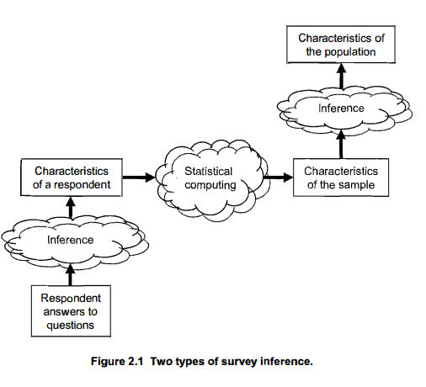
Grooves et al., 2009, p. 39
Notes:
First: a step back & refresher; internal (first type of inference) vs. external (second type of inference) validity

Slide 6
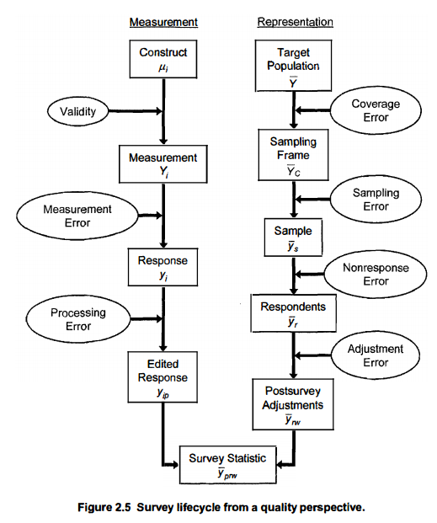
Grooves et al., 2009, p. 48

Slide 7
Total survey error
Measurement error:
Response variance:
  ’random’ mistakes
  Interviewer makes mistake in noting down correct response
  Interview circumstances impact (randomly) on responses / performance
Response bias:
  ‘systematic’ mistakes
  Socially desirable responses (e.g. use of illegal drugs)
  Systematic recollection error (e.g. small crimes)
  Bad or culturally sensitive tests (e.g. IQ tests)
  Mode of data collection may have an impact!
    Personal interview: CAPI, PAPI, CATI, WAPI, …

Slide 8
Total survey error
Register data:
  Usually better captures small income components (e.g. part-time workers)
  But lacks non-taxed income
  Problem of tax evasion
Survey data
  Recollection errors
  Over-reporting at bottom, under-reporting at the top?
  Potential to capture informal incomes
Proxy interviews
  Unable (sick, language, work,…) or unwilling to reply => important information, but bias!
  Random selection rule to lower costs => less bias

Slide 9
Grooves et al., 2009, p. 48

Slide 10
Total survey error
Processing error:
Converting text to numbers (“coding”)
Imputation of missing values (item non-response)
Outlier treatment (top-bottom coding)
  Winsorize: replace extremely low/extremely high values with threshold value (e.g. p1 and p99)
  Trimming: drop cases with observations below/above threshold values
  Need for ‘sensitivity analyses’
  Example: Van Kerm, P. (2007), Extreme Incomes and the Estimation of Poverty and Inequality Indicators from EU-SILC, CEPS-Instead, Luxembourg.

Slide 11
Grooves et al., 2009, p. 48

Slide 12
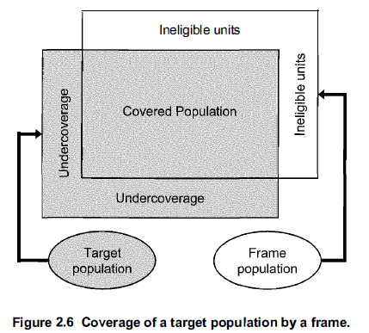
Total survey error
Coverage error depends on:
1/ Proportion of target population not covered
2/ Degree to which the covered population differs from the noncovered population
Systematic problem for people illegally residing in the country, the homeless, …
Is strongly related to characteristics of target population and sampling frame
Source: Groves et al., 2009, p. 55

Slide 13
Grooves et al., 2009, p. 48

Slide 14
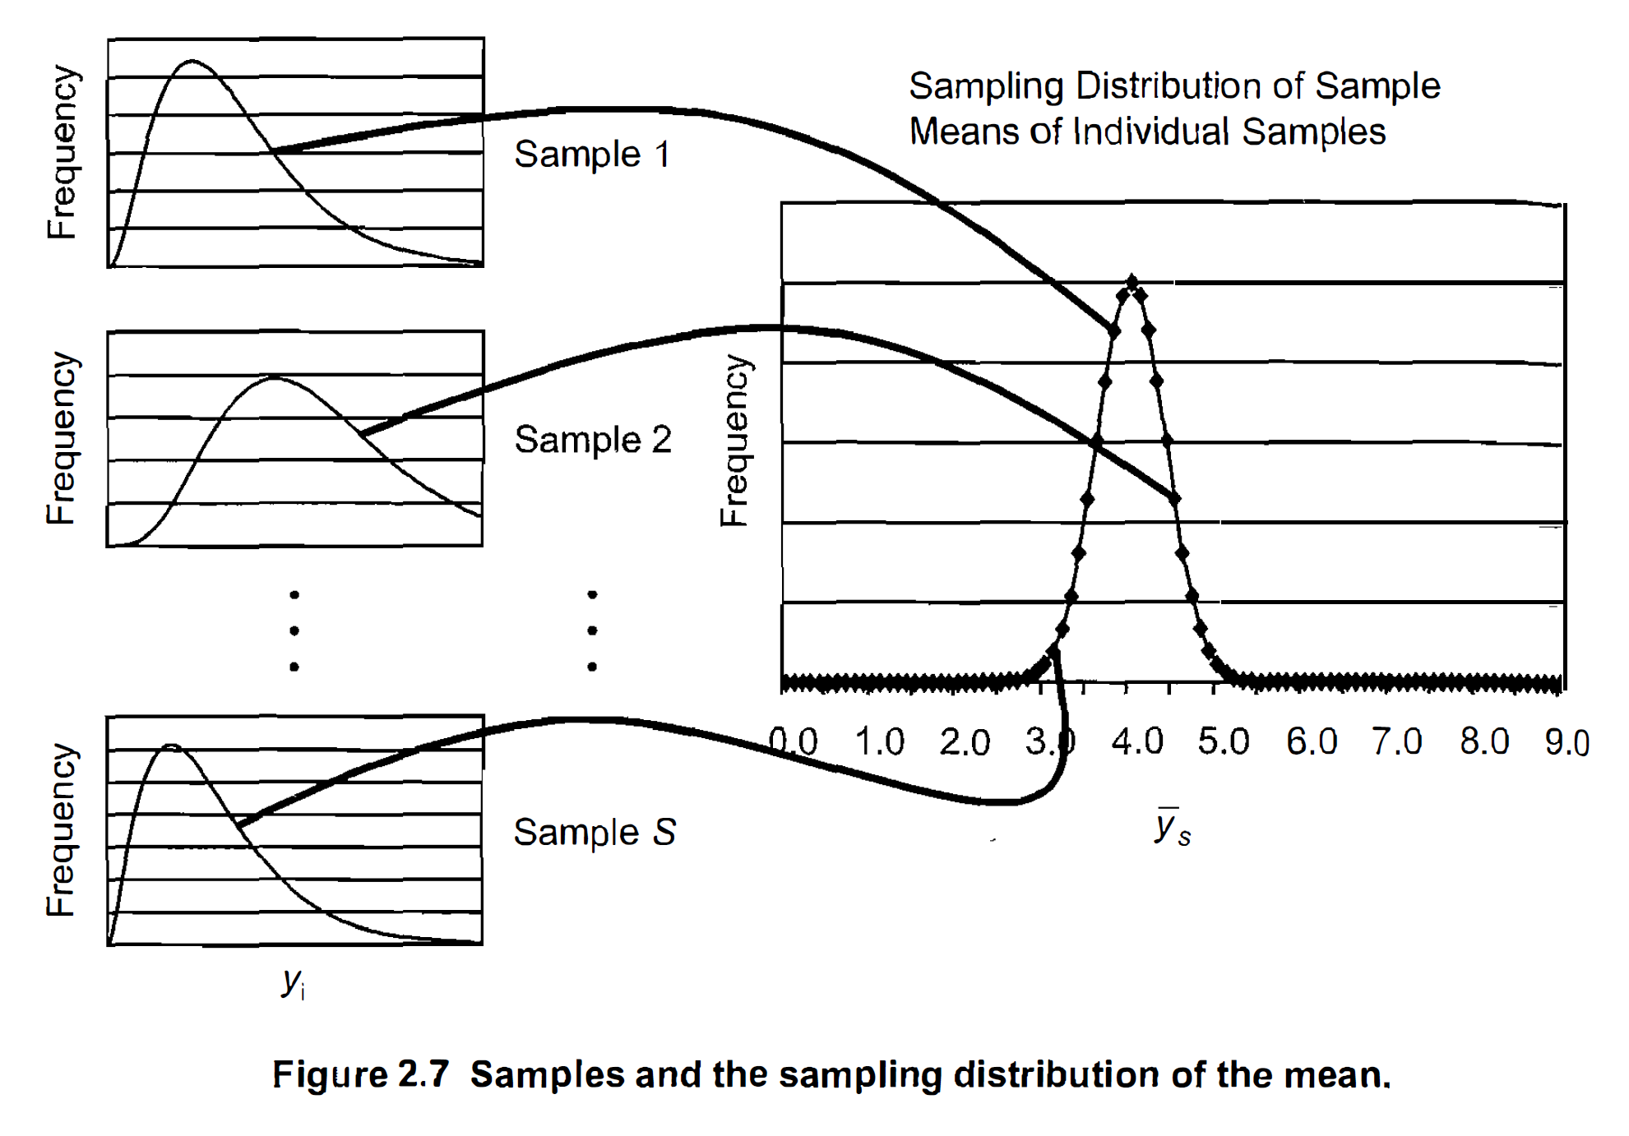
Grooves et al., 2009, p. 48

Slide 15
Total survey error
Sampling variance = the variance of the sampling distribution of a survey statistic
  => the higher the sampling variance, the less reliable the estimate of a single sample
Sampling distribution = the distribution of a statistic (an estimate) over multiple samples drawn in the same way from the same distribution
  => it is a theoretical distribution, which would consist of the value that you would get if you would repeat the same sample and estimation procedure many times
Approximates in many cases a normal (bell-curve), or a (rather similar) t-distribution

Slide 16
Grooves et al., 2009, p. 48

Slide 17
Total survey error
Non-response error
Item non-response: missing observations for some variables
=> imputation
Unit non-response: record for unit of observation entirely missing (e.g. unwillingness to participate in survey)
=> non-response correction through weighting (cf. below)
=> Non-response bias

Slide 18
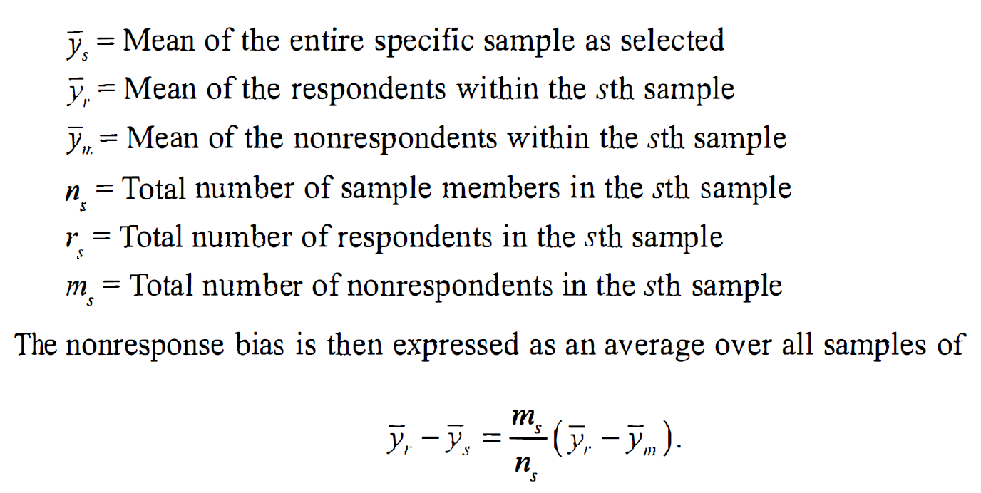
Total survey error
Non-reponse bias (size of non-response and size of bias):

Slide 19
Grooves et al., 2009, p. 48

Slide 20
Total survey error
Adjustments:
Weighting:
  Gives more weight to some observations than to others
  Probabilities of selection
  Unit non-response
  Difference in the distribution in the sample compared to known population totals (calibration)
Could also be in changes to estimated indicators

Slide 21
Random vs. non-random errors (bias)
Applies individually to every single survey statistic, not to entire survey
Groves et al. (2004: 48)
Computation error
Reliability
Internal validity
Computation
Bias
External validity

Slide 22
1. Total survey error & sampling variance
Bias vs. reliability
 | Errors in observation | Errors in non-observation
Bias / validity | Response / processing bias | Coverage / Sampling / non-response / adjustment bias
Reliability | Response variance | Adjustment variance /Sampling variance
Notes:
Estimated sampling variance is an indicator of reliability, nothing else
Internal vs. external validity
What if measurement error and sample selection correlate? (i.e. is measurement error & response bias interact with sample selection)?

Slide 23
Crash course statistics: the sampling variance
Some things that should be known to everyone producing or interpreting a sample estimate, but are not always taught in statistics courses…

Slide 24

Notes:
Using a sample to observe the world around us, is in many ways similar to watching the world around us on the basis of … a picture.
First of all, the more you zoom in on a detail, the more blurred the picture gets. The same is most of the time true for a sample estimate: zooming in on a specific subpopulation does not necessarily result in gaining much more insight into the details of the world around us, because our estimate will be less precise than for a larger subgroup.
Second, for a picture, the quality of the method for taking the picture is crucial for the quality of the picture itself: the higher the resolution, the sharper the image will be. The same is true for sample estimates: the better the sample design ensures that all parts of the population are represented in the survey, the more precise the sample estimates will be.
However, there is an important difference between using a picture for observing the world and using a sample for telling us how this world looks like: In the case of a picture it is easy to observe the precision of the image we get. This is not the case for a sample estimate: in that case there is only one way to find out the precision, that is: to calculate the sampling variance.
And it is precisely because we cannot directly observe the precision of a sample estimate, that without an estimate of its precision, a point estimate is pointless.

Slide 25


Slide 27


Slide 30
Basic idea
Statistics are a powerful tool
  Need limited number of observations
  Point estimate and estimate of precision
  However, without an estimate of its precision, a point estimate is pointless!
Notes:
In this presentation I focus on random error only.
Of course there is also bias and non-random error.
However, often the impact of this bias is much harder to estimate.
Therefore, the mere fact of its existence should be no excuse for not to calculate the random error.
Furthermore, if we present consistently standard errors and confidence intervals, users will be come also more cautious regarding non-random errors.

Slide 31
Key Messages
If estimates are based on samples -> estimate and report SEs, CIs & p-values
Always take as much as possible account of sample design when estimating SEs, CIs & p-values
Never delete observations from the dataset
Never simply compare confidence intervals

Slide 32
Overview
The 4 big determinants of the sampling variance
(The ultimate cluster method)
Analysing subpopulations
Comparing point estimates
Conclusion

Slide 33
1. Sampling variance
Sampling variance =
  variance of a survey statistic between independent, identical samples of the same population, i.e. the variance of a sampling distribution
Standard error = (sampling variance)^0.5
  (i.e. the standard deviation of the sampling distribution)
In the absence of bias, the lower the variance, the more precise the point estimate will be
Notes:
Clearly indicate what you mean with ‘precision of a point estimate’

Slide 34
Grooves et al., 2009, p. 48

Slide 35
Other measures of statistical precision
Confidence intervals
  Show an interval around the point estimate, which indicates an interval which would contain the population value with a preset level of confidence (e.g. often 90% or 95%)
  With a 90% confidence interval: "Were this procedure to be repeated on numerous samples, the fraction of calculated confidence intervals (which would differ for each sample) that encompass the true population parameter would tend toward 90%” (Cox D.R., Hinkley D.V. (1974) Theoretical Statistics, Chapman & Hall, p49, p209)
P-values
  Express the probability of having a more extreme value by random chance, under the hypothesis that the value in the population (usually) is zero (i.e. that the null-hypothesis is correct)

Slide 36
1. Sampling variance
Determinants of the sampling variance
  Shape of population distribution + everything from drawing the sample to calculation and level of the point estimate
4 big components:
  Sample design
  Weighting
  Imputation
  Characteristics of statistic of interest

Slide 37
1. Sampling variance
Sample design
Simple random sample
Complex samples
  Stratification
  Clustering
  Multiple stages of selection (PSUs, SSUs, USUs)
  (un)equal probabilities of selection
Notes:
Een pot: a jar

Slide 38
1. Sampling variance
Sample design
Stratification:
  Divide population in non-intersecting groups (strata)
  Independent sample in each stratum
  Increases precision (representativeness more assured)
  Decreases sampling variance with between-stratum variance

Slide 39
1. Sampling variance
Sample design
Clustering:
  Within each stratum, divide elements in non-intersecting groups of elements, apply a random selection of these groups (i.e. ‘clusters’)
  For pragmatical reasons
  In most cases decreases precision
  Increase in sampling variance depends on Rho
  Rho=intraclass correlation coefficient, i.e. the degree of cluster homogeneity

Slide 40
1. Sampling variance
Sample design
Multiple stages of selection:
  Whenever clusters are selected at the first stage (=> these clusters are the primary sampling units (PSUs) and the strata at this stage are primary strata)
  And at a subsequent stage within each selected PSU a further selection is made of (clusters) of elements
  The clusters of elements selected at the second stage are ‘secondary sampling units’ (SSUs), and the (clusters of) elements selected at the final stage are the ‘ultimate sampling units’ (USUs)

Slide 41
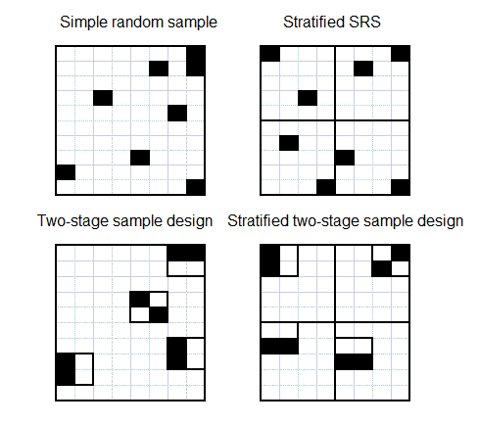
1. Sampling variance
Sample design

Slide 42
1. Sampling variance
Weighting
3 basic steps in weighting:
  Probability weighting (increases variance)
  Adjustment to unit non-response (increases variance)
  Calibration (decreases variance)
Increase variance
Decreases variance

Slide 43
1. Sampling variance
Imputation
Imputation
  Item non-response
  Different methods (random, non-random)
  Special case: micro simulation studies
Neglect leads usually to under-estimation of variance
Easiest for researchers: multiple imputation
Notes:
Under-estimation due to extra source of random error and over-estimation of the number of respondents

Slide 44
1. Sampling variance
Statistic of interest
Most common:
  Mean; total; proportion; ratio; regression coefficient; ...
More complex:
  When measure is based on sample estimate: e.g. % of population with income below 60% of the median income in the sample
  Non-smooth inequality measures
  …
  Solution for many poverty and inequality estimates: DASP for Stata (Araar and Duclos, 2007)
Notes:
Under estimation due to extra source of random error and over-estimation of the number of respondents

Slide 45
Overview
The 4 big determinants of sampling variance
The ultimate cluster method
Analysing subpopulations
Comparing point estimates
Conclusion

Slide 46
(2. Ultimate cluster method)
Only take account of the first stage of the sample design (stratification and clustering)
Assume there is no subsampling within PSUs
Assume sampling with replacement

Slide 47
(2. Ultimate cluster method)
Why: ease of computation
Second and subsequent stages add little variance if sampled fraction of PSUs is small
(which is often the case – but not always)

Slide 48
(2. Ultimate cluster method)
Need of good sample design variables to:
Identify PSUs
Identify Primary strata
Take account of calibration (post-stratification, raking)
More details in:
Goedemé, T. (2013), The EU-SILC Sample Design Variables, CSB Working Paper No. 13/02, Antwerp: CSB.

Slide 49
(2. Ultimate cluster method)
In Stata
use sample design variables to identify the sample design
svyset PSU [pweight = weight], strata(strata)
Subsequently: svy: commands
SPSS: CSPLAN & Complex sample commands
R: survey package (svydesign and other commands)
SAS: PROC SURVEYFREQ and others

Slide 50
Overview
The 4 big determinants of sampling variance
(The ultimate cluster method)
Analysing subpopulations
Comparing point estimates
Conclusion

Slide 51
3. Subpopulations
Various types of subpopulations, which may be differently distributed across Strata and PSUs
Size of subpopulation in sample may be random, not fixed (except if stratum) => additional source of random error!
Missing observations are best treated as a different subpopulation, rather than dropped from the data

Slide 52
3. Subpopulations
Reliability of estimates depends on number of observations AND how they are distributed across PSUs
If variance within subsample is small, SE of small subpopulation is not necessarily very large

Slide 53
3. Subpopulations
Conclusion:
-> sample size extra source of random error!
-> always check both the number of observations AND the number of PSUs with observations
-> never drop cases from sample
Instead:
Create indicator variable
Use the svy, subpop option (Stata)
Use ‘domain’ option in SAS

Slide 54
Overview
The 4 big determinants of sampling variance
The ultimate cluster method
Analysing subpopulations
Comparing point estimates
Conclusion

Slide 55
4. Comparing point estimates
Usual approach: check whether confidence intervals overlap
Problem: overly conservative when samples are independent
May be completely wrong when samples are dependent

Slide 56
4. Comparing point estimates
Variance of the difference of two averages:
  VAR(a-b) = VAR(a) + VAR(b) – 2*COVAR(a,b)
COVAR can be positive or negative
COVAR = 0 when samples are independent

Slide 57
4. Comparing point estimates
Dependent samples
  Overlapping subpopulations (e.g. micro simulation)
  Subpopulations which may be part of the same PSUs (e.g. Age groups in household surveys)
  Comparisons over time with (rotational) panel data
  Comparisons over time with cross-sectional data with fixed PSUs
  Dependence induced by type of indicator (e.g. Household income)

Slide 58
4. Comparing point estimates
Independent samples
  Completely different surveys
  When (sub)populations belong to different strata
In Stata: post-estimation commands lincom (linear combinations) nlcom (non-linear estimations, e.g. ratios)

Slide 59
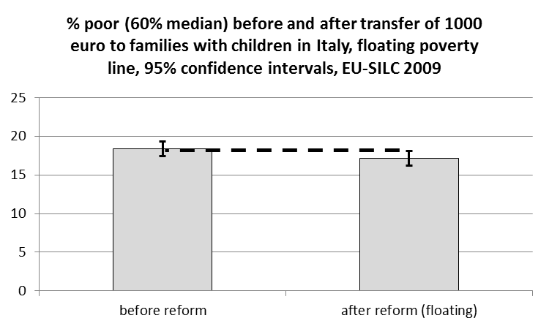
Comparing point estimates
Difference = 1.2pp
Standard error independence = 0.68
Standard error dependence = 0.15

Slide 60
4. Approaches
Notes:
Point: 5,74%
Full / persons = 2,47
Full / households = 1,53
CI-arm:
Persons: 0,4
Households: 0,7
Full: 1,02

Slide 61
Key Messages
If estimates are based on samples -> estimate and report SEs CIs
Always take as much as possible account of sample design when estimating SEs and CIs
Never delete observations from the dataset
Never simply compare confidence intervals

Slide 62
Overall conclusion
Random sampling is a very powerful tool to study the characteristics and relations between variables in a broader population
However, one have to be conscious about both ‘random’ and ‘non-random’ errors
The total survey error model provides a good overview of the various kinds of errors that could, and often do, occur
Some errors are relatively easy to estimate, if some rules are followed
This is particularly the case for statistical reliability
Given that only a part of the population is surveyed, without an estimate of its statistical precision, a point estimate is pointless if one wants to say something about the population, rather than the specific sample.

Slide 63
References and further reading
Goedemé, T. (2013) ‘How much confidence can we have in EU-SILC?’, Social indicators research, 110(1): 89-110, doi:10.1007/s11205-011-9918-2 [background]
Groves, R. M., Fowler, F. J. J., Couper, M. P., Lepkowski, J. M., Singer, E., and Tourangeau, R. (2009), Survey Methodology (Second edition), New Jersey: John Wiley & Sons, 461p. Chapter 2 [compulsory]
Heeringa, S. G., West, B. T. and Berglund, P. A. (2010), Applied Survey Data Analysis, Boca Raton: Chapman & Hall/CRC, 467p.
Wolter, K. M. (2007), Introduction to Variance Estimation, New York: Springer, 447p.

