Slide 1
Maatschappij, Beleid en Evaluatie
Tim Goedemé
tim.goedeme@uantwerpen.be
Les 9 – 24/11/2015
Notes:
Start met namen te vragen + vragen of er nog onduidelijkheden waren bij vorige les / te kennen leerstof.

Slide 2
Lecture 9
Identifying driving factors: shift-share and decomposition analysis
Evaluation ‘microsimulation’ assignment
Driving factors vs. causal factors
A simple decomposition by population characteristics & shift share
Advanced decomposition by population characteristics: Oaxaca-Blinder
Bargain-Callan: decomposing policy effects and other effects

Slide 3
Main questions this lecture
Is it a good idea to have a flat child benefit in Belgium? Why (not)?
What is the difference between a causal factor and a driving factor?
What are the strengths and weaknesses of decompositions?
How can a Oaxaca-Blinder decomposition be interpreted?
What are the most important challenges of identifying policy effects through microsimulation?

Slide 4
Background texts
Corluy, V., and Verbist, G. (2014), Can education bridge the gap? Education and the employment position of immigrants in Belgium, ImPRovE WP 14/02, Antwerp: Herman Deleeck Centre for Social Policy - University of Antwerp, 31p. [compulsory]
Decoster, A., Perelman, S., Vandelannoote, D., Vanheukelom, T., and Verbist, G. (2015), A bird’s eye view on 20 years of tax-benefit reforms in Belgium, CSB Working paper WP15/02, Antwerp: Herman Deleeck Centre for Social Policy, University of Antwerp, 45p. [compulsory]

Slide 5
Assignment Lecture 8: Reforming child benefits in Belgium
Source: MEFISTO (November 2015)
Notes:
Overloop mondeling opdracht en vraag naar antwoorden op verschillende vragen, uitgezonderd vraag 5
Toon slides met resultaten
Leg uit hoe iteratief tot budgetneutrale hervorming te komen
Discussie over vraag 5

Slide 6
Assignment Lecture 8: Reforming child benefits in Belgium
Source: MEFISTO (November 2015)

Slide 7
Assignment Lecture 8: Reforming child benefits in Belgium
Source: MEFISTO (November 2015)

Slide 8
Assignment Lecture 8: Reforming child benefits in Belgium
…Gainers and losers…

Slide 9
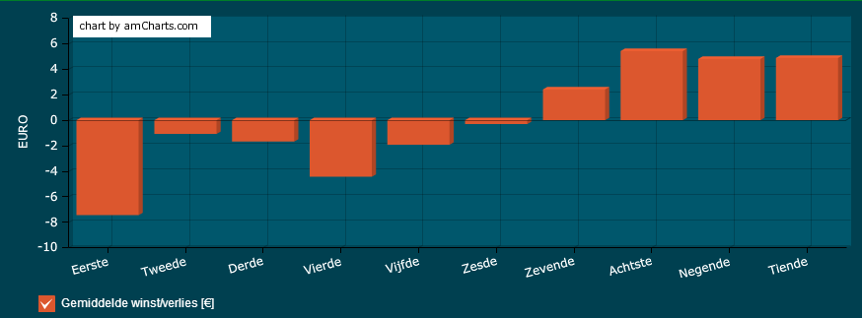
Assignment Lecture 8: Reforming child benefits in Belgium
Gemiddelde winst/verlies per maand voor elk inkomensdeciel: alle basisbedragen 137 EUR
Source: MEFISTO (November 2015)

Slide 10
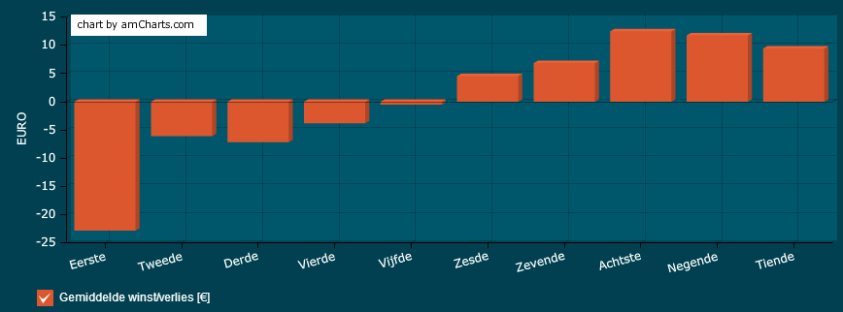
Assignment Lecture 8: Reforming child benefits in Belgium
Gemiddelde winst/verlies per gezin per maand voor elk inkomensdeciel: alle basisbedragen 175 EUR, geen toeslagen
Source: MEFISTO (November 2015)

Slide 11
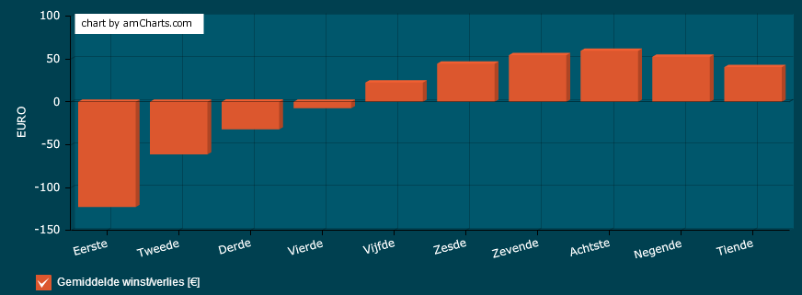
Assignment Lecture 8: Reforming child benefits in Belgium
Gemiddelde winst/verlies per gezin per maand voor elk inkomensdeciel: Bijkomend vrijgesteld inkomen voor kinderen ten laste = 9205 EUR per kind
Source: MEFISTO (November 2015)

Slide 12
Assignment Lecture 8: Reforming child benefits in Belgium
Should child benefits be equal for each child?

Slide 13
Assignment Lecture 8: Reforming child benefits in Belgium
Source: EU-SILC 2012, ver2, own calculations; 95% confidence intervals

Slide 14
Assignment Lecture 8: Reforming child benefits in Belgium
Source: Eurostat; Storms et al., 2015; FAMIFED.

Slide 15
Assignment Lecture 8: Reforming child benefits in Belgium
Source: Eurostat; Storms et al., 2015; FAMIFED.

Slide 16
Assignment Lecture 8: Reforming child benefits in Belgium
Source: Eurostat; Storms et al., 2015; FAMIFED.

Slide 17
Assignment Lecture 8: Reforming child benefits in Belgium
Source: Eurostat; Storms et al., 2015; FAMIFED.

Slide 18
Assignment Lecture 8: Reforming child benefits in Belgium
Should child benefits be equal for each child?

Slide 19
Characteristics of microsimulation
Advantages:
  Full heterogeneity of population (<-> macro / representative agent models)
  Analysis of singular cases
  Counterfactual for same persons (cf. ‘fundamental problem of causality’)
  Decomposition of effects and identification of driving factors (cf. Lecture 9)

Slide 20
Characteristics of microsimulation
Advantages (continued):
  Interactions between policies + interactions between individuals taken into account: no SUTVA assumption required (to be nuanced)
  Not only average effect, but complete distribution of effect
  With representative data (in contrast to ‘model family simulations’)
  Both ex-ante and ex-post evaluations are possible (causes of effects and effects of causes)

Slide 21
Characteristics of microsimulation
Limitations
Data quality
  measurement error, missing variables (e.g. wealth, contribution record), representativeness, sample size…
  Sampling & non-sampling errors are important!
  Mismatch with existing administrative aggregate data
Quality simulation model:
  Not all policies simulated (lack of data & complexity, e.g. pensions)
  Non-take up and tax evasion not adequately modelled
  Discretionary and local measures not adequately modelled

Slide 22
Characteristics of microsimulation
Limitations
First-order effects: direct effect (“morning-after effect”)
  Fixed vs. floating poverty line
Second-order effects: behavioural changes
  Labour supply models
  Models of consumption (e.g. estimate effect on VAT)
  Demographic effects, …
  (Reweighting vs. simulation)
‘Third-order’: general equilibrium (inflation, labour demand, …)
=> Second, and third order effect may substantially change conclusion! Caution is necessary!

Slide 23
Characteristics of microsimulation
Additional advantage:
Microsimulation allows to decompose changes in poverty and inequality into:
  Policy effects and other effects
  The contribution of separate policies & their interaction to the total (policy) effect
  Across time, countries or scenarios
Not necessarily pure causal analysis in the real sense, rather an identification of ‘driving factors’

Slide 24
Driving factors
A driving factor: something which makes a clear contribution, but is not a ‘pure’ cause in itself
May be useful to understand for policy makers and helpful for designing policies, even if no direct causal link
For instance:
  Differences in demographic composition and poverty rates
  Differences in earnings distributions and inequality
  Poverty line effect vs. income effect and the change in at-risk-of-poverty indicator

Slide 25
Identifying driving factors: decompositions
Decompositions: ‘exercises in ceteris paribus’
Step 1: Identify relevant components of the outcome variable
Step 2: decompose the outcome variable mathematically (‘mechanically’) into the relevant components
Step 3: estimate the contribution of each component, keeping the other components constant

Slide 26
Decompositions
General principles / idea + decomposition of poverty by group
‘Shift-share’
Oaxaca-Blinder
‘Policy effect’
Bargain & Callan

Slide 27
Decompositions: basics
General idea (of decompositions discussed here):
Either decompose one outcome mathematically
  E.g.: x = a + b + c; x = a*b*c
Or add & subtract component when calculating the difference between two outcomes
  E.g.: x-y
  = x (– z + z) – y
  = (x-z) + (z-y)

Slide 28
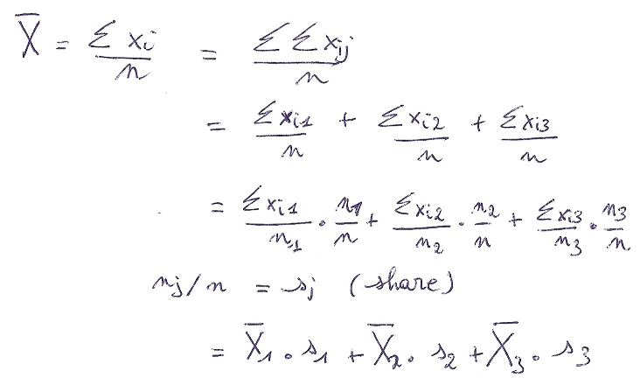
Decomposition of single outcome
Decompose one outcome mathematically: e.g.: the average (or proportion) can be decomposed in the contribution of groups:

Slide 29
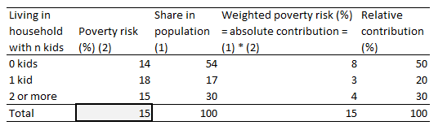
Decomposition of single outcome
Example: decomposition of poverty rate by number of children (<18 years) in the household (BE, EU-SILC 2012)

Slide 30
Decomposition of single outcome
Can be applied to decompositions by groups:
  every proportion, e.g. poverty rate
  Total poverty gap
  Average poverty gap (ratio)
But:
  Not median poverty gap
  Not taking into account effect of groups on poverty line

Slide 31
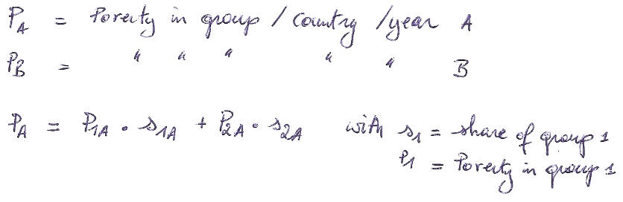
Decomposition of difference: basic shift-share
Decompose two outcomes mathematically, add and subtract a term for which the share of one group is replaced with the share of the other group

Slide 32
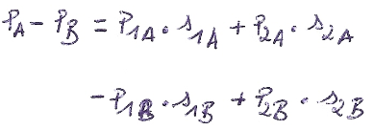
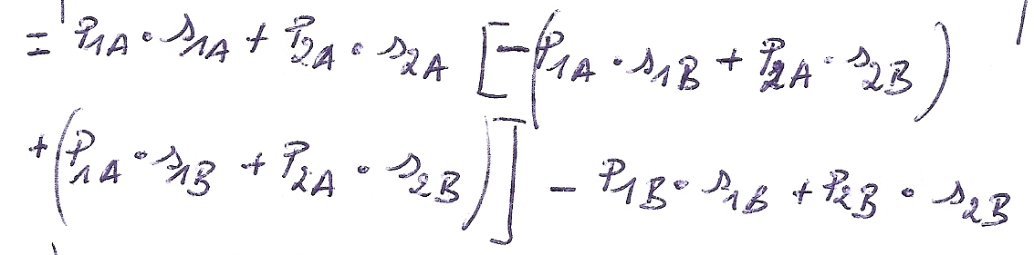
Decomposition of difference: basic shift-share
Decompose two outcomes mathematically, add and subtract a term for which the share of one group is replaced with the share of the other group
Demographic effect
Effect of difference in conditional poverty risk / “unexplained part”

Slide 33
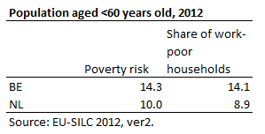
Decomposition of difference: basic shift-share
Can differences in shares of work-poor households explain part of difference in poverty between BE and NL?

Slide 34
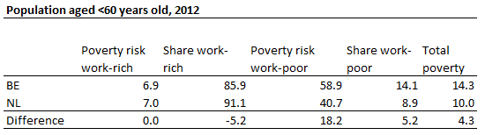
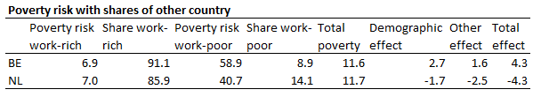
Decomposition of difference: basic shift-share
Path dependence => average demographic effect

Slide 35
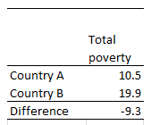
Decomposition of difference: basic shift-share
Which country has the highest poverty risk? (fictitious example)

Slide 36
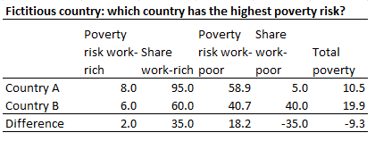
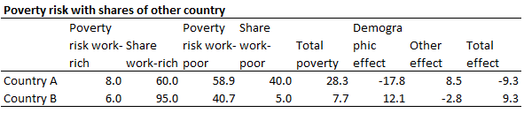
Decomposition of difference: basic shift-share
Which country has the highest poverty risk? (fictitious example)

Slide 37
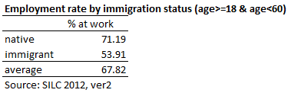
Decomposition of difference: Basic shift-share
Can also be used for within-country decompositions to better understand difference between groups (BE)
To what extent due to difference in educational differences?

Slide 38
Decomposition of difference: Basic shift-share
Can also be used for within-country decompositions to better understand difference between groups (BE)
To what extent due to difference in educational differences?

Slide 39
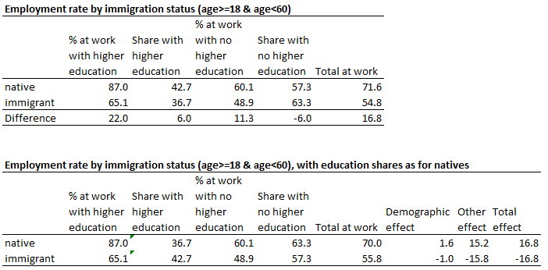
Decomposition of difference: Basic shift-share

Slide 40
Advanced shift-share: Oaxaca-Blinder
Blinder, Alan (1973), Wage Discrimination: Reduced Form and Structural Estimates, Journal of Human Resources 8:436-455.
Oaxaca, Ronald (1973), Male-Female Wage Differentials in Urban Labor Markets, International Economic Review 14: 693-709.

Slide 41
Advanced shift-share: Oaxaca-Blinder
Basically same approach
But now decompose by multiple variables
=> regression of dependent on many independent variables
=> recompute outcome with regression coefficients of ‘other’ group (twice for average effect)
=> remaining difference in outcomes = ‘treatment effect’

Slide 42

Advanced shift-share: Oaxaca-Blinder
For a linear regression:
  Ẍ is a row of mean values of the control variables
  β is a vector of coefficient estimates
First term = difference in outcome due to difference in mean values on ‘independent’ variables, if effect of each variable would be the same in both groups
Second term = difference in outcome due to difference in ‘effect’ of independent variables = ‘unexplained part’
= (e.g.) ethnic penalty?

Slide 43
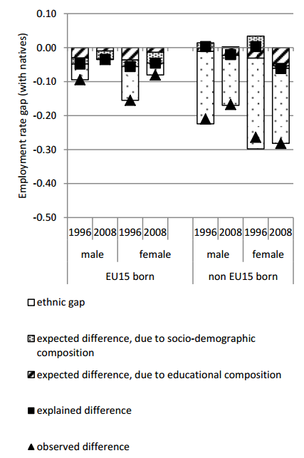
Contribution of education and other socio-economic characteristics in observed and expected employment rate gap with natives, 1996 – 2008
Source:
Corluy and Verbist (2014)

Slide 44
Decompositions for identifying policy effects
Differences in outcomes between countries or years are result of policy effects, differences / changes in demographic composition, labour market effects, …
With microsimulation, one can keep policies ‘constant’ and apply it to different populations
Poverty(A) – Poverty(B) =
Poverty(A) – Poverty(A|Policies B) [[policy effect]]
+ Poverty(A|policies B) – Poverty(B) [[other effect]]

Slide 45

Decompositions for identifying policy effects
More formal framework: Bargain & Callan (2010):
x (e.g. net income) for each household h in year k with policies of policy year j
d refers to tax-transfer system, with policy parameters p of policy year j
y refers to the pre-tax, pre-transfer income of household h in year k
z refers to relevant demographic and labour market characteristics in year k

Slide 46
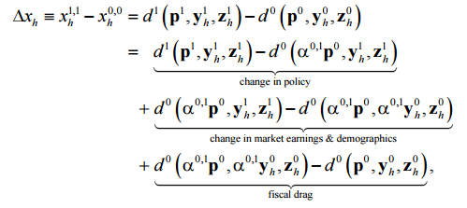
Decompositions for identifying policy effects
With a being an uprating factor to make incomes and policy parameters ‘comparable’

Slide 47
Decompositions for identifying policy effects
As is the case for demographic decompositions: starting point matters (‘path dependence’)
However, to compensate: one needs two datasets (start and ending year)
Not always available

Slide 48
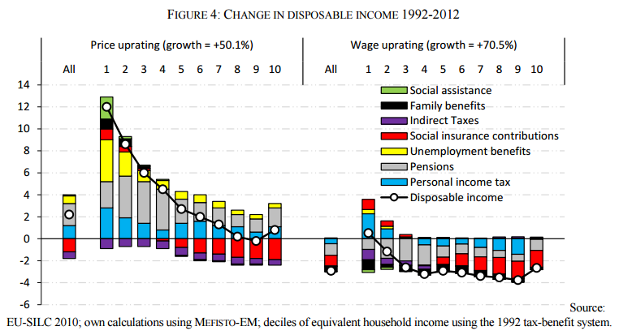
Decompositions for identifying policy effects
How much better off are we now then if we would still live under the 1992 tax-benefit system?
Source: Decoster et al., 2014

Slide 49
Decompositions for identifying policy effects
Strengths:
Possible to identify effects of policies on outcome variables, in isolation or in combination with other policies (ceteris paribus)
Through microsimulation with microdata, decomposition possible for very complex outcome variables, with relative ease
New insights, hitherto unknown/shown

Slide 50
Decompositions for identifying policy effects
Limitations:
Does not incorporate behavioural effects!
Path dependence: dependent on which year as base year (data)
No experiment, but still identification of policy changes that have made strongest direct difference

Slide 51
Decompositions
Advantages:
  Quantification of size and direction of effect of individual factors
  Identification of relative importance of potential causal factors

Slide 52
Decompositions
Limitations:
  Not experiments: rough identification of relevant variables, not necessarily or clearly causes (or strong partial equilibrium assumptions)
  ‘Accounting’ approaches (interactions may be ignored, mechanisms may remain unclear)
  Order of decomposition (factors kept constant) may influence results (“path dependence”)
  Not all quantities can easily or straightforwardly decomposed be (e.g. quantiles, some inequality measures,… but strong developments in this direction)
  Direction of causal effect

Slide 53
Some points to remember
Level of child benefits: complex debate
Decompositions allow for mechanically identifying contributing factors, which may help to understand (changes / differences in) outcomes
But do not allow for exactly identifying causal impacts

Slide 54
References
Bargain, O., and Callan, T. (2010), 'Analysing the effects of tax-benefit reforms on income distribution: a decomposition approach' in The Journal of Economic Inequality, 8(1): 1-21. doi: 10.1007/s10888-008-9101-4.
Corluy, V., and Verbist, G. (2014), Can education bridge the gap? Education and the employment position of immigrants in Belgium, ImPRovE WP 14/02, Antwerp: Herman Deleeck Centre for Social Policy - University of Antwerp, 31p.
Decoster, A., Perelman, S., Vandelannoote, D., Vanheukelom, T., and Verbist, G. (2015), A bird’s eye view on 20 years of tax-benefit reforms in Belgium, CSB Working paper WP15/02, Antwerp: Herman Deleeck Centre for Social Policy, University of Antwerp, 45p.
Storms, B., Penne, T., Vandelannoote, D., and Van Thielen, L. (2015), Is de minimuminkomensbescherming in ons land doeltreffender geworden sinds 2008? Wat leren we uit de geüpdatete referentiebudgetten?, VLAS-Studies 21, Antwerpen: Vlaams Armoedesteunpunt, 67p.
Fortin, N., Lemieux, T., and Firpo, S. (2010), Decomposition methods in economics, NBER Working Paper 16045, Cambridge: National Bureau of Economic Research, 118p

