Slide 1
Maatschappij, Beleid en Evaluatie
Tim Goedemé
tim.goedeme@uantwerpen.be
Les 7 – 10/11/2015
Notes:
Start met namen te vragen + vragen of er nog onduidelijkheden waren bij vorige les / te kennen leerstof.

Slide 2
Q&A course so far, brief evaluation
Interim evaluation of course
Three types of texts:
  Texts to study: slides help to understand texts
  Texts to read: texts help to understand slides
  Background texts: most relevant texts with additional material on which I have drawn
Questions and answers

Slide 3
Lecture 7
Causality and public policy
Types of causal relationships
Frameworks for thinking about causality
The Neymar-Rubin-Holland approach
Questions for causal analysis

Slide 4
Main questions this lecture
What is causality?
What type of causality should be of interest to policy makers?
Are randomised controlled trials the ideal for evidence-based policy? Are they sufficient? Why (not)?
Please explain…

Slide 5
Background texts
Brady, H. E. (2008), 'Causation and explanation in social science', in Box-Steffensmeier, J. M., Brady, H. E. and Collier, D. (eds.), The Oxford Handbook of Political Methodology, Oxford: Oxford University Press, pp. 217-270. [compulsory]
Angrist, J. D., and Pischke, J.-S. (2009), Mostly Harmless Econometrics, Princeton: Princeton University Press, 373p. Chapter 1 & 2 [background]
Holland, P. W. (1986), 'Statistics and Causal Inference' in Journal of the American Statistical Association, 81(396): 945-960 [background]

Slide 6
Introduction
For monitoring the social situation and policies, we use indicators
However, when designing or evaluating policies, we need more
We want to know how we can change things through manipulating policy parameters
And we want to understand the current situation, and in particular how policies and changes in policies have contributed to the current (or past) situation
For evidence-based policy and policy evaluation, we need additional tools: theories & methods that help us understand causes and effects
Notes:
Ask: what is causality, how can we identify it?

Slide 7


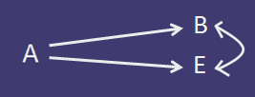
Types of causal relationships
Direct effect
Indirect effect
Common cause (spurious correlation)
Notes:
Ask first about what they understand under causality and how causality could be identified.

Slide 8


Types of causal relationships
Bidirectional causation (e.g. self-reinforcing processes) (and endogeneity)
(Insufficient but) necessary condition of cause

Slide 9

Types of causal relationships
(Unnecessary but) exclusively sufficient cause
Others:
Interacting causes
Coincidence (pure correlation, so no causality)

Slide 10
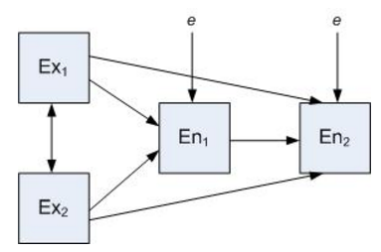
Types of causal relationships
Endogenous vs. exogenous causes / variables
(Picture: wikipedia)

Slide 11
Types of causal relationships
Formal ways to present causal relationships in e.g.:
Bayesian network (& Directed acyclic graphs, DAGs)
Path diagrams in path analysis

Slide 12
Characteristics of causal relationships
Identification of symmetry of causal relationship
Identification of asymmetry of causal relationship
Deterministic causation (e.g. switch on light) vs. probabilistic causation (e.g. work and poverty)

Slide 13
Learning from philosophy
Causality: 3 questions (Brady, 2008)
Psychological: what do we mean by causality when we use the concept
Ontological: What is causality
Epistemological: how do we discover when causality is operative?

Slide 14
4 approaches (Brady, 2008)
Humean and Neo-Humean approach
Counterfactual approach
Manipulation approach
Mechanism approach

Slide 15
4 Approaches
Approaches differ with respect to:
  Emphasis on causes of effects or effects of causes
  Approach to identifying symmetric aspect of causality
  Approach to identifying asymmetric aspect of causality
  Major problems solved

Slide 16
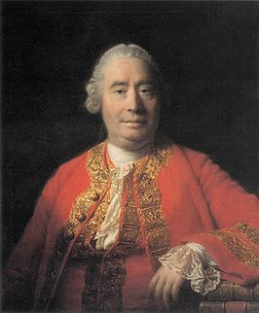
Humean & neo-humean approach
The simple approach:
Two events are causally related if:
They are contiguous in space and time
One precedes the other
They occur regularly in constant conjunction with one another
David Hume
1711 – 1776 , UK
(Wikipedia)
Notes:
Contiguous: aangrenzend
What with Day and Night?
What with lagged effects?
What with multiple causes?

Slide 17
Humean & neo-humean approach
=> Focus is on identifying logical conditions that must hold
Classic definition of causality:
“X is a cause of Y if and only if X is sufficient for Y”
But many ‘causes’ are not sufficient:
E.g. working and not being poor, striking a match…
Notes:
Contiguous: aangrenzend
What with Day and Night?
What with lagged effects?
What with multiple causes?

Slide 18
Humean & neo-humean approach
“X is a cause of Y if and only if X is necessary for Y”
But many effects may have multiple sufficient causes:
E.g. feeling sick (virus, bacteria, car sick, …)
And some necessary conditions are not always considered a cause
E.g. there must be men and women before someone can get pregnant
Notes:
Contiguous: aangrenzend
What with Day and Night?
What with lagged effects?
What with multiple causes?

Slide 19

Humean & neo-humean approach
John Mackie: the INUS conditions: A cause…
is Insufficient, but a [I]
Necessary part of a condition, [N]
which is itself Unnecessary, [U]
but exclusively Sufficient [S]
Notes:
Contiguous: aangrenzend
What with Day and Night?
What with lagged effects?
What with multiple causes?

Slide 20
Humean & neo-humean approach
In other words:
A putative cause is not always the cause if other factors may cause the same phenomenon to happen (multiplicity of causal pathways)
Interactions among causes may be necessary for any one cause to be sufficient (conjunctural causation)
Relationship between any INUS cause and its effect might appear to be probabilistic because of the other INUS causes
=> social science relationships will appear probabilistic even if they are deterministic
Notes:
Contiguous: aangrenzend
What with Day and Night?
What with lagged effects?
What with multiple causes?

Slide 21
Humean & neo-humean approach
But INUS conditions are no perfect definition of causal relationships:
Situations where there are common causes (third variable affecting both A and B, but also the effect + indirect effects)
Accidental regularities
Based on correlations: impossible to assess whether effect is cause or cause is effect, except for temporal precedence
Notes:
Contiguous: aangrenzend
What with Day and Night?
What with lagged effects?
What with multiple causes?

Slide 22
Humean & neo-humean approach
Symmetric aspect of causality: observation of constant conjunction and correlation
Asymmetric aspect: temporal precedence
Major problems solved: necessary condition
Emphasis: causes of effects
Notes:
Contiguous: aangrenzend
What with Day and Night?
What with lagged effects?
What with multiple causes?

Slide 23
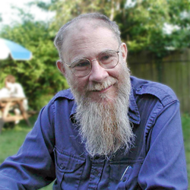
Counterfactual approach
If, in the most similar world, X would not have occurred, would Y then still have occurred?
=> counterfactual
David Kellogg Lewis
1941-2001, US
(Univ of Melbourne)
Notes:
Contiguous: aangrenzend
What with Day and Night?
What with lagged effects?
What with multiple causes?

Slide 24
Counterfactual approach
X causes Y if (assuming X and Y have occurred):
If X were to occur, then Y would occur; and
If X were not to occur, then Y would not occur either

Slide 25
Counterfactual approach
Causal assessment of singular events is possible (not general laws as in neo-Humean approach)
But how to evaluate the second counterfactual if it never took place?
Identify the ‘closest possible world’ and assess what would happen (e.g. world without social policies?)
Only possible if one knows the ‘lawlike regularities that govern our world’ (cf. Humean approach) (cf. deficiencies of pre-post approach)

Slide 26
Counterfactual approach
Benefits of the approach:
No need to observe universal conjunction of cause and effect
Provides way to think about causality of singular events
Notes:
(One observation of a cause followed by an effect is sufficient for establishing causation if it can be shown that in a most similar world without the cause, the effect does not occur)

Slide 27
Counterfactual approach
Problems:
  Direction of causation cannot be established
  When is a surrogate world ‘close enough’ to function as an adequate counterfactual?
  Common causal factor of putative cause and effect (i.e. ‘spurious correlation’)
  > Assess whether “if Y did not occur, then X would not occur” is false?

Slide 28
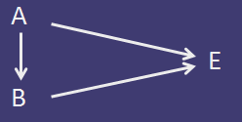



Counterfactual approach
Causal pre-emption: when two causes have the same effect, and one cause excludes the other

Slide 29
Counterfactual approach
Symmetric aspect: truth in otherwise similar world of ‘if the cause occurs, then so does the effect’ and ‘if the cause does not occur, then the effect does not occur’
Asymmetric aspect: ‘if the effect does not occur, then the cause may still occur’
Major problems solved: singular causation, nature of necessity
Emphasis: Effects of causes & causes of effects

Slide 30
Manipulation approach
Rather than imagining a counterfactual, create a counterfactual through manipulation of the putative cause
(Quasi-)Experiment: manipulate one and only one factor, keep all else constant
If Y occurs when X is not, and Y occurs when X occurs, than X is cause of Y, because X is only difference between the two situations
=> Manipulation allows for establishing the direction of the relationship

Slide 31
Manipulation approach
In contrast to philosophers, methodologists and practitioners blend counterfactual and manipulation approach for better understanding of causality
Closest possible worlds (rule out accidental correlation) & manipulation (identify direction of causality)

Slide 32
Manipulation approach
Symmetric aspect: recipe that regularly produces the effect from cause
Asymmetric aspect: observation of the effect of the manipulation
Major problems solved: common cause and causal direction
Emphasis: effects of causes

Slide 33
The mechanism approach
Experiments / counterfactual approach do badly with regard to:
  Causal pre-emption (when one cause acts just before and pre-empts another)
  Cannot readily explain the causes of effects (in contrast to the effects of specific causes)
  Phenomena (causal factors) that cannot be easily manipulated or isolated

Slide 34
The mechanism approach
Two events are causally connected if and only if there is a mechanism connecting them
=> there is a need to understand the mechanisms at work
“Mechanisms are entities and activities organised such that they are productive of regular changes from start or setup to finish or termination conditions” (Machamber et al., 2000: 3 in Brady, 2008)
=> break causal mechanisms down into their different parts and study those in various contexts

Slide 35
The mechanism approach
Symmetric aspect: is there a mechanism or capacity that leads from cause to effect?
Asymmetric aspect: appeal to operation of mechanism
Major problems solved: causal pre-emption
Emphasis: Causes of effects

Slide 36
Summing up
Identification of causality is strongest if:
Constant conjunction of causes and effects (Neo-Humean)
No effect when the cause is absent in the most similar world (counterfactual)
An effect after a cause is manipulated (manipulation)
Identification of activities and processes linking causes and effects (mechanism)

Slide 37
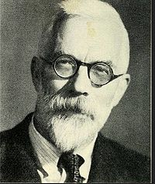
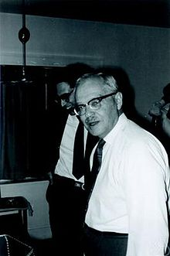

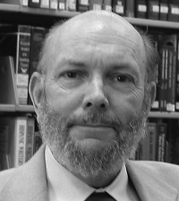
Neyman-Rubin-Holland: a golden standard?
  Ronald Fisher – Jerzy Neyman – Donald Rubin – Paul Holland
  (pictures: wikipedia / Psychometric society)

Slide 38
Neyman-Rubin-Holland
No causation without manipulation (attributes such as race and gender are no causes)
A cause is always relative to another cause (A vs. not A)
Fundamental problem of causal inference: it is impossible to observe the effect of a cause on the same case (either one is subject to the cause, or one is not)

Slide 39
Neyman-Rubin-Holland
Solutions (assumptions):
Temporal stability (one can measure effect on same case by manipulating consecutively) and causal transience (effect does not change after one manipulation or the other)
  => usually not applicable to humans or institutions
Unit homogeneity or invariance: identicality of units and treatment (assume all units have the same (conditional) properties and reaction to cause)
  => usually not applicable to humans or institutions

Slide 40
Neyman-Rubin-Holland
Solutions (assumptions):
Independence assumption: if treatment is assigned randomly, then difference in outcome between treated and non-treated equals expected average causal effect
Constant effect: effect on each unit is equal to average causal effect
Stable-Unit-Treatment Value Assumption (SUTVA): non-interference of units (treatment of one unit does not affect outcome of other unit) (micro-meso-macro level)

Slide 41

Neyman-Rubin-Holland
When independence and SUTVA assumptions hold, randomised experiments are a powerful tool!
(equations from Angrist and Pischke)

Slide 42
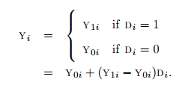
Neyman-Rubin-Holland
Observed outcome Y for individual i:
With Y_{1i} – Y_{0i} the causal effect for individual i

Slide 43
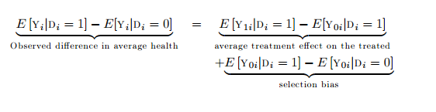
Neyman-Rubin-Holland
Average causal effect:

Slide 44


Neyman-Rubin-Holland
With random assignment of D_{i}, D_{i} is independent of potential outcomes:

Slide 45
Neyman-Rubin-Holland
Random assignment solves problem of selection bias!
If your study does not include random assignment, selection bias is probably a very important challenge for causal statements.

Slide 46
Neyman-Rubin-Holland: a golden standard?
Limitations of experiments:
Average causal effect: assumption of constant effect is not realistic, variance may be substantial
Causal pre-emption
Pairing (identifying exact causes in singular events)
Assumption of SUTVA (stable-unit-treatment value assumption

Slide 47
Neyman-Rubin-Holland: a golden standard?
Problems with SUTVA (Brady, 2008: 265):
Compensatory rivalry
Resentful demoralization
Compensatory equalisation
Treatment diffusion
But also: macro level effects (e.g. general equilibrium, reduced value of education, poverty line effect, …)

Slide 48
Neyman-Rubin-Holland: a golden standard?
Limitations of experiments:
Average causal effect
Causal pre-emption
Pairing (identifying exact causes in singular events)
SUTVA (through micro, meso- or macro-level interactions)
Limits to external validity (repetition, population, other policies, upscaling)
Only possible for effects of causes, not causes of effects

Slide 49
Neyman-Rubin-Holland: a golden standard?
Evidence-based policy requires more than random experiments (and equivalents):
  Descriptive studies
  Comparative studies
  Decompositions
  Model-based studies (e.g. microsimulations)
  …
But one should be clear about limits to causal inference and external validity!

Slide 50
Causal analysis: crucial questions
What is the causal relationship of interest? What are its characteristics, and what would you like to infer from it?
What is the research setup (experiment) that could ideally be used to capture the causal effect of interest?
What is your identification strategy?
What is your mode of statistical inference?
To what extent are results generalizable (to broader population, other fields of interest/policy areas; upscaling)?
What lessons for policy makers do you wish to draw?

Slide 51
Causal analysis: crucial questions
ALWAYS reflect upon ideal research design, and limitations of the actual research design
Report limitations (and how future research might improve on current setup)

Slide 52
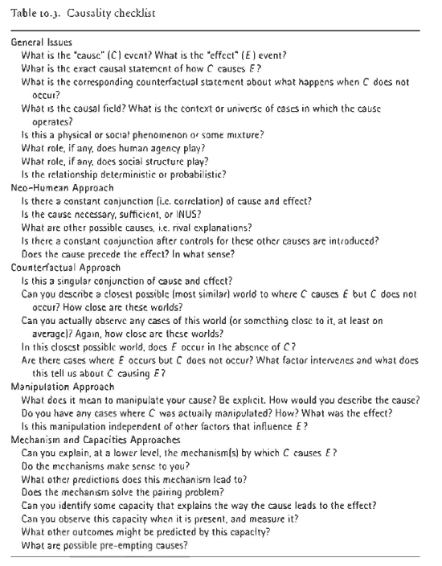
Brady, 2008: 248

Slide 53
Some points to remember
When interpreting results in a causal way, reflect upon limitations caused by:
Endogeneity
Selection bias
Measurement error & bias
Violations of SUTVA
Common cause, causal pre-emption
Correlation does not imply causation; most regressions based on observational data canNOT identify causality

Slide 54
Some points to remember
Understanding mechanism not precondition for identifying causality, but essential for understanding it.
When reading research results or designing a research setup, always:
Clearly identify causal question
Reflect upon ideal setup, and limitations of implemented setup
… and their consequences for the internal and external validity of the results.

Slide 55
References
Brady, H. E. (2008), 'Causation and explanation in social science', in Box-Steffensmeier, J. M., Brady, H. E. and Collier, D. (eds.), The Oxford Handbook of Political Methodology, Oxford: Oxford University Press, pp. 217-270. [compulsory]
Angrist, J. D., and Pischke, J.-S. (2009), Mostly Harmless Econometrics, Princeton: Princeton University Press, 373p. Chapter 1 & 2 [background]
Holland, P. W. (1986), 'Statistics and Causal Inference' in Journal of the American Statistical Association, 81(396): 945-960 [background]

