Slide 1
Maatschappij, Beleid en Evaluatie
Tim Goedemé
tim.goedeme@uantwerpen.be
Les 6 – 3/11/2015
Notes:
Start met namen te vragen + vragen of er nog onduidelijkheden waren bij vorige les / te kennen leerstof.

Slide 2
Lecture 6
The construction of policy indicators
The level of benefits: hypothetical tax-benefit simulations
Measuring trends in income levels
Measuring the adequacy of incomes
Constructing comparable reference budgets in Europe

Slide 3
Main questions
How do we usually measure real trends in income levels? How does this compare to an ‘ideal’ measurement?
What are the strengths and weaknesses of hypothetical household tax-benefit simulations?
Can you briefly explain different approaches to measuring adequacy?
How has the adequacy of minimum income protection in Belgium evolved over the past 10 years?

Slide 4
Background texts
Goedemé, T., De Vil, G., et al. (2012), 'Hoogte en adequaatheid van de Belgische sociale minima in de periode 2000-2011', in Vranken, J., et al. (eds.), Armoede in België. jaarboek 2012, Leuven: Acco, pp. 215-238. [compulsory]
Van den Bosch, K., Storms, B., Van Mechelen, N., and Goedemé, T. (2009), 'Armoedegrenzen voor Europa', in Vranken, J., Campaert, G., Dierckx, D. and Van Haarlem, A. (eds.), Arm Europa. Over armoede en armoedebestrijding op het Europese niveau, Leuven / Den Haag: Acco, pp. 195-211. [compulsory]
Storms, B., Penne, T., Vandelannoote, D., Van Thielen, L. (2015) ‘Rondkomen met een minimum inkomen: hoe (on)mogelijk is dit? Studie naar de doeltreffendheid van de minimuminkomensbescherming anno 2013’, De gids op maatschappelijk gebied, 106(1): 18-24 [compulsory]
Economie, F. (2014), De nieuwe consumptieprijsindex – een betere inflatiemeter, Brussels: FOD Economie, 10p. [compulsory reading]
Goedemé, T., Storms, B., Stockman, S., Penne, T., and Van den Bosch, K. (2015), 'Towards Cross-country Comparable Reference Budgets in Europe: First Results of a Concerted Effort' in European Journal of Social Security (EJSS), 17(1): 3-31. [background]

Slide 5
Measuring trends in the adequacy of benefits
Two data requirements:
  Indicator of the level of benefits
  Indicator of adequacy
In this lecture: theoretical adequacy, not distribution
Focus is on ‘input’ & ‘output’ indicators

Slide 6
1. Measuring benefit levels
Gross
  Evaluate changes in particular policies
  But may change due to change in tax-benefit system:
    Taxation
    Effect on other benefit levels (e.g. social assistance)

Slide 7
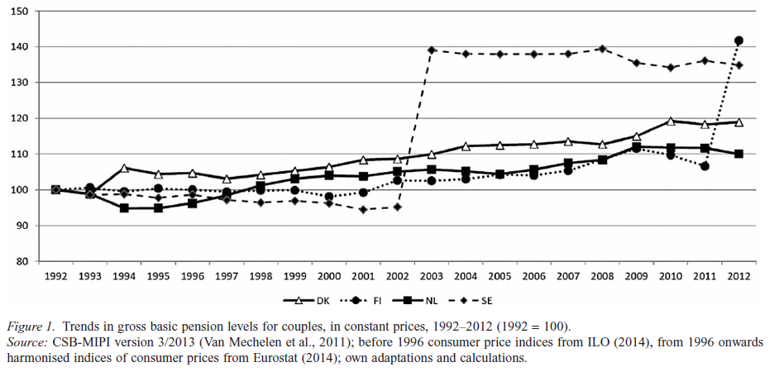
1. Measuring benefit levels
Source: Goedemé and Marchal (2015: 6)

Slide 8
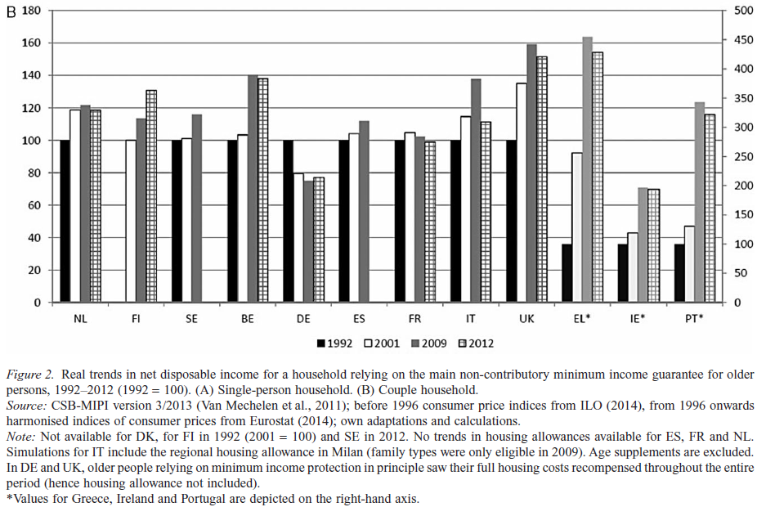
1. Measuring benefit levels
Source: Goedemé and Marchal (2015: 7)

Slide 9
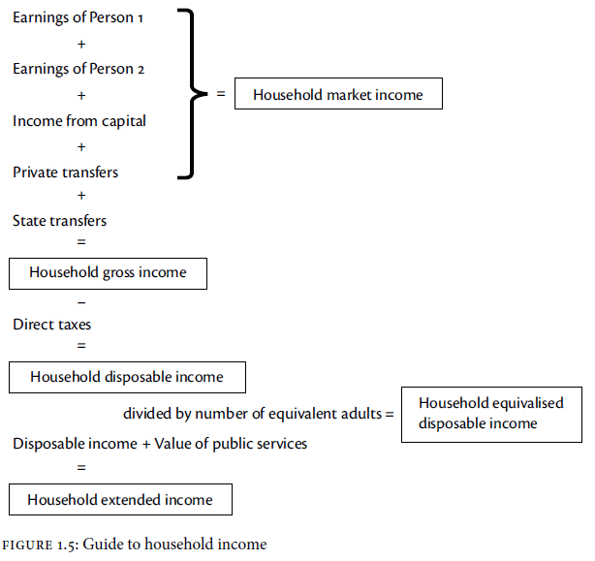
1. Measuring benefit levels
Source: Atkinson, 2015: 30

Slide 10
1. Measuring benefit levels
Gross
  Evaluate changes in particular policies
  But may change due to change in tax-benefit system:
    Taxation
    Effect on other benefit levels (e.g. social assistance)
=> net ‘benefit levels’ => net incomes
=> hypothetical household tax-benefit simulations

Slide 11
Model Family Simulations
Tax-benefit model family simulations:
  simulate
    entitlements
    liabilities
    net disposable income
  for well-described hypothetical household situations
<-> microsimulations
Main use: policy indicators: illustrate how tax-benefit systems work for hypothetical cases

Slide 12
Model Family Simulations
Function of model family simulations
Interactions between tax-benefit policies
Effects on composition and level of income packages for a range of household types
Better understand (changes in) tax-benefit policies
Evaluate the adequacy, fairness and labour market incentives of tax-benefit policies
Better understand cross-national differences in social outcomes and evaluate trends in the generosity of tax-benefit systems over time

Slide 13
Model Family Simulations
Advantages
Not require detailed micro-data, not very costly
Can construct generosity index, making abstraction of composition of the population
Relatively simple: make it easier to understand what happens

Slide 14
Model family simulations
Institutional approach:
  Starts from characteristics of hypothetical families
  With clear indication of which benefit(s) to simulate
The risk type approach:
  Define the characteristics of the model families on the basis of generic assumptions and
  Let the simulation model ‘decide’ which policies are applicable
  As if hypothetical households were ‘real households’ in a micro dataset

Slide 15
Model family simulations
Types of assumptions:
  Household composition
  Earnings & employment
  Other income
  Housing costs
  …

Slide 16
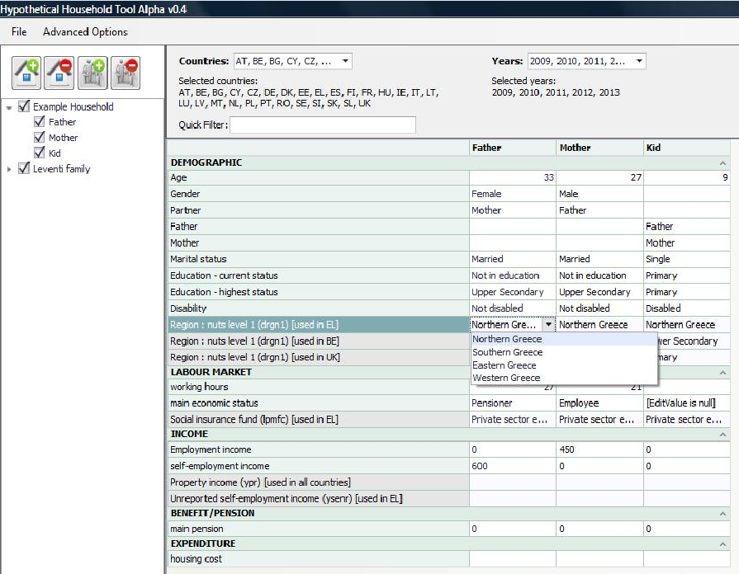
Input screen HHOT (EUROMOD)

Slide 17
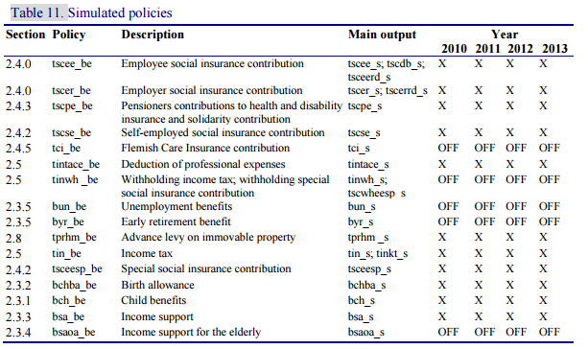
1. Measuring benefit levels
The “policy spine” BE EUROMOD; Hufkens et al., 2014: 21

Slide 18
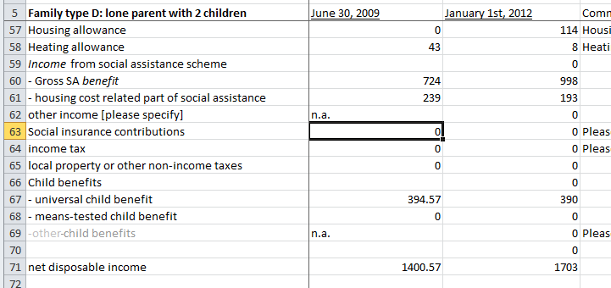
Model Family Simulations
Example from output CSB-MIPI
http://www.centrumvoorsociaalbeleid.be/index.php?q=node/3270/en

Slide 19
Model Family Simulations
Example from CSB-MIPI
Goedemé, 2013

Slide 20
EUROMOD - HHOT
Tax-benefit microsimulation model for the EU
Many countries & years, regular updates
Comparative framework => facilitates construction of comparable indicators
Covers complete sets of tax-benefit rules: the user has a lot of flexibility to define and modify the characteristics of the model families
Software designed to assess changes in tax-benefit rules: easy to simulate effects of a reform

Slide 21
EUROMOD - HHOT
EUROMOD calculates direct taxes (national and local), social contribution liabilities and entitlements to cash benefits
  Family benefits
  Housing benefits
  Social assistance
  Unemployment (+/-)
Taken from the data:
  Sickness and disability benefits
  pensions

Slide 22
EUROMOD - HHOT
  Define characteristics of model families (within EUROMOD)
  Generate data file
  Run EUROMOD to simulate taxes and benefits
  Display results in EUROMOD
  Analyse output data file

Slide 23
Hypothetical simulations: Limitations
Not for distributional analyses!!!
Different role of benefits in different countries
Housing costs & comparability
Non-take up
Discretionary deviations from standard legislation
Means test: no info (in databases, not models!)
Coverage & Representativeness vary

Slide 24
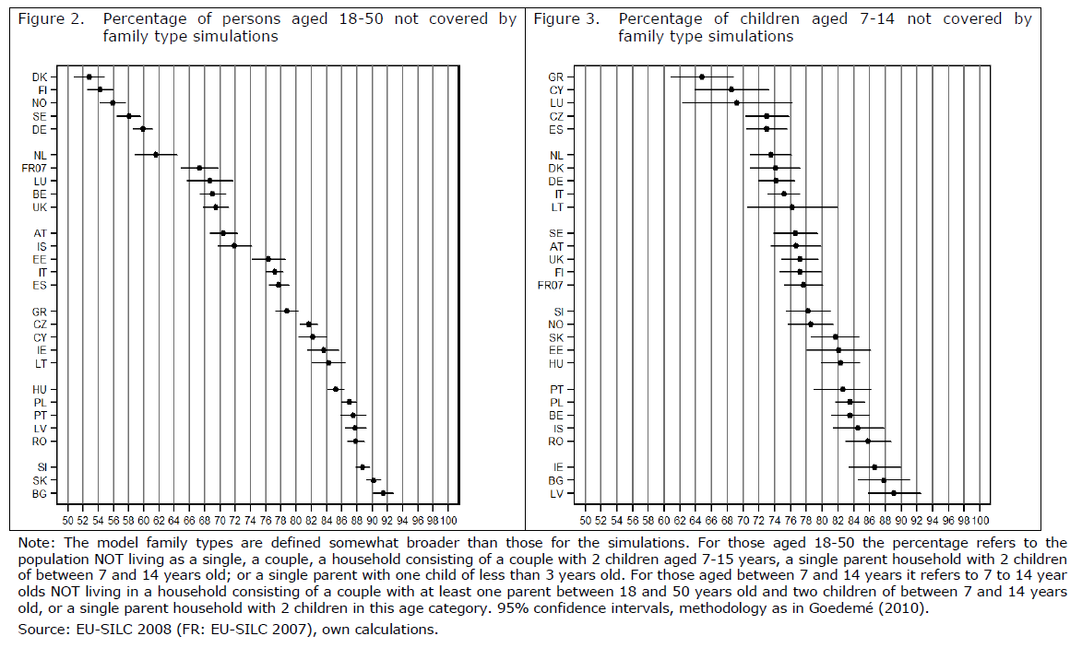
Representativeness

Slide 25
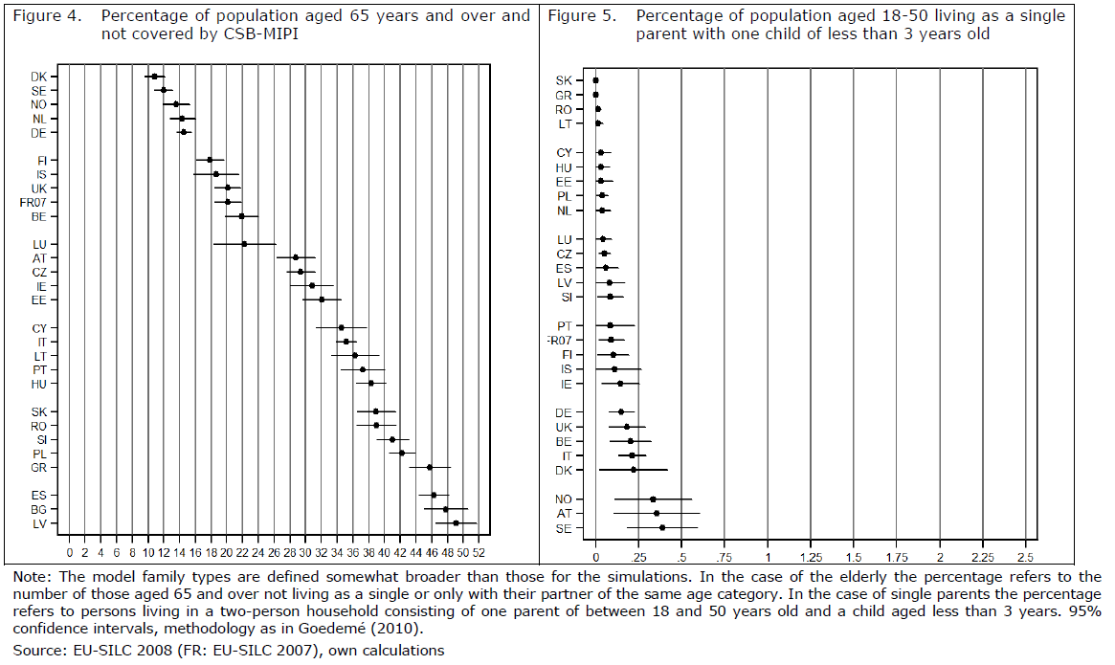
Representativeness

Slide 26
Data & tools
Databases:
  CSB-MIPI: http://www.centrumvoorsociaalbeleid.be/index.php?q=node/3270
  SPIN (incl. SCIP & SaMip): http://www.sofi.su.se/spin/.
  Theoretical net replacement rates (pensions, EC)
Tools:
  OECD Tax benefit calculator (http://www.oecd.org/els/soc/benefitsandwagestax-benefitcalculator.htm)
  MOTYFF (http://econflemosi1.econ.kuleuven.ac.be/motyffui/)
  OECD Pension calculator (http://www.oecd.org/els/public-pensions/pensionsataglancepensioncalculator.htm)
  EUROMOD: HHOT (under construction)

Slide 27
MOTYFF
Do it yourself:
MOTYFF (2013 policies)
http://econflemosi1.econ.kuleuven.ac.be/motyffui/
http://www.flemosi.be
Questions (only if for paper or work):
Tine.hufkens@uantwerpen.be

Slide 28
Assignment
Simulate with MOTYFF the situation of a family (your family)
Simulate change in family composition (child born, child leaves the house)
Simulate change in employment status of one of the members
Simulate policy change
What can you learn from this?

Slide 29
2. Measuring trends in real income levels
Key question: how has the purchasing power of certain groups / income components (e.g. benefits) in the population evolved?
Nominal trends: trends in ‘local’ prices
Real trends: trends in ‘fixed’ prices

Slide 30
2. Measuring trends in real income levels
Purpose: assess to what extent the purchasing power of individuals or benefits change over time
Basic approach:
  identify a relevant basket of goods and services
  Assess how its price has changed over time
But:
  which basket of goods and services?
  And how to weight the items in the basket?

Slide 31
2. Measuring trends in real income levels
Challenges:
  Substitution effects
  New goods & services / old goods and services
  Changes in the quality of goods & services
  Heterogeneity of prices
  Heterogeneity of consumption

Slide 32
2. Measuring trends in real income levels
Etienne Laspeyres vs. Hermann Paasche
Laspeyres index: https://youtu.be/yBmaSYRtjBg?list=PLr3ti8G3MCuqzyWqVXNqqa3zmaLiJsMlO
Paasche index:
https://youtu.be/LR4-A6IvrFw?list=PLr3ti8G3MCuqzyWqVXNqqa3zmaLiJsMlO

Slide 33
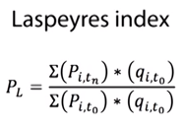
2. Measuring trends in real income levels
i = goods and services
t = time
P = Price
q = quantities (weights)

Slide 34
2. Measuring trends in real income levels
i = goods and services
t = time
P = Price
q = quantities (weights)

Slide 35
2. Measuring trends in real income levels
Laspeyres index takes bundle of t(0) as starting point:
  Ignores substitution effect: if a good becomes more expensive, we will exchange for another, cheaper alternative, with less than proportional utility loss
  => overstates inflation

Slide 36
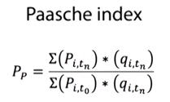
2. Measuring trends in real income levels
i = goods and services
t = time
P = Price
q = quantities (weights)

Slide 37
2. Measuring trends in real income levels
i = goods and services
t = time
P = Price
q = quantities (weights)

Slide 38
2. Measuring trends in real income levels
Paasche index takes bundle of t(1) as starting point:
  Ignores substitution effect: the new bundle contains more of the goods with relatively lower inflation, and less than those with relatively higher
  => understates inflation

Slide 39
2. Measuring trends in real income levels
Hicksian demand: what we would consume when prices change if our utility stays the same
Marshallian demand: what we actually consume taking the income effect into account as a result of price changes.

Slide 40
Consumer price index Belgium
Weights of product categories: Household budget survey (HuishoudBudgetOnderzoek, HBO)
Two-yearly
Diaries of household consumption expenditures
About 6,000 households (but very low response of 17%, from LFS)
Focus on average consumption pattern

Slide 41
Consumer price index Belgium
Since 2014: Chained Laspeyres Index (weights change more frequently)
At product level: now Jevons index, in contrast to Dutot’s index before

Slide 42

Consumer Price Index Belgium
Dutot’s Index:
The more expensive the product, the higher the (implicit) weight given to the same proportional increase in price
Source: Equation: Wikipedia

Slide 43

Consumer Price Index Belgium
Jevons Index:
Each product same weight, but what if price falls to zero?
Source: Equation: Wikipedia

Slide 44
Consumer price indices in Belgium
Consumer price index (CPI)
Health index (gezondheidsindex)
  CPI - alcoholische dranken, tabakswaren en motorbrandstoffen, met uitzondering van LPG
Averaged health index (afgevlakte gezondheidsindex)
Spilindex

Slide 45
Consumer Price indices Belgium
Source: FOD Economie, own calculations

Slide 46
2. Measuring real changes over time
Assignment: Calculate real trend in gross income, expressed in currency of 2013; and as index with 2010 = 100.
 | 2010 | 2011 | 2012 | 2013
Gross income (EUR) | 500 | 520 | 540 | 550
Health index (base 2013 = 100) | 90 | 92 | 95 | 100
CPI (base 2005 = 100) | 120 | 124 | 130 | 135
Real trend in EUR (2013) | 562 | 566 | 561 | 550
Real trend (2010 = 100) | 100.0 | 100.6 | 99.7 | 97.8

Slide 47
2. Measuring trends in real income levels
First express all prices as ratio of base year:
  If 2013 is base year: divide price index of year x by price index of 2013
Divide value in current prices by ratio of indices
Express value as % of base year 2010

Slide 48
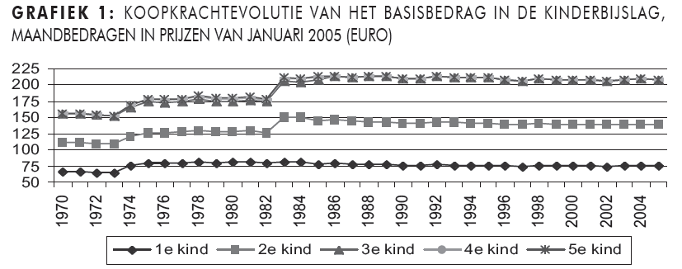
Illustration
Cantillon and Goedemé, 2006

Slide 49
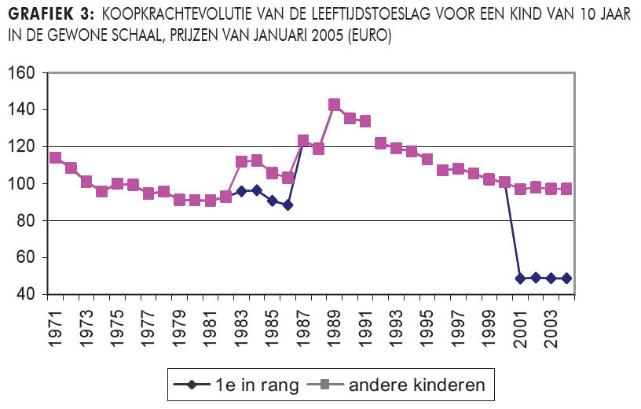
Illustration
Cantillon and Goedemé, 2006

Slide 50
2. Measuring real changes in income levels
Challenges:
  Substitution effects
  New goods & services / old goods and services
  Changes in the quality of goods & services
  Heterogeneity of prices
  Heterogeneity of consumption
Same challenges apply to computation of purchasing power parities (PPPs) for comparing real incomes across countries!

Slide 51
3. Measuring the adequacy of income levels
Two measures:
  (net) income
  Adequacy threshold
4 approaches for identifying adequacy threshold:
  Legal
  Statistical
  Subjective
  Reference Budgets (Budget standards)

Slide 52
3. Measuring the adequacy of income levels
Legal method
  Minimum income support
  Reflects social consensus?
  But:
    What if there is no social assistance
    Implicit equivalence scales differ strongly
    Level is influenced by many factors
    How to assess the adequacy of minimum income support in this case?

Slide 53
3. Measuring the adequacy of income levels
Legal method
Statistical approaches
  % median or mean
  -> arbitrary
  -> consistent across countries?
  Townsend: ‘disproportionate increase in deprivation’
  Others: latent class analysis
  -> Consensus by ‘coincidence’?
  -> only impression of objectivity?

Slide 54
3. Measuring the adequacy of income levels
Legal method
Statistical approaches
Subjective measures
  ‘What is the minimum income with which your household could make ends meet?’
  -> correlates with income
  -> changes in wording strong effect
  -> patterns across countries difficult to understand
  -> ‘publicly-oriented evaluation’?

Slide 55
3. Measuring the adequacy of income levels
Legal method
Statistical approaches
Subjective measures
Reference budgets:
  Living standard – goods and services - price
  Needs & circumstances & non-cash incomes
  Fully-specified approaches
    Ghastly chore
    Always arbitrary, never fully robust?
    Cross-country comparability possible?
    Equivalence scales

Slide 56
3. Measuring the adequacy of income levels
The at-risk-of-poverty indicator: 60% of national median equivalent disposable household income
Identify total disposable household income for each household
Divide by equivalent household size
Assign this to all household members
Identify median equivalent disposable household income

Slide 57
3. Measuring the adequacy of income levels
Compute equivalent household incomes using the modified OECD equivalence scale:
1 for first adult
0.5 for other household members aged 14 and over
0.3 for children younger than 14
 | Composition | Income | Costs (all rent apartment)
A | Single 20 years old | 1000 | Student
B | Couple, 22 years old | 2000 | Just working
C | Couple, 22 years old | 1500 | Just working
D | Single, 20 years old | 1500 | Student, wheelchair
E | Couple, 2 children (8 & 14 years old) | 2200 | working, education

Slide 58
3. Measuring the adequacy of income levels
Compute equivalent household incomes using the modified OECD equivalence scale:
1 for first adult
0.5 for other household members aged 14 and over
0.3 for children younger than 14
 | Composition | Income | Costs (all rent apartment) | Eq income
A | Single 20 years old | 1000 | Student | 1000
B | Couple, 22 years old | 2000 | Just working | 1333
C | Couple, 22 years old | 1500 | Just working | 1000
D | Single, 20 years old | 1500 | Student, wheelchair | 1500
E | Couple, 2 children (8 & 14 years old) | 2200 | working, education | 957

Slide 59
3. Measuring the adequacy of income levels
RO
EU27
BE
LU
60% poverty threshold BE
+/- 97% of RO below poverty threshold BE
Notes:
Leg PPS uit. BE: prijzen 11% hoger dan EU27 gemiddelde - > inkomens delen door 1.11; BG 50% van Europees gemiddelde -> inkomens*2.
>>sneller overschakelen naar voorbeeld landen bv. BE en RO!<<
>>Duidelijker belang en probleem voor AROP uitleggen!<<
Europese mediaan is ongeveer gelijk aan 850 euro per maand voor een alleenstaande en 1250 euro voor een gezin.
60% armoedelijn van Roemenië ligt op +/- 12% van de EU27 mediaan (0.6*0.2), die van Belgie op 72% van EU27 mediaan.
-> 97% van Roemenen heeft inkomen onder Belgische armoedegrens en minder dan 1% van de Belgen heeft een inkomen onder de Roemeense armoedegrens. Dus veel van de Belgische armen hebben wellicht een hogere koopkracht dan een deel van de ‘rijkere’ Roemenen.
MAAR: gaat hier puur over koopkracht. Levensstandaard is meer dan dat: gaat ook over de mate waarin men in de samenleving kan participeren. Het mag duidelijk zijn dat wie in Roemenië tot de 20 procent rijkste behoort, wellicht veel beter aan het dagelijks leven (cultuur, media, politiek,…) kan participeren dan wie tot de 15% armsten behoort in België. Misschien heb je in Roemenië gewoon een minder hoog inkomen nodig om niet uitgesloten te zijn van de minimum aanvaardbare levensstandaard?
M.a.w., zolang we niet kunnen zeggen dat de grenzen van de samenleving veel meer samenvallen met de Europese grenzen of zolang we niet met zekerheid kunnen zeggen dat de middelen die nodig zijn om niet te zijn uitgesloten van de minimaal aanvaardbare levensstandaard, zijn grote koopkrachtverschillen op zich onvoldoende om de AROP indicator in de prullenmand te gooien als een indicator van armoede. (en zeker niet zolang we over een betere indicator beschikken).
EU15 is goed voor 80% van de EU bevolking, en 90% van het beschikbaar equivalent inkomen
NMS12 is goed voor 20% van de EU bevolking en nog geen 10% van het totaal equivalent beschikbaar huishoudinkomen
50% bevolking EU27; 40% EU15 en 90% NMS heeft inkomen lager dan EU-wide median; RO: 99 – BE: 39
20% bevolking EU27; 10% EU15 en 60% NMS heeft een lager inkomen dan 50% van EU-wide median RO: 92% - BE: 5.5%
10% bevolking EU27; 12% EU15 en 1% NMS heeft inkomen hoger dan 2*EU-wide median; RO: 0.05 – BE: 10%
RO: Median 24 % EU-wide median -> 20% NMS & 2% EU15
LU: Median 186 % EU-wide median -> 99% NMS & 85% EU15 (7,5x median RO)
BE: Median 120 % EU-wide median -> 95% NMS & 57% EU15 (5x median RO)

Slide 60
3. Measuring the adequacy of income levels

Slide 61
3. Measuring the adequacy of income levels
Two-yearly ratio of median equivalent household income

Slide 62
Constructing new indicators
Identify purpose of indicator
Identify concept that should be measured
Review literature and existing methods in light of quality criteria
Test case
Evaluation
Methodological and policy conclusions

Slide 63
Constructing new indicators
Example of the ‘Pilot project for the development of a common methodology on reference budgets in Europe’, financed by DG EMPL
http://referencebudgets.eu.
http://ec.europa.eu/social/main.jsp?catId=1092&intPageId=2312&langId=en.

Slide 64
Some points to remember
Do indicators really measure what they try to measure?
Measurement error is everywhere
Measuring trends in real incomes within and between countries is extremely relevant, but fraught with difficulties
This is even more so, if ‘adequacy’ is to be evaluated

Slide 65
References
Atkinson, A. B. (2015), Inequality. What can be done?, Cambridge: Harvard University Press.
Cantillon, B., and Goedemé, T. (2006), 'De kinderbijslag in het werknemersstelsel: een terugblik in de toekomst: reflecties bij 75 jaar kinderbijslag' in Belgisch Tijdschrift voor Sociale Zekerheid, 48(1): 7-34.
Goedemé, T., and Marchal, S. (2015), 'Exploring a blind spot in comparative pension reform research: Long-term trends in non-contributory pensions in Europe' in International Journal of Social Welfare. doi: 10.1111/ijsw.12189.
Goedemé, T. (2013), 'Minimum Income Protection for Europe's Elderly: What and How Much has been Guaranteed during the 2000s?', in Marx, I. and Nelson, K. (eds.), Minimum Income Protection in Flux, Hampshire: Palgrave Macmillan, pp. 108-136.
Goedemé, T., Storms, B., Stockman, S., Penne, T., and Van den Bosch, K. (2015), 'Towards Cross-country Comparable Reference Budgets in Europe: First Results of a Concerted Effort' in European Journal of Social Security (EJSS), 17(1): 3-31.
Hufkens, T., Spiritus, K., and Vanhille, J. (2014), EUROMOD Country report Belgium (BE), 2009-2013, Colchester: ISER, 90p.
Van Mechelen, N., Marchal, S., Goedemé, T., Marx, I., and Cantillon, B. (2011), The CSB-Minimum Income Protection Indicators dataset (CSB-MIPI), CSB Working Paper Series, CSB WP 11/05, Antwerp: Herman Deleeck Centre for Social Policy, University of Antwerp, 104p.

