Slide 1
Maatschappij, Beleid en Evaluatie
Tim Goedemé
tim.goedeme@uantwerpen.be
Les 5 – 27/10/2015
Notes:
Start met namen te vragen + vragen of er nog onduidelijkheden waren bij vorige les / te kennen leerstof.

Slide 2
Lecture 5
The construction of social indicators
Different types of indicators
Quality criteria for social and policy indicators
Challenges of social indicators based on survey data: total survey error
Sampling errors
Non-sampling errors

Slide 3
Main questions
What are the most important characteristics of good indicators?
How can one define comparability?
What are specific concerns when social indicators make use of survey data?
What are the (dis)advantages of using administrative data vs. survey data?

Slide 4
Background texts
Atkinson, A. B., Cantillon, B., Marlier, E., and Nolan, B. (2002), Social Indicators: the EU and Social Inclusion, Oxford: Oxford University Press, 240p. Chapter 2 [compulsory]
Groves, R. M., Fowler, F. J. J., Couper, M. P., Lepkowski, J. M., Singer, E., and Tourangeau, R. (2009), Survey Methodology (Second edition), New Jersey: John Wiley & Sons, 461p. Chapter 2 [compulsory]
Goedemé, T. (2013), 'How much confidence can we have in EU-SILC? Complex sample designs and the standard error of the Europe 2020 poverty indicators' in Social Indicators Research, 110(1): 89-110. doi: 10.1007/s11205-011-9918-2. [background]
Lohmann, H. (2011), 'Comparability of EU-SILC survey and register data: The relationship among employment, earnings and poverty' in Journal of European Social Policy, 21(1): 37-54. doi: 10.1177/0958928710385734. [Background]

Slide 5
Part 1: Types of indicators
An indicator = a summary statistic which tries to measure a phenomenon or a (past, current or future) state of affairs
Types by policy cycle:
  Input indicators
  Output indicators
  Outcome indicators
Policy indicators vs. social (outcome) indicators

Slide 6
Dimensions of social programmes
Dimension | Question | Important characteristics
Risk or contingency | What is the problem to solve? | New vs. old social risks Prevention vs. curative Poverty vs. income maintenance
Mode of access | Who is protected, who receives? | Universality vs. selectivity Caseload Non-take up Conditionalities
Benefit structure | Who receives what and how much? | In-cash vs. in-kind Progressiveness Minima Means test Basis for calculation

Slide 7
Dimensions of social programmes (continued)
Dimension | Question | Important characteristics
Financing | Who pays? | Taxes vs. contributions Basis for calculation Non-compliance Funded vs. pay as you go
Governance | Who determines? Who manages? Who administers? Who executes? | Role of the government Role of the private sector Role of the social partners and other interest groups Degree of centralisation

Slide 8
Types of indicators
Mode of access:
  Coverage
  Number & distribution of beneficiaries (caseload)
    Direct + indirect beneficiaries
  Non take-up; sanctions
  Leakage

Slide 9
Types of indicators
Benefit structure:
  Level of benefit in theory (‘typical cases’ / hypothetical households)
  Level of benefit in practice (distribution -> incidental analysis + microsimulation)
  Progressiveness of benefit structure in theory (institutional measurement) & in practice (outcome measurement based on distribution in current population)

Slide 10
Types of indicators
Financing:
  Distribution of costs (in theory and practice)
  Total amount of resources committed
  Resources per capita (beneficiaries)
  Short term vs. long-term cost; implicit debt

Slide 11
Types of indicators
Dimensions:
  Winners and losers: who gets what? Who pays what?
  Non-intended consequences
  Eye for all relevant dimensions (social, economic, political, environmental, …)

Slide 12
Some examples
 | Input | Output | Outcome
Financing | Tariff structure | Total taxes collected, average tax rate | Distribution of taxes
Mode of access | Legal retirement age | Average effective retirement age | Dependency ratio
Benefit structure | Theoretical benefit level | Average benefit level | Distribution of benefits among the population
Other important outcome indicators relate to:
Unemployment, average effective marginal tax rate, poverty, inequality, …

Slide 13
Part 2: Quality criteria
Of individual indicators (Atkinson et al., 2002):
Validity:
  an indicator should identify the essence of the problem and have a clear and accepted normative interpretation (Face validity, transparency & acceptability)
  Internal vs. external validity
Reliability:
  an indicator should be robust and statistically validated
Responsiveness:
  an indicator should be responsive to effective policy interventions but not subject to manipulation

Slide 14
Quality criteria
Comparability (Goedemé et al., 2015)
  Place & time:
    an indicator should be measurable in a sufficiently comparable way across member states
  Procedural comparability:
    the same procedures are implemented for measuring a phenomenon or characteristic at different occasions – different times or different places
  Substantive comparability:
    the same phenomenon is captured similarly in different (social) contexts
Operational feasibility, timeliness and potential for revision

Slide 15
Quality criteria
For the portfolio of indicators (Atkinson et al., 2002):
Balance across different dimensions (and be comprehensive but selective rather than exhaustive)
Mutual consistency of indicators & proportionate weight of indicators
Transparency and accessibility

Slide 16
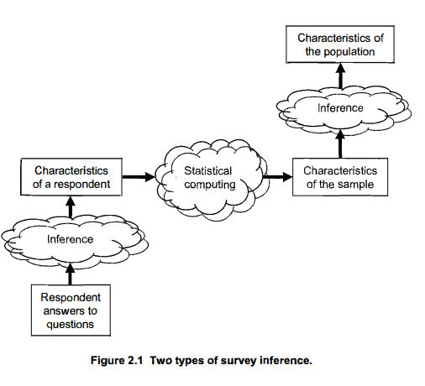
Part 3: Challenges of social indicators based on survey data
Source: Groves et al. (2004: 39)

Slide 17
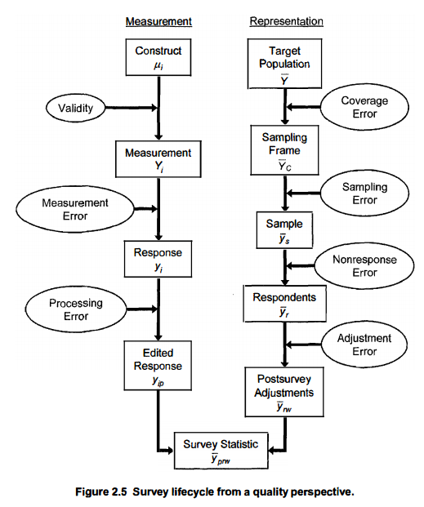
random vs. non-random errors (bias)
Groves et al. (2004: 48)

Slide 18
Crash course statistics: the sampling variance
Some things that should be known to everyone producing or interpreting a sample estimate, but are not always taught in statistics courses…

Slide 19

Notes:
Using a sample to observe the world around us, is in many ways similar to watching the world around us on the basis of … a picture.
First of all, the more you zoom in on a detail, the more blurred the picture gets. The same is most of the time true for a sample estimate: zooming in on a specific subpopulation does not necessarily result in gaining much more insight into the details of the world around us, because our estimate will be less precise than for a larger subgroup.
Second, for a picture, the quality of the method for taking the picture is crucial for the quality of the picture itself: the higher the resolution, the sharper the image will be. The same is true for sample estimates: the better the sample design ensures that all parts of the population are represented in the survey, the more precise the sample estimates will be.
However, there is an important difference between using a picture for observing the world and using a sample for telling us how this world looks like: In the case of a picture it is easy to observe the precision of the image we get. This is not the case for a sample estimate: in that case there is only one way to find out the precision, that is: to calculate the sampling variance.
And it is precisely because we cannot directly observe the precision of a sample estimate, that without an estimate of its precision, a point estimate is pointless.

Slide 20


Slide 22


Slide 23
Notes:
In vele opzichten is een steekproef hetzelfde als een foto: Hoe meer je op details inzoomt, hoe waziger het beeld wordt. Hetzelfde geldt voor steekproeven: hoe meer je naar kleine groepen in de populatie kijkt, hoe kleiner de precisie van de cijfers.
Bovendien geldt dat hoe hoger de resolutie van de foto is, hoe scherper het beeld is. Hetzelfde geldt voor steekproeven: hoe groter ze zijn, en hoe beter ze ervoor zorgen dat alle elementen uit de populatie in de steekproef vertegenwoordigd zijn, hoe preciezer de resultaten zijn. Met andere woorden, de manier waarop een foto wordt gemaakt en de wijze waarop een steekproef zijn getrokken, zijn van het grootste belang voor de precisie van het resultaat.
Net zoals bij foto’s, zit er dus op steekproefschattingen een fout. Het probleem is dat je bij een foto – letterlijk – op het zicht kan zien hoe precies hij is. Bij steekproeven is dit niet het geval, daarvoor moet je de precisie schatten / berekenen.
En net omdat je de precisie niet op het zicht kan inschatten, geldt dat een resultaat van een steekproef maar zinvol is, als je weet hoe precies of betrouwbaar het is.

Slide 24
Notes:
In vele opzichten is een steekproef hetzelfde als een foto: Hoe meer je op details inzoomt, hoe waziger het beeld wordt. Hetzelfde geldt voor steekproeven: hoe meer je naar kleine groepen in de populatie kijkt, hoe kleiner de precisie van de cijfers.
Bovendien geldt dat hoe hoger de resolutie van de foto is, hoe scherper het beeld is. Hetzelfde geldt voor steekproeven: hoe groter ze zijn, en hoe beter ze ervoor zorgen dat alle elementen uit de populatie in de steekproef vertegenwoordigd zijn, hoe preciezer de resultaten zijn en hoe kleiner de statistische foutenmarge is. Met andere woorden, de manier waarop een foto wordt gemaakt en de wijze waarop een steekproef zijn getrokken, zijn van het grootste belang voor de precisie van het resultaat.
Net zoals bij foto’s, zit er dus op steekproefschattingen een fout. Het probleem is dat je bij een foto – letterlijk – op het zicht kan zien hoe precies hij is. Bij steekproeven is dit niet het geval, daarvoor moet je de precisie schatten / berekenen.
En net omdat je de precisie niet op het zicht kan inschatten, geldt dat een resultaat van een steekproef maar zinvol is, als je weet hoe precies of betrouwbaar het is.

Slide 25
Basic idea
Statistics are a powerful tool
  Need limited number of observations
  Point estimate and estimate of precision
  However, without an estimate of its precision, a point estimate is pointless!
Notes:
In this presentation I focus on random error only.
Of course there is also bias and non-random error.
However, often the impact of this bias is much harder to estimate.
Therefore, the mere fact of its existence should be no excuse for not to calculate the random error.
Furthermore, if we present consistently standard errors and confidence intervals, users will be come also more cautious regarding non-random errors.

Slide 26
Key Messages
If estimates are based on samples -> estimate and report SEs, CIs & p-values
Always take as much as possible account of sample design when estimating SEs, CIs & p-values
Never delete observations from the dataset
Never simply compare confidence intervals

Slide 27
Overview
The 4 big determinants of the sampling variance
(The ultimate cluster method)
Analysing subpopulations
Comparing point estimates
Conclusion

Slide 28
1. Sampling variance
Sampling variance =
  variance of a survey statistic between independent, identical samples of the same population, i.e. the variance of a sampling distribution
Standard error = (sampling variance)^0.5
In the absence of bias, the lower the variance, the more precise the point estimate will be
Notes:
Clearly indicate what you mean with ‘precision of a point estimate’

Slide 29
1. Sampling variance
Determinants
  Shape of population distribution + everything from drawing the sample to calculation and level of the point estimate
4 big components:
  Sample design
  Weighting
  Imputation
  Characteristics of statistic of interest

Slide 30
1. Sampling variance
Sample design
Simple random sample
Complex samples
  Stratification
  Clustering
  Multiple stages of selection (PSUs, SSUs, USUs)
  (un)equal probabilities of selection
Notes:
Een pot: a jar

Slide 31
1. Sampling variance
Sample design
Stratification:
  Divide population in non-intersecting groups (strata)
  Independent sample in each stratum
  Increases precision (representativeness more assured)
  Decreases sampling variance with between-stratum variance

Slide 32
1. Sampling variance
Sample design
Clustering:
  Within each stratum, divide elements in non-intersecting groups of elements, apply a random selection of these groups (i.e. ‘clusters’)
  For pragmatical reasons
  In most cases decreases precision
  Increase in sampling variance depends on Rho
  Rho=intraclass correlation coefficient, i.e. the degree of cluster homogeneity

Slide 33
1. Sampling variance
Sample design
Multiple stages of selection:
  Whenever clusters are selected at the first stage (=> these clusters are the primary sampling units (PSUs) and the strata at this stage are primary strata)
  And at a subsequent stage within each selected PSU a further selection is made of (clusters) of elements
  The clusters of elements selected at the second stage are ‘secondary sampling units’ (SSUs), and the (clusters of) elements selected at the final stage are the ‘ultimate sampling units’ (USUs)

Slide 34
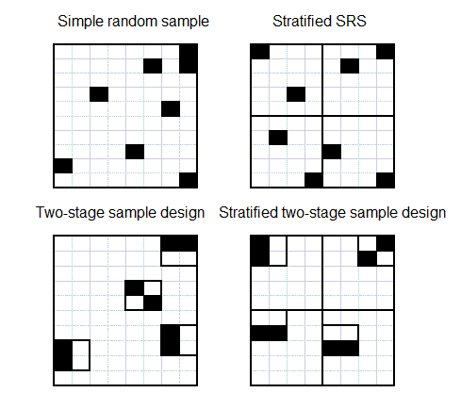
1. Sampling variance
Sample design

Slide 35
1. Sampling variance
Weighting
3 basic steps in weighting:
  Probability weighting
  Adjustment to unit non-response
  Calibration
Increase variance
Decreases variance

Slide 36
1. Sampling variance
Imputation
Imputation
  Item non-response
  Different methods (random, non-random)
  Special case: micro simulation studies
Neglect leads usually to under-estimation of variance
Easiest for researchers: multiple imputation
Notes:
Under-estimation due to extra source of random error and over-estimation of the number of respondents

Slide 37
1. Sampling variance
Statistic of interest
Most common:
  Mean; total; proportion; ratio; regression coefficient; ...
More complex:
  When measure is based on sample estimate: e.g. % of population with income below 60% of the median income in the sample
  Non-smooth inequality measures
  …
  Solution for many estimates: DASP (Araar and Duclos, 2007)
Notes:
Under estimation due to extra source of random error and over-estimation of the number of respondents

Slide 38
1. Sampling variance
So, 4 big determinants:
  Sample design
  Weighting
  Imputation
  Characteristics of statistic of interest
=> whichever approach to variance estimation (linearisation, bootstrap, regression-based, …) the 4 determinants should be taken into account by ‘replicating’ as closely as possible all steps from drawing the sample until calculating the statistic of interest

Slide 39
Overview
The 4 big determinants of sampling variance
The ultimate cluster method
Analysing subpopulations
Comparing point estimates
Conclusion

Slide 40
(2. Ultimate cluster method)
Only take account of the first stage of the sample design (stratification and clustering)
Assume there is no subsampling within PSUs
Assume sampling with replacement

Slide 41
(2. Ultimate cluster method)
Why: ease of computation
Second and subsequent stages add little variance if sampled fraction of PSUs is small
(which is often the case – but not always in EU-SILC, still an issue for further research)

Slide 42
(2. Ultimate cluster method)
Need of good sample design variables to:
Identify PSUs
Identify Primary strata
Take account of calibration (post-stratification, raking)
More details in:
Goedemé, T. (2013), The EU-SILC Sample Design Variables, CSB Working Paper No. 13/02, Antwerp: CSB.

Slide 43
(2. Ultimate cluster method)
Strata with one PSU:
  One of many PSUs selected (with respondents) -> join similar strata (on sampling frame)
  Self-representing PSU? -> PSU is stratum, use next stage of sample design as PSUs

Slide 44
(2. Ultimate cluster method)
Remarks:
Sample design variables should refer to moment of selection (not interview)
PSU codes must at least be unique within strata
Panels: use consistent PSU and strata codes
Degrees of freedom: #PSUs-#Strata

Slide 45
(2. Ultimate cluster method)
In Stata
use sample design variables to identify the sample design
svyset PSU [pweight = weight], strata(strata)
Subsequently: svy: commands
SPSS: CSPLAN & Complex sample commands
R: survey package (svydesign and other commands)
SAS: PROC SURVEYFREQ and others

Slide 46
Overview
The 4 big determinants of sampling variance
(The ultimate cluster method)
Analysing subpopulations
Comparing point estimates
Conclusion

Slide 47
3. Subpopulations
Various types of subpopulations, which may be differently distributed across Strata and PSUs
Size of subpopulation in sample may be random, not fixed (except if stratum) => additional source of random error!

Slide 48
3. Subpopulations
DFs = #PSU(in stratum with n obs>=1) - #Strata(with n obs>=1)
Reliability of estimates depends on number of observations AND how they are distributed across PSUs
If variance within subsample is small, SE of small subpopulation is not necessarily very large

Slide 49
3. Subpopulations
Conclusion:
-> sample size extra source of random error!
-> always check both the number of observations AND the number of PSUs with observations
-> never drop cases from sample
Instead:
Create indicator variable
Use the svy, subpop option (Stata)
Use ‘domain’ option in SAS

Slide 50
Overview
The 4 big determinants of sampling variance
The ultimate cluster method
Analysing subpopulations
Comparing point estimates
Conclusion

Slide 51
4. Comparing point estimates
Usual approach: check whether confidence intervals overlap
Problem: overly conservative when samples are independent
May be completely wrong when samples are dependent

Slide 52
4. Comparing point estimates
Variance of the difference of two averages:
  VAR(a-b) = VAR(a) + VAR(b) – 2*COVAR(a,b)
COVAR can be positive or negative!
COVAR = 0 when samples are independent

Slide 53
4. Comparing point estimates
  Independent samples: COVAR ==0; However:
  (VARa-b)^0.5 = (VARa + VARb – 2*0)^0.5
  < (VARa)^0.5 + (VARb)^0.5
  Do not simply compare confidence intervals!

Slide 54
4. Comparing point estimates
Dependent samples
  Overlapping subpopulations (e.g. micro simulation)
  Subpopulations which may be part of the same PSUs (e.g. Age groups in household surveys)
  Comparisons over time with (rotational) panel data
  Comparisons over time with cross-sectional data with fixed PSUs
  Dependence induced by type of indicator (e.g. Household income)

Slide 55
4. Comparing point estimates
Independent samples
  Completely different surveys
  When (sub)populations belong to different strata
In Stata: post-estimation commands lincom (linear combinations) nlcom (non-linear estimations, e.g. ratios)

Slide 56
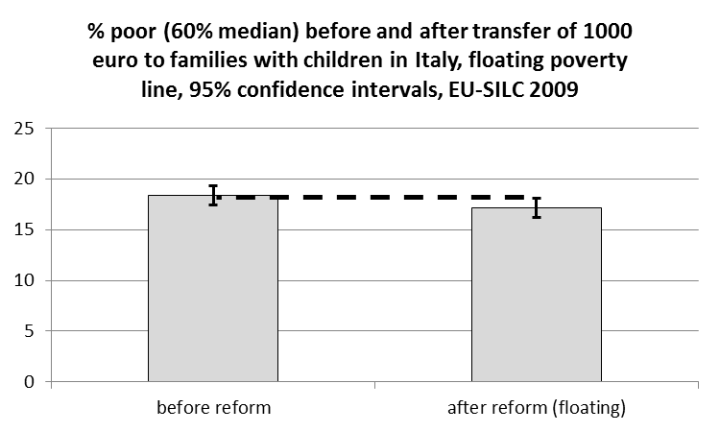
Comparing point estimates
Difference = 1.2pp
Standard error independence = 0.68
Standard error dependence = 0.15

Slide 57
4. Approaches
Notes:
Point: 5,74%
Full / persons = 2,47
Full / households = 1,53
CI-arm:
Persons: 0,4
Households: 0,7
Full: 1,02

Slide 58
Key Messages
If estimates are based on samples -> estimate and report SEs CIs
Always take as much as possible account of sample design when estimating SEs and CIs
Never delete observations from the dataset
Never simply compare confidence intervals

Slide 59
Part 5: non-sampling errors
Employment, earnings and poverty
Lohmann, H. (2011), 'Comparability of EU-SILC survey and register data: The relationship among employment, earnings and poverty' in Journal of European Social Policy, 21(1): 37-54. doi: 10.1177/0958928710385734.

Slide 60
Non-sampling errors: Lohmann
How does the relationship among employment, earnings and poverty change when different data collection approaches are used?
Difference between ‘being employed’ & ‘receiving earnings’?
EU-SILC
Approaches to data collection
register vs survey data
personal vs proxy interviews

Slide 61
Non-sampling errors
Register data:
  Usually better captures small income components (e.g. part-time workers)
  But lacks non-taxed income
  Problem of tax evasion
Survey data
  Recollection errors
  Over-reporting at bottom, under-reporting at the top?
  Potential to capture informal incomes
Proxy interviews
  Unable (sick, language, work,…) or unwilling to reply => important information, but bias!
  Random selection rule to lower costs => less bias

Slide 62
Non-sampling errors
Adapted from Glaser et al., 2015: 24

Slide 63
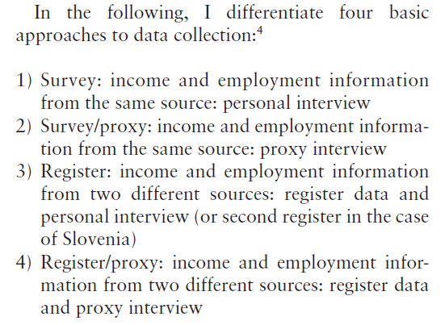
Approaches to data collection in EU-SILC

Slide 64
Definitions of working
Having worked at least 1 month in income reference period (main activity)
At least one euro cash income from employment

Slide 65
Register data more comprehensive
Note: Persons with earnings from self-employment excluded.
Source: adapted from Lohmann, 2011: 42

Slide 66
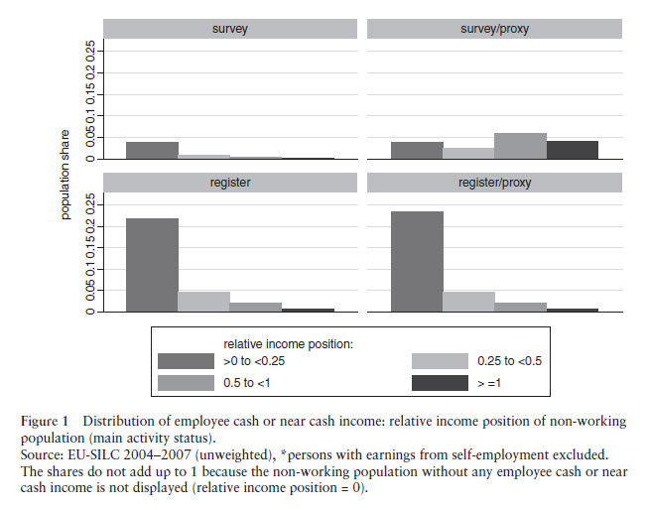
With impact on level of income
Notes:
Surfey/proxy: results driven by UK, without UK same pattern as ‘survey’.

Slide 67
Lohmann, conclusions
A limited overlap between employment and income information affects poverty measures of the working and non-working population when register or proxy information is used.
It is not unlikely that other factors that have nothing to do with data collection methods influence the differences between poverty measures using different definitions of ‘working’
The extent to which working lowers the poverty risk depends on the data collection approach used.
Other features of data collection may matter as well.

Slide 68
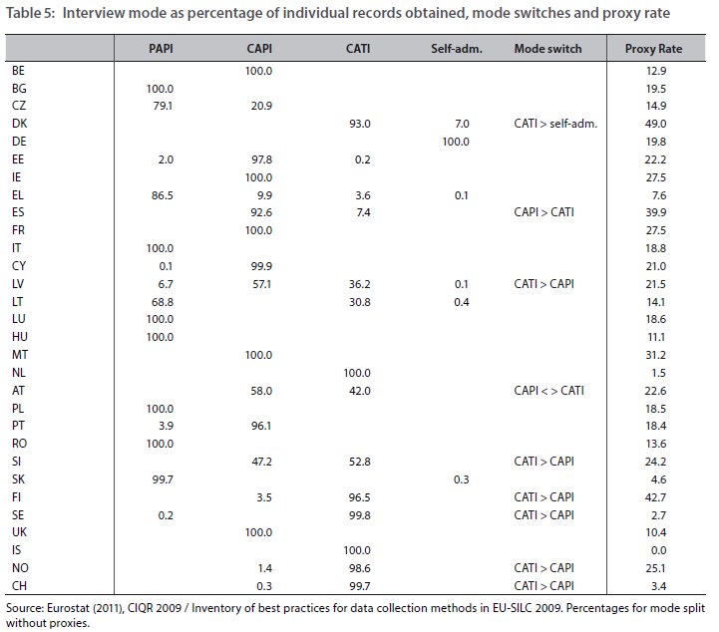
Glaser et al., 2015: 24

Slide 69
Discussion
In which respects does a different sample design not necessarily adversely affect comparability?

Slide 70
Some points to remember
Do indicators really measure what they try to measure?
Measurement error is everywhere
Most samples are complex, and this affect the sampling variance
Never simply check whether confidence overlap or not to assess statistical significance
Both sampling errors and non-sampling errors may matter a great deal

Slide 71
References
Atkinson, A. B., Cantillon, B., Marlier, E., and Nolan, B. (2002), Social Indicators: the EU and Social Inclusion, Oxford: Oxford University Press, 240p. Chapter 2 [compulsory]
Glaser, T., Kafka, E., Lamei, N., Lyberg, L., and Till, M. (2015), European Comparability and National Best Practices of EU-SILC: A Review of Data Collection and Coherence of the Longitudinal Component, NetSILC 2, Working Paper 5/2015, Vienna: Statistics Austria.
Goedemé, T. (2013) ‘How much confidence can we have in EU-SILC?’, Social indicators research, 110(1): 89-110, doi:10.1007/s11205-011-9918-2 [background]
Groves, R. M., Fowler, F. J. J., Couper, M. P., Lepkowski, J. M., Singer, E., and Tourangeau, R. (2009), Survey Methodology (Second edition), New Jersey: John Wiley & Sons, 461p. Chapter 2 [compulsory]
Heeringa, S. G., West, B. T. and Berglund, P. A. (2010), Applied Survey Data Analysis, Boca Raton: Chapman & Hall/CRC, 467p.
Lohmann, H. (2011), 'Comparability of EU-SILC survey and register data: The relationship among employment, earnings and poverty' in Journal of European Social Policy, 21(1): 37-54. doi: 10.1177/0958928710385734. [Background]
Wolter, K. M. (2007), Introduction to Variance Estimation, New York: Springer, 447p.

