Slide 1
Maatschappij, Beleid en Evaluatie
Tim Goedemé
tim.goedeme@uantwerpen.be
Les 3 – 13/10/2015
Notes:
Start met namen te vragen + vragen of er nog onduidelijkheden waren bij vorige les / te kennen leerstof.

Slide 2
Lecture 3
The objectives of public policy & the welfare state
Sets of objectives
Public policy and objectives
Conflicting objectives? The equity vs. efficiency debate
Discussion: what objectives for the welfare state in the 21st century?

Slide 3
Main questions
Which objectives of the welfare state are also reflected in central documents describing the rights of Belgian citizens?
Can these rights offer concrete guidance for evaluating public policies?
Which important trade-offs may exist between important objectives? Which mechanisms are at play when assessing the equity-efficiency trade-off?
What should be the objectives of the welfare state in the 21st century? What kind of growth do you want? What could the capability approach contribute to the debate?

Slide 4
Background texts
Barr, N. (2012), Economics of the welfare state, Oxford: Oxford University Press, Chapter 1, p. 3-21 [Compulsory]
Voitchovsky, S. (2009), 'Inequality and economic growth', in Salverda, W., Nolan, B. and Smeeding, T. M. (eds.), The Oxford Handbook of Economic Inequality, Oxford: Oxford University Press, pp. 549-574. [Compulsory]
Donnelly, J. (2011), 'The social construction of international human rights' in Relaciones Internacionales, 17: 1-30. [background]
Alkire, S. (2002), 'Dimensions of Human Development' in World Development, 30(2): 181-205. [background]

Slide 5
Part 1: Sets of objectives
Two perspectives (here):
Philosophical
Constitutional
Putting it together, a canon of objectives

Slide 6
Philosophical
Libertarianism:
  Law and order (internal & external)
  Functioning free markets
  (Some poverty relief)
Utilitarianism: maximise utility
Liberal egalitarianism
  Basic freedoms
  Equal opportunities & support ‘equal’ outcomes

Slide 7
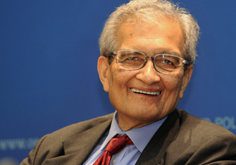
Critique of Amartya Sen
We do not just care about utility, freedom, or equality (example poor, distressed, disabled)
We care about all these things, we do not necessarily have to choose
The fundamental goal is broadening the substantive freedoms people have to live the lives they have reason to value, their capabilities

Slide 8
Sen: means and ends of development
Capabilities: set of functionings from which people can choose (depending on rights, opportunities and entitlements that people have)
Functionings: the things people are or do
Development as a process of expanding the real freedoms that people enjoy
Expanding freedom as primary end (constitutive role); and principal means of development (instrumental role)
Freedom of one type may greatly help in advancing freedom of other types

Slide 9
Sen: means and ends of development
Examples of instrumental freedoms:
  Political freedoms
  Economic facilities
  Social opportunities
  Transparency guarantees
  Protective security

Slide 10
A ‘rights’ perspective
Philosophically & ideologically derived objectives are part of political struggles
Some objectives have become part of general ‘consensus’, either because considered constraints, or as established ‘rights’
Throughout 20th century gradual extension of political, economic and social rights, for which states are held accountable

Slide 11
A ‘rights’ perspective
Here, three levels considered:
International
European
National (Constitutional)

Slide 12
International ‘rights’
Until WWII, human rights were not an issue in international diplomacy
Development of a global human rights regime that significantly shapes the behaviour of states (Donnelly, 2011)
Ambiguous position of social rights: some have been interpreted positively, but mainly broad goals

Slide 13
International ‘rights’
10 December 1948: Universal Declaration of Human Rights
decisive step in codifying the emerging view that the way in which states treat their own citizens is not only a legitimate international concern but subject to international standards
December 1966 (open for ratification):
  The International Covenant on Economic, Social and Cultural Rights
  The International Covenant on Civil and Political Rights

Slide 14
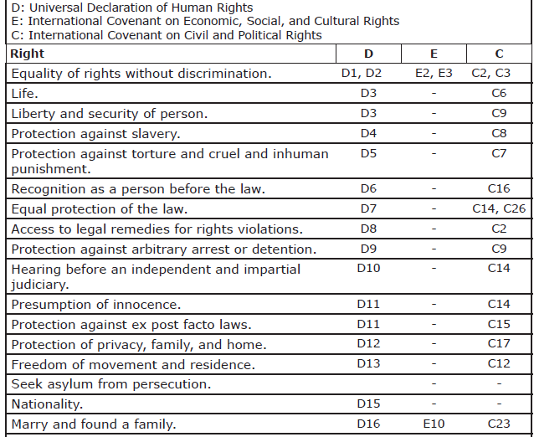
International ‘rights’

Slide 15

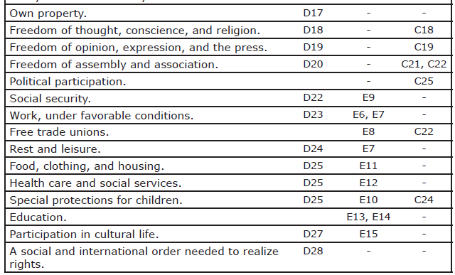
International ‘rights’

Slide 16
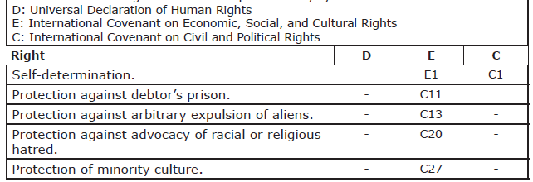
International ‘rights’
Source: Donnelly, 2011: 5-6

Slide 17
International ‘rights’
Further steps:
Convention on the Elimination of All Forms of Discrimination Against Women (1979)
Convention Against Torture and Other Cruel Inhuman or Degrading Treatment or Punishment (1984)
Convention on the Rights of the Child (1989)
End of Cold War: human rights in foreign policy
1993: High-Commissioner for Human Rights
Legal right to armed intervention against genocide
2002: International Criminal Court
http://www.ohchr.org/EN/ProfessionalInterest/Pages/CoreInstruments.aspx.

Slide 18
International ‘rights’
Sometimes very concrete, positive objectives for state policies, e.g. (Disabilities)
Article 19 - Living independently and being included in the community
[…] ensuring that:
[…] Persons with disabilities have access to a range of in-home, residential and other community support services, including personal assistance necessary to support living and inclusion in the community, and to prevent isolation or segregation from the community;

Slide 19
International ‘rights’
These rights are:
  Universal (entitlement because one is human)
  Equal (for all humans)
  Inalienable (cannot be taken away)
Although held equally by all human beings, these rights are held with respect to, and exercised against, the sovereign territorial state.

Slide 20
International ‘rights’
To respect, to protect, to fulfil:
The obligation to respect: States must refrain from interfering with or curtailing the enjoyment of human rights.
The obligation to protect: States must protect individuals and groups against human rights abuses.
The obligation to fulfil: States must take positive action to facilitate the enjoyment of basic human rights.

Slide 21
International ‘rights’
“The practical heart of the human right to social security is the obligation of the state to assure that some system of provision is in place that gives everyone a reasonable guarantee of social security.” (Donnelley, 2013: 37)
“Nonetheless, the state has primary and ultimate responsibility for implementing an effective system of universal (national) provision. “ (Donnelley, 2013: 38)
‘Progressive realisation’ (Article 2 ICESCR)
“Each State Party to the present Covenant undertakes to take steps […] to the maximum of its available resources, with a view to achieving progressively the full realization of the rights recognized in the present Covenant by all appropriate means, including particularly the adoption of legislative measures.”
Human rights norms fully internationalised, but implementation and enforcement nearly completely national

Slide 22
European rights
European Convention on Human Rights (1953)
  Council of Europe
  European Court of Human Rights (ECHR)
European Social Charter (1961; 1996)
  Council of Europe
  European Committee of Social Rights
Charter of Fundamental Rights of the European Union (2009)
  Court of Justice of the European Union (CJEU)

Slide 23
European rights
Treaty on the functioning of the European Union (2009)
  Article 9 “Horizontal Social Clause”
“In defining and implementing its policies and activities, the Union shall take into account requirements linked to the promotion of a high level of employment, the guarantee of adequate social protection, the fight against social exclusion, and a high level of education, training and protection of human health.”
Until now, no real bite?

Slide 24
Constitution of Belgium
Titel Ibis (Artikel 7bis GW):
“Bij de uitoefening van hun respectieve bevoegdheden streven de federale Staat, de gemeenschappen en de gewesten de doelstellingen na van een duurzame ontwikkeling in haar sociale, economische en milieu-gebonden aspecten, rekening houdend met de solidariteit tussen de generaties.”
(25 april 2007)

Slide 25
Constitution of Belgium
Sustainable development:
“Sustainable development is development that meets the needs of the present without compromising the ability of future generations to meet their own needs”
(World Commission on Environment and Development, 1987)

Slide 26
Constitution of Belgium
Artikel 23:
Ieder heeft het recht een menswaardig leven te leiden.
Daartoe waarborgen de wet, het decreet of de in artikel 134 bedoelde regel, rekening houdend met de overeenkomstige plichten, de economische, sociale en culturele rechten, waarvan ze de voorwaarden voor de uitoefening bepalen.
Die rechten omvatten inzonderheid :
1° het recht op arbeid en op de vrije keuze van beroepsarbeid in het raam van een algemeen werkgelegenheidsbeleid dat onder meer gericht is op het waarborgen van een zo hoog en stabiel mogelijk werkgelegenheidspeil, het recht op billijke arbeidsvoorwaarden en een billijke beloning, alsmede het recht op informatie, overleg en collectief onderhandelen;
2° het recht op sociale zekerheid, bescherming van de gezondheid en sociale, geneeskundige en juridische bijstand;
3° het recht op een behoorlijke huisvesting;
4° het recht op de bescherming van een gezond leefmilieu;
5° het recht op culturele en maatschappelijke ontplooiing;
6° het recht op gezinsbijslagen.

Slide 27
Assignment
Read:
  Universal Declaration of Human Rights
  Charter of Fundamental Rights of the European Union
  Belgian constitution (in particular ‘Title I, Title 1bis & Title II)

Slide 28
Objectives of the welfare state
Nicholas Barr (2012)
Efficiency
Equity
Administrative feasibility

Slide 29
Objectives of the welfare state
Nicholas Barr (2012)
Efficiency:
Macro-efficiency
Micro-efficiency
Consumption-smoothing (piggy-bank)
Risk sharing (piggy-bank)
Incentives
Allocative / external efficiency (quantity, quality and mix)

Slide 30
Objectives of the welfare state
Nicholas Barr (2012)
Equity:
Relieving poverty (Robin Hood function)
Reducing inequality
  Vertical equity
  Horizontal equity
Addressing social exclusion
Social solidarity
Dignity (and stigma)

Slide 31
Objectives of the welfare state
Nicholas Barr (2012)
Administrative feasibility
Intelligibility
Absence of abuse

Slide 32
Objectives of the welfare state
Nicholas Barr (2012)
Discuss: Once objectives are set, decision on instruments should be a technical matter

Slide 33
Part 2: Public Policy and objectives
Objectives should guide action
Problematic ends (Rein, 2006):
  Conflicting aims
  Ambiguity and vagueness
  Abstract ends
  Unwanted precarious ends
  Unattainable ends
  Missing ends

Slide 34
Crucial questions
What is the public good / ‘public interest’? [Bart DW 02:30]
  Who is taken into account (voters, current generation, future, …?)
  Which interests are taken on board?
  What is the time horizon?
Who gains, who loses?

Slide 35
Public Policy: definition
Who gains, who loses?

Slide 36
Crucial questions
What is the public good?
Who gains, who loses?
What is the purpose / objective?
  The direct purpose
  The underlying purpose
  The ultimate purpose
  How does the current measure relate to this?

Slide 37
Public Policy: definition
Why? What for?

Slide 38
Part 3: Trade-offs
Different values and objectives may not be fully compatible
[Three approaches for coping with value conflicts (Rein, 2006):
  Casuistry (precedents)
  Cycling (alternating between values)
  Separation (institutional structures for each value)]

Slide 39
Potential conflicts between objectives
Efficiency vs. equity (distributional objectives)
Horizontal equity vs. administrative simplicity
Consumption smoothing & reciprocity vs. vertical equity & social solidarity
Vertical equity vs. dignity
Need satisfaction current and future populations (ageing, environmental impact)

Slide 40
Inequality vs. Growth?
‘equity vs. efficiency’ = long-standing debate
Complex argument
Main conclusions:
  different types of inequality have different effects
  Especially inequality in the bottom half has a negative effect on growth
  Redistribution is on average pro-growth
  but more research and better data are required

Slide 41
Inequality vs. Growth?
Increased attention to inequality, also by OECD and IMF:
Ostry, J. D., Berg, A., and Tsangarides, C. G. (2014), Redistribution, Inequality, and Growth, IMF Staff Discussion Notes No. 14/2, Washington, D.C.: International Monetary Fund, 30p.
Cingano, F. (2014), Trends in Income Inequality and its Impact on Economic Growth, OECD Social, Employment and Migration Working Papers, No. 163, Paris: OECD, 64p.

Slide 42
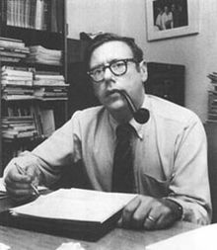
Inequality vs. Growth?
Early point of view: Arthur Okun ‘leaky bucket’ effect when transferring income from rich to poor:
Administrative loss + redistribution:
reduces incentives at the bottom (means tests)
reduces incentives at the top (high marginal tax rates) + tax avoidance
=> Redistribution is appropriate, but inefficient and may hamper growth

Slide 43
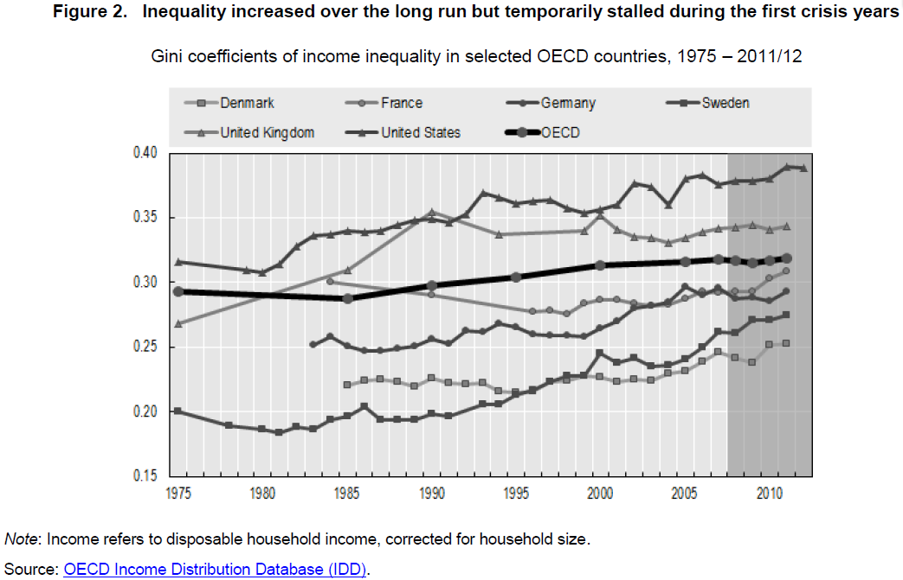
Source: Cingano, 2014: 10

Slide 44
Inequality vs. Growth?
Mechanisms (Voitchovsky, 2009):
  Effects of different behaviour of different income groups
  Effects of distance between groups on interaction between these groups

Slide 45
Inequality vs. Growth?
Effects of specific groups: Poverty
Credit constraints (poverty trap), and lack of investment in education / human capital
Low rates of return for effort, lower productivity of the poor
Property crime: when return from crime is higher than return from legal activities or investment in education
Fertility (low opportunity cost of children, child’s prospective labour earnings, lack of old-age insurance)
Effects of specific groups: The middle class
The median voter mechanism, taxation & redistribution (median vs. average income)
The size of domestic demand for manufactured goods

Slide 46
Inequality vs. Growth?
Effects of specific groups: The rich
Savings and investment
The trickle-down process
Lobbying, corruption, and misallocation of resources (rent-seeking of the rich)

Slide 47
Inequality vs. Growth?
Effects of overall inequality
Trust and social capital (smooth economy, institutions, investment in health and education)
Polarisation, unrest, and social conflicts (increase in production costs)
Macroeconomic volatility (policy coordination failure) and shock management

Slide 48
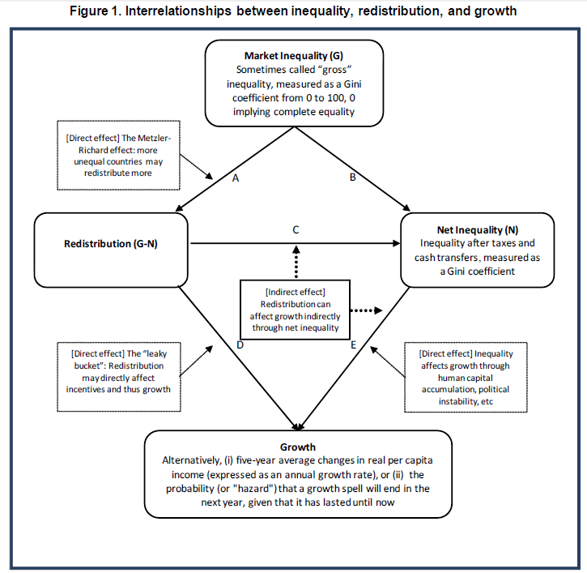
Source: Ostry et al., 2014: 9

Slide 49
Preliminary conclusion
OECD study (2014):
  Inequality has a negative impact on economic growth (over past 30 years in OECD countries)
  Impact is in particular result of distance between low incomes and rest of population (not at the top)
  Increased inequality depresses skills development among individuals with poorer parental education background (not among rich)
  It follows that policies to reduce income inequalities should not only be pursued to improve social outcomes but also to sustain long-term growth

Slide 50
Preliminary conclusion
IMF study (2014) (broad country coverage):
  more unequal societies tend to redistribute more. (distinguish between market and net inequality)
  lower net inequality is robustly correlated with faster and more durable growth, for a given level of redistribution
  redistribution appears generally benign in terms of its impact on growth; only in extreme cases is there some evidence that it may have direct negative effects on growth.
Both studies agree: the types of policies & redistribution matter

Slide 51
Inequality vs. Growth?
Pitfall of instrumental look at inequality:
  what if future research shows that inequality is not beneficial for growth?

Slide 52
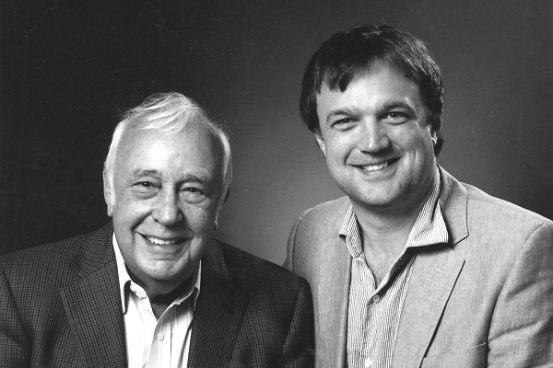
Part 4: Which objectives for the welfare state in the 21st century?
Skidelsky, R., and Skidelsky, E. (2012), How much is enough? Money and the good life, New York: Other Press, 243p.
Alkire, S. (2002), 'Dimensions of Human Development' in World Development, 30(2): 181-205.

Slide 53
Keynes: Economic possibilities for our grandchildren (1930)
“If capital increases, say, 2 per cent per annum, the capital equipment of the world will have increased by a half in twenty years, and seven and a half times in a hundred years. Think of this in terms of material things—houses, transport, and the like”
“In quite a few years-in our own lifetimes I mean-we may be able to perform all the operations of agriculture, mining, and manufacture with a quarter of the human effort to which we have been accustomed”
“I would predict that the standard of life in progressive countries one hundred years hence will be between four and eight times as high as it is.”
“the economic problem may be solved, or be at least within sight of solution, within a hundred years. This means that the economic problem is not-if we look into the future-the permanent problem of the human race. “

Slide 54
Keynes: Economic possibilities for our grandchildren (1930)
“If the economic problem is solved, mankind will be deprived of its traditional purpose.”
“Thus for the first time since his creation man will be faced with his real, his permanent problem how to use his freedom from pressing economic cares, how to occupy the leisure, which science and compound interest will have won for him, to live wisely and agreeably and well.”
“Three-hour shifts or a fifteen-hour week may put off the problem for a great while. For three hours a day is quite enough to satisfy the old Adam in most of us!”

Slide 55
Keynes: Economic possibilities for our grandchildren (1930)
“The pace at which we can reach our destination of economic bliss will be governed by four things:
  our power to control population,
  our determination to avoid wars and civil dissensions,
  our willingness to entrust to science the direction of those matters which are properly the concern of science, and
  the rate of accumulation as fixed by the margin between our production and our consumption.”
“Meanwhile there will be no harm in making mild preparations for our destiny, in encouraging, and experimenting in, the arts of life as well as the activities of purpose.”

Slide 56
The Maddison-Project, http://www.ggdc.net/maddison/maddison-project/home.htm, 2013 version.
Bolt, J. and J. L. van Zanden (2014). The Maddison Project: collaborative research on historical national accounts. The Economic History Review, 67 (3): 627–651.

Slide 57
The Maddison-Project, http://www.ggdc.net/maddison/maddison-project/home.htm, 2013 version.
Bolt, J. and J. L. van Zanden (2014). The Maddison Project: collaborative research on historical national accounts. The Economic History Review, 67 (3): 627–651.

Slide 58
Growth in Belgium
Source: ADSEI, own calculations

Slide 59
Skidelsky & Skidelsky (2012)
Basic goods:
  Universal (belong to the good life as such)
  Final (good in themselves)
  Sui generis (not part of some other good)
  Indispensable (lack = serious loss or harm)

Slide 60
Skidelsky & Skidelsky (2012)
Basic goods:
  Health
  Security
  Respect
  Personality (ability to frame and execute a plan of life reflective of one’s tastes, temperament and conception of the good)
  Harmony with nature
  Friendship
  Leisure (what we do for its own sake)
Non-coercive paternalism

Slide 61
Discussion
What is the good life? Is the list of ‘basic goods’ complete?
Should governments be more explicit about their conception of the good life? Should they more actively promote their conception of the good life?
What role for public policies in realising the good life?
What changes in our moral and economic system would be needed to realise it?
Should governments prepare people for ‘useful leisure’ and better division of labour?

Slide 62
Discussion
What goals for development and public policy the coming 30 years?
List individually top 5 priorities
Discuss in group, make top 10 list
How figures economic growth into this picture?
What about capabilities?

Slide 63
Some points to remember
Many of the objectives justified and promoted by philosophical traditions have received real ‘legal bite’ during the past 70 years
When discussing or evaluating policies, crucial questions include: which idea of the common good, which purpose is served, and who gains-who loses.
Many objectives have received legal backup, through international, and especially European & constitutional agreements
Welfare states & public policy serve a multitude of objectives
Sometimes there are important trade-offs, but, overall, redistribution and equality are benign for economic growth
What kind of growth do you want?

Slide 64
References
Alkire, S. (2002), 'Dimensions of Human Development' in World Development, 30(2): 181-205.
Barr, N. (2012), Economics of the welfare state, Oxford: Oxford University Press.
Cingano, F. (2014), Trends in Income Inequality and its Impact on Economic Growth, OECD Social, Employment and Migration Working Papers, No. 163, Paris: OECD.
De Smedt, P. (2009), 'Duurzame ontwikkeling in de grondwet: codificatie van een ideaal of een nieuw juridisch wapen?' in Oikos, 50(3): 40-45.
Donnelly, J. (2011), 'The social construction of international human rights' in Relaciones Internacionales, 17: 1-30.
Donnelly, J. (2013), Universal Human Rights in Theory and Practice. Third edition, Ithaca and London: Cornell University Press, 320p.
Hartley, D. (2015), Social rights and human welfare, Oxon: Routledge.
Keynes, John Maynard , Essays in Persuasion, New York: W.W.Norton & Co., 1963, pp. 358-373.
Ostry, J. D., Berg, A., and Tsangarides, C. G. (2014), Redistribution, Inequality, and Growth, IMF Staff Discussion Notes No. 14/2, Washington, D.C.: International Monetary Fund.
Rein, M. (2006), 'Reframing problematic policies', in Moran, M., Rein, M. and Goodin, R. E. (eds.), The Oxford Handbook of Public Policy, Oxford: Oxford University Press, pp. 389-405. [Background]
Sen, A. K. (1999), Development as Freedom: Oxford University Press.
Skidelsky, R., and Skidelsky, E. (2012), How much is enough? Money and the good life, New York: Other Press, 243p.
Voitchovsky, S. (2009), 'Inequality and economic growth', in Salverda, W., Nolan, B. and Smeeding, T. M. (eds.), The Oxford Handbook of Economic Inequality, Oxford: Oxford University Press, pp. 549-574.
World Commission on Environment and Development (1987), Our common future, Oxford: Oxford University Press.

