Slide 1
Social Policy in the EU and the Role of the EU
Tim Goedemé, PhD
tim.goedeme@kuleuven.be
tim.goedeme@uantwerpen.be
Lecture 9 – 11/05/2016

Slide 2
Pension policy
Some basics
Why government intervention?
Huge diversity pension system design
Ageing & reforming pensions
(The EU and pension policy)
Conclusion

Slide 3
Pension policy: some basics
Main goals of pension policy:
  Consumption smoothing
  Avoiding poverty in old-age

Slide 4
Pension policy: some basics
With perfect information (certainty) and rational behaviour: Fisher model

Slide 5
Pension policy: some basics
With complete information:
  Insurance is not necessary (no risk)
  Voluntary action using private institutions
  Transient poverty solved by borrowing and/or saving
  Lifetime poor => government intervention

Slide 6
Pension policy: some basics
Consumption smoothing
Problem of production and consumption of goods and services (not money)
Only two ways:
  Storing
  Claim
Notes:
Money is irrelevant unless the output is there for pensioners to buy.
Storing:
Opportunity cost of forgone
Storage costs are high
Impractical
Uncertainty: what to store, what new goods become available, how one taste’s and needs may change
Services cannot be stored
Claim: exchange current consumption for a claim on future production

Slide 7
Pension policy: some basics
Claim:
  Money => Building up financial assets (funding)
  Promise => unfunded / pay-as-you-go (PAYG) schemes
Notes:
Money => Funded schemes
Promise => pay as you go or unfunded schemes

Slide 8
Pension policy: some basics
Funded schemes
  Lump sum v. annuity
  => exchange for goods & services when retired
  Reserves match all outstanding liabilities
  Generation is constrained by own past savings
Notes:
Contributions + interests & dividends
- administrative costs - taxes

Slide 9
Pension policy: some basics
PAYG schemes
  Current contributions of working population
  => contractarian
  Can redistribute across generations (broader risk sharing)
  Especially important in start-up phase, after high inflation (cf. historical developments), or other shocks

Slide 10
Pension policy: some basics
Relation contributions-benefits
  Defined-contribution (DC) plans
    Real rates of return
    Future earnings
    Future pricing of annuities

Slide 11
Pension policy: some basics
Relation contributions-benefits
  Defined-contribution (DC) plans
  Defined-benefit (DB) plans
    Promise
    No direct link between contributions and benefits
    E.g. pension = total gross earnings * 0.6 * 1/45
    Risk => employer / society
  Notional Defined-contribution (NDC) plans

Slide 12
Why government intervention?
First-best economy:
  Perfect competition (price taker, equal power)
  No externalities, no public goods, or increasing returns to scale
    Public good: non-rivalness in consumption, non-excludability, non-rejectability
  Perfect information (of buyers and sellers, about quality, price and future)
  Maximizing behaviour (vs. bounded rationality & bounded will-power)
  Complete markets
  No distortionary taxation (changing behaviour)
Notes:
Bounded rationality: rules of thumb (e.g. mental accounting); framing (informing first about risks then benefits or other way around leads to different decisions); irrational choices (utility gain from gain or loss in assets is different from utility loss)

Slide 13
Why government intervention?
Supply side
  Risk, not certainty
  Risk, not uncertainty
    Asymmetric information: adverse selection (hidden info; cream skimming) & moral hazard (hidden action)
    Known individual risk, not common shock (macroeconomic, demographic, political,…)
Premium = (1 + admin costs and profit) * individual’s probability * expected loss
Notes:
Illustrate first point with excel file: if it is certain that everyone will die at 80, their is no point in setting up an insurance. (see also Barr, 2012: 88ff)
Adverse selection: e.g. not saying you smoke when applying for an ‘outstanding balance insurance’ (schuldsaldoverzekering) when buying a mortgage.
Cream skimming: insurers try to attract (mainly) ‘good risks’
For pensions: people that buy annuities tend to live longer; moral hazard: higher pensions can buy better medical care and preventive measures, increasing longevity => compulsory insurance
Common shock: life expectancy => increases in life expectancy covered by taxpayers / longevity bonds?; similar for inflation
PAYG systems can better cope with inflation than funded schemes (esp. Private schemes). Explain. (p. 161)

Slide 14
Why government intervention?
Demand side
Lifetime poor
Can people make good choices? (cf. Fisher model)
  Premium, retirement age, provider, investment plan, annuitization, …
  Uncertainty (longevity, intrests, inflation, needs, society, …)
  Pension investments require continuous monitoring (and asymmetric information)
  Sizable administrative costs
  Management risk & investment risk

Slide 15
Why government intervention?
Demand side
  Lifetime poor
  Can people make good choices? (cf. Fisher model)
  Behavioural problems
    Bounded rationality
    Bounded will power
Notes:
Bounded rationality => when a problem is too complex to make good decisions, even with good information (esp. When time horizon is long, outcome involves complex probabilities, or details are inherently complex => all case of pension products)
* Framing, familiarity, excessive trading, immobilisation
Bounded will power: short-term gratification; procrastination; inertia (esp. With saving; or starting up life insurance or voluntary savings plan; especially for those already living on low income / consumption) => auto-enrollment; mandatory pension plans

Slide 16
Why government intervention?
Demand side
  Lifetime poor
  Can people make good choices? (cf. Fisher model)
  Behavioural problems
  With high potential cost of mistaken choices or wrong (non-)action
  Regulation and limiting choice
  Compulsory (auto-)enrollment
Notes:
Bounded rationality => when a problem is too complex to make good decisions, even with good information (esp. When time horizon is long, outcome involves complex probabilities, or details are inherently complex => all case of pension products)
* Framing, familiarity, excessive trading, immobilisation
Bounded will power: short-term gratification; procrastination; inertia (esp. With saving; or starting up life insurance or voluntary savings plan) => auto-enrollment; mandatory pension plans

Slide 17
Pension policy
Some basics
Why government intervention?
Huge diversity pension system design
Ageing & reforming pensions
The EU and pension policy
Conclusion

Slide 18
Diversity in pension system design
Aim
Social Risk
Primary aims
Mode of access
Who is protected (category)
Who receives (circumstance / conduct)
Benefit structure
Nature of benefit
Who receives how much
Financing
Governance
Secondary aims
indexation
Who pays how much, under what conditions?
Financing technique
Who are the actors?
What is their role?
Notes:
Retirement / old-age pension
Disability pension
Survivor’s / widow’s orphan’s pension
Early retirement pension
Pre-retirement pension

Slide 19
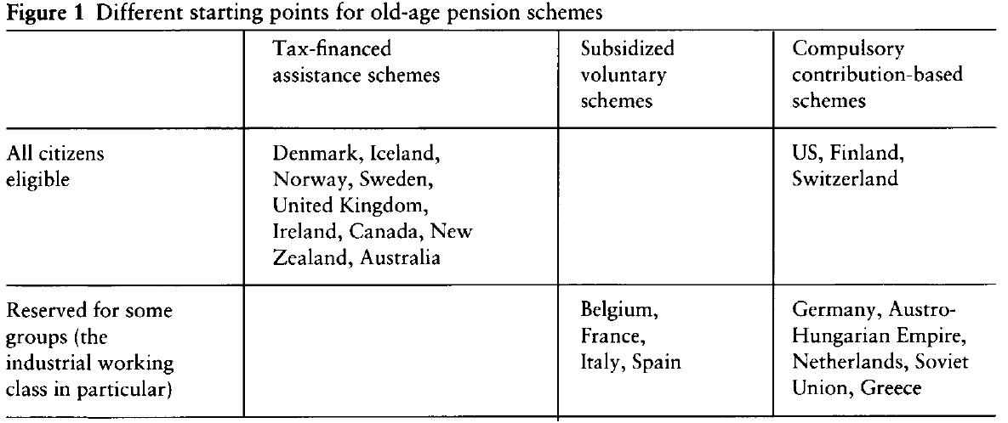
Diversity in pension system design
Overbye, E. (1997), 'Mainstream Pattern, Deviant Cases: the New Zealand and Danish Pension Systems in an International Context' in Journal of European Social Policy, 7(2): 101-117

Slide 20
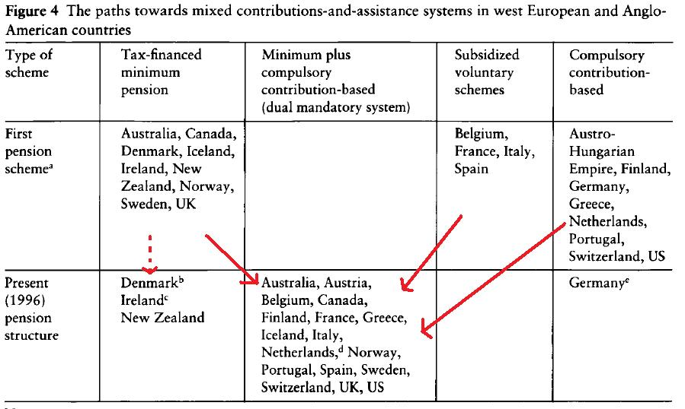
3. Pensions in the EU
Overbye, E. (1997), 'Mainstream Pattern, Deviant Cases: the New Zealand and Danish Pension Systems in an International Context' in Journal of European Social Policy, 7(2): 101-117

Slide 21
Diversity in pension system design
Hybridisation

Slide 22
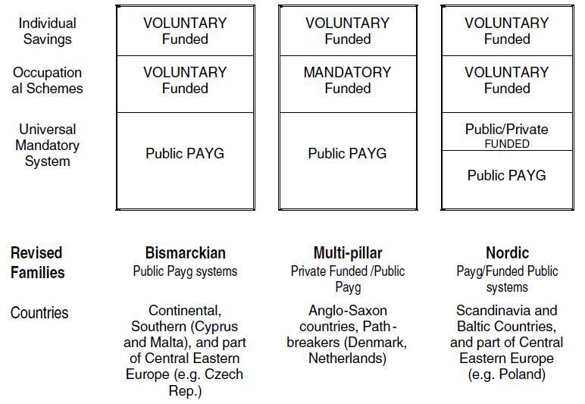
Natali, D. (2004), 'The Hybridisation of Pension Systems Within the Enlarged EU: Recent Reforms in Old and New Members' in Belgisch Tijdschrift voor Sociale Zekerheid (Belgian Review of Social Security), 46(2): 349-374

Slide 23
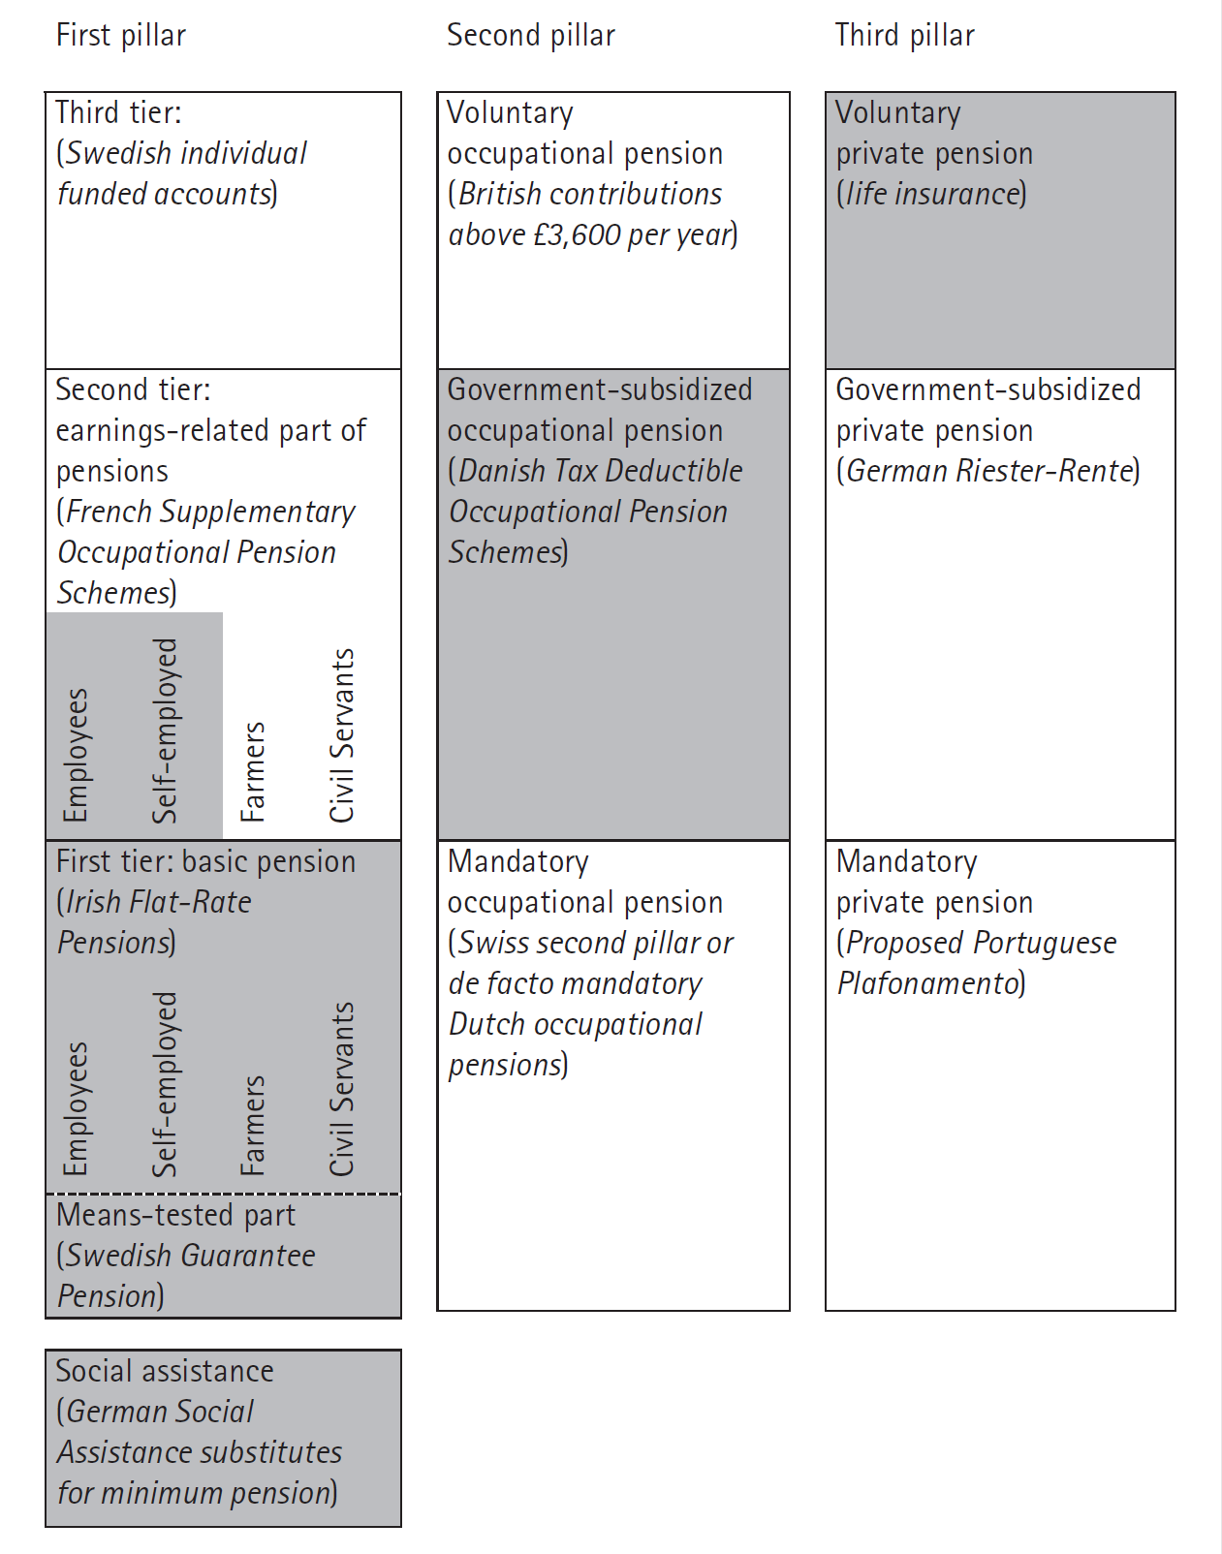
  A classification scheme of pension programmes
  Source: Immergut et al., 2007: 22.
Notes:
First pillar: public sector
Second: occupational sector
Third: individual sector
Tiers: whether
- targeted
- minimum
- flat-rate
- earnings-related
- defined contribution in an individual account
- mandatory // government-subsidised or // voluntary

Slide 24
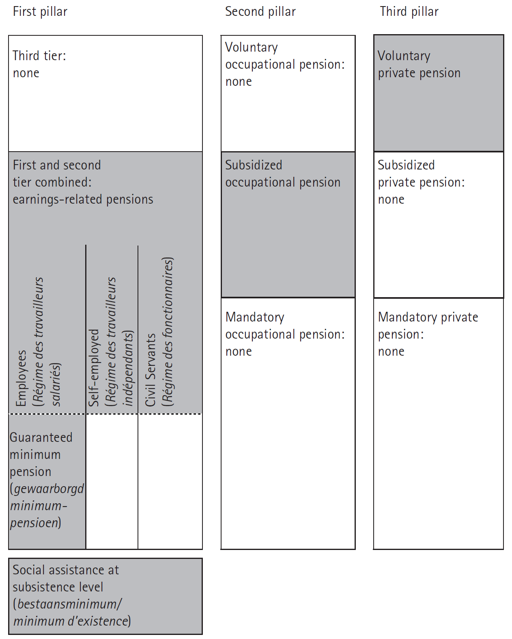
Belgium (mid-2000s)
Anderson et al. (2007: 316)

Slide 25
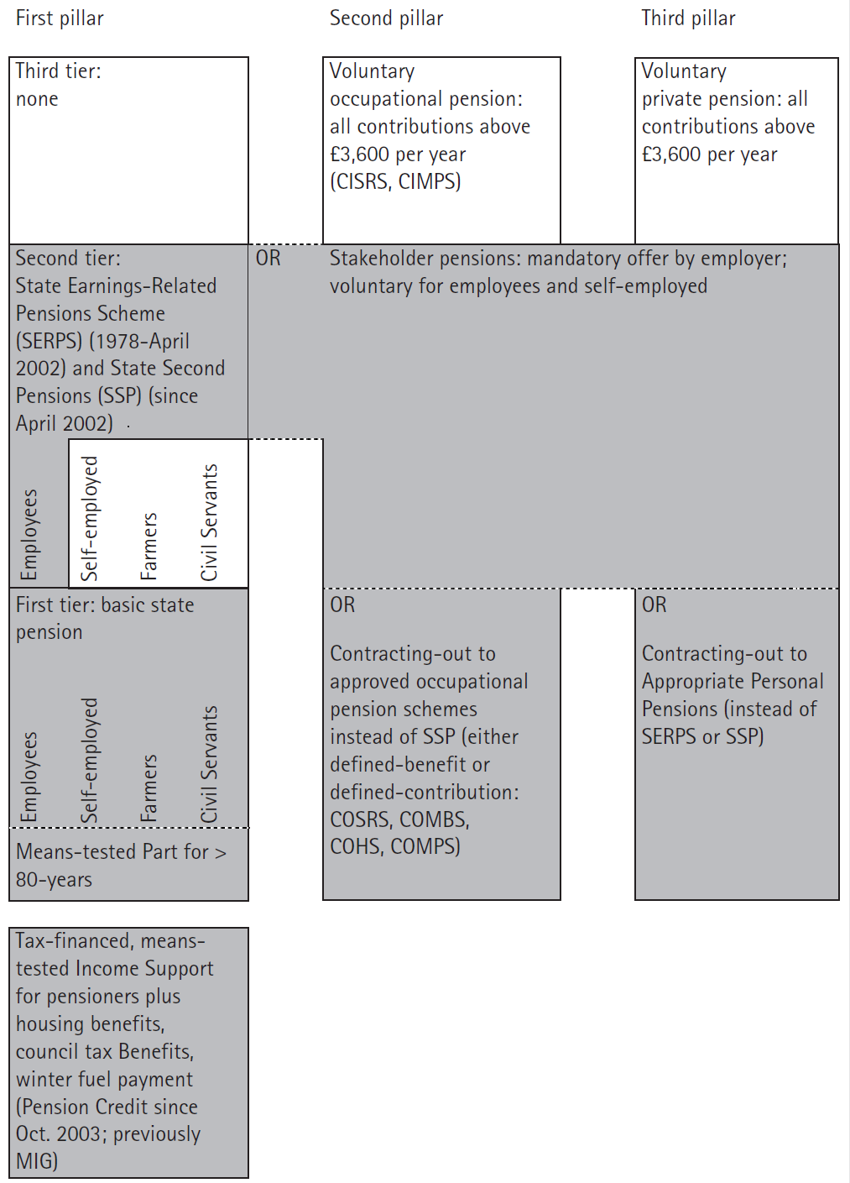
United Kingdom (mid-2000s)
Schulze and Moran (2007: 63)

Slide 26
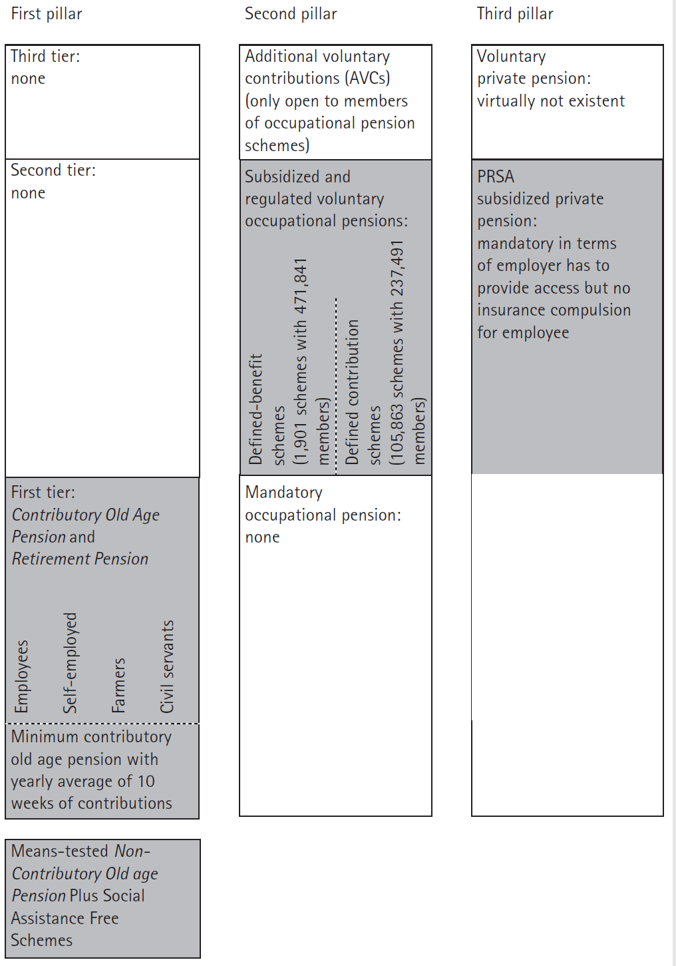
Ireland (mid-2000s)
Schulze and Moran (2007: 772)

Slide 27
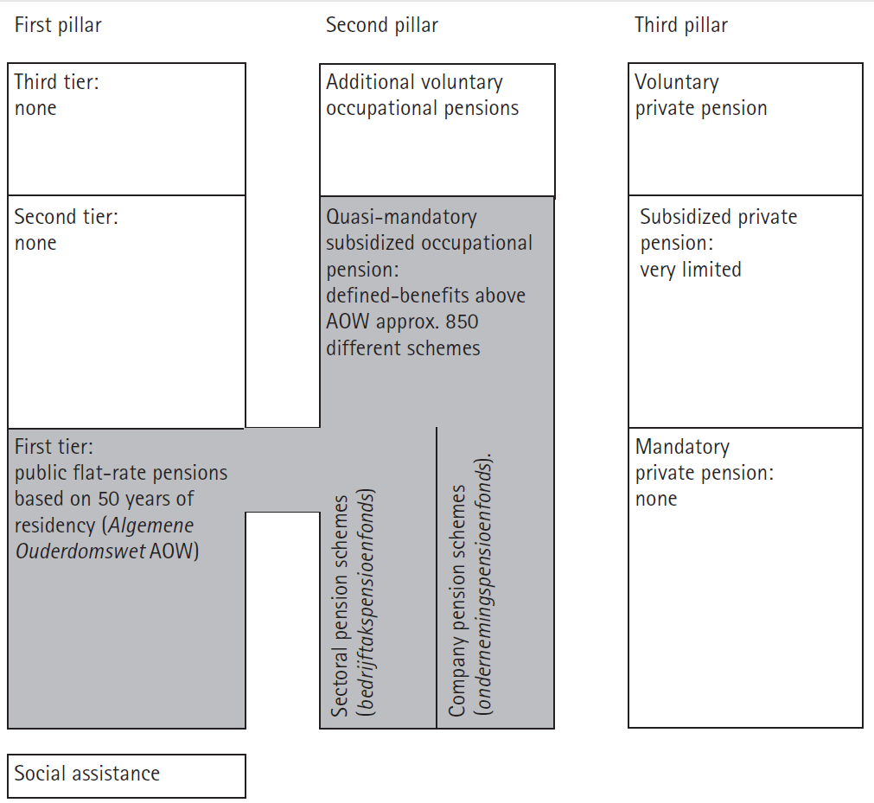
Netherlands(mid-2000s)
Anderson (2007: 727)

Slide 28
Diversity in pension system design
Avoiding old-age poverty is major goal
But also other types of redistribution
Minima more important in future? (E.g. EC, 2010)
  re-strengthening of the link between contributions and benefits
  growing reliance on defined-contribution (private) pensions
  a projected fall in public pension replacement rates
  growing reliance on price indexation of pensions in payment
  improved benefit levels of minimum income guarantees

Slide 29
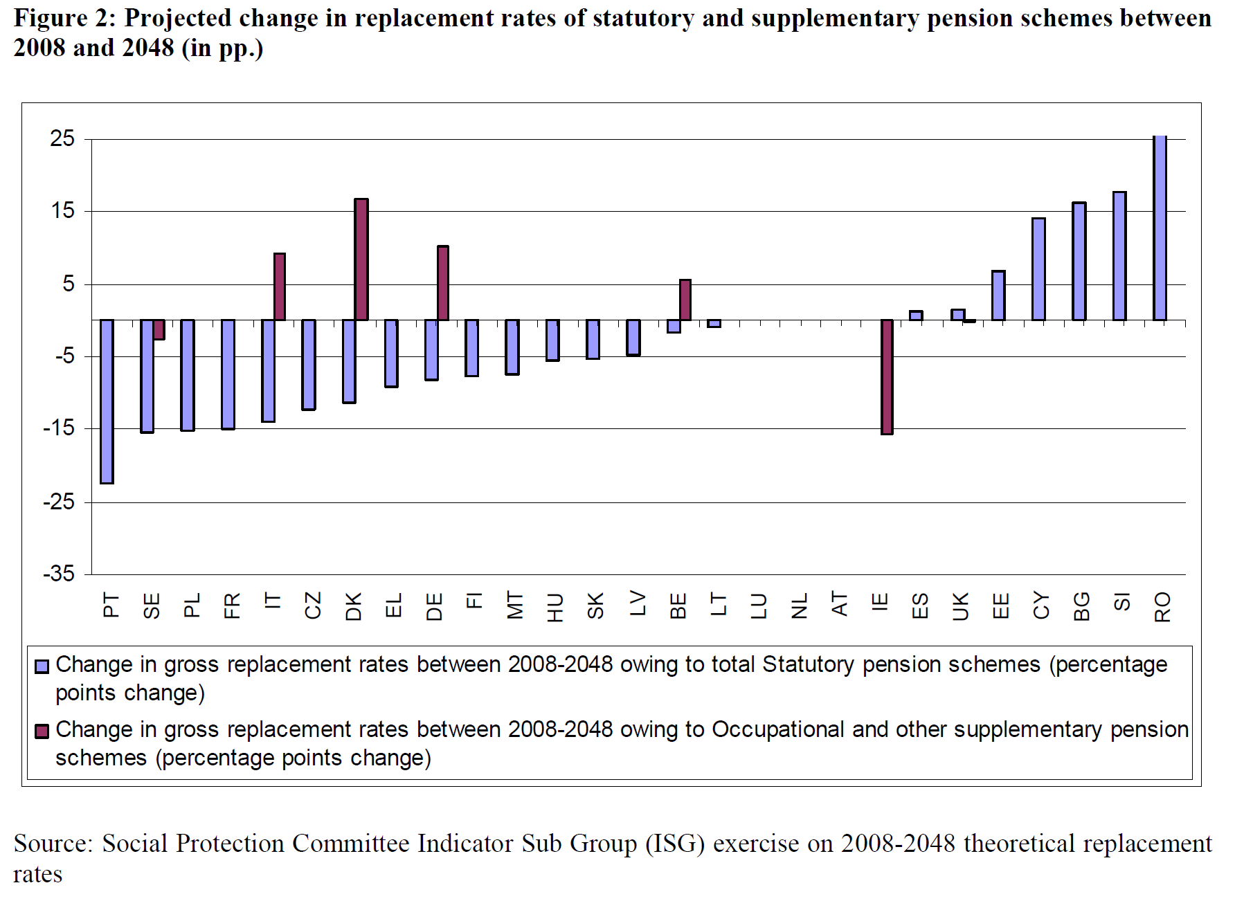
Diversity in pension system design
Source: European Commission, 2012: 5

Slide 30
Diversity in pension system design
Solidarity & redistribution
‘Risk’ pooling
Notes:
Study for UK (2015) found that over half of redistribution is redistribution across the life cycle. Lifetime income inequality is much lower than cross-sectional income inequality. Nonetheless, the tax benefit system is much less effective in reducing lifetime income inequality than inequality in the cross-section. The UK state pension reduces lifetime income inequality. (Levell et al., 2015)

Slide 31
Diversity in pension system design
Source: OECD Health Statistics 2015, http://dx.doi.org/10.1787/health-data-en.
Notes:
Study for UK (2015) found that over half of redistribution is redistribution across the life cycle. Lifetime income inequality is much lower than cross-sectional income inequality. Nonetheless, the tax benefit system is much less effective in reducing lifetime income inequality than inequality in the cross-section. The UK state pension reduces lifetime income inequality. (Levell et al., 2015)

Slide 32
Diversity in pension system design
Source: Source: http://ec.europa.eu/health/dyna/echi/datatool/index.cfm (May 2016)

Slide 33
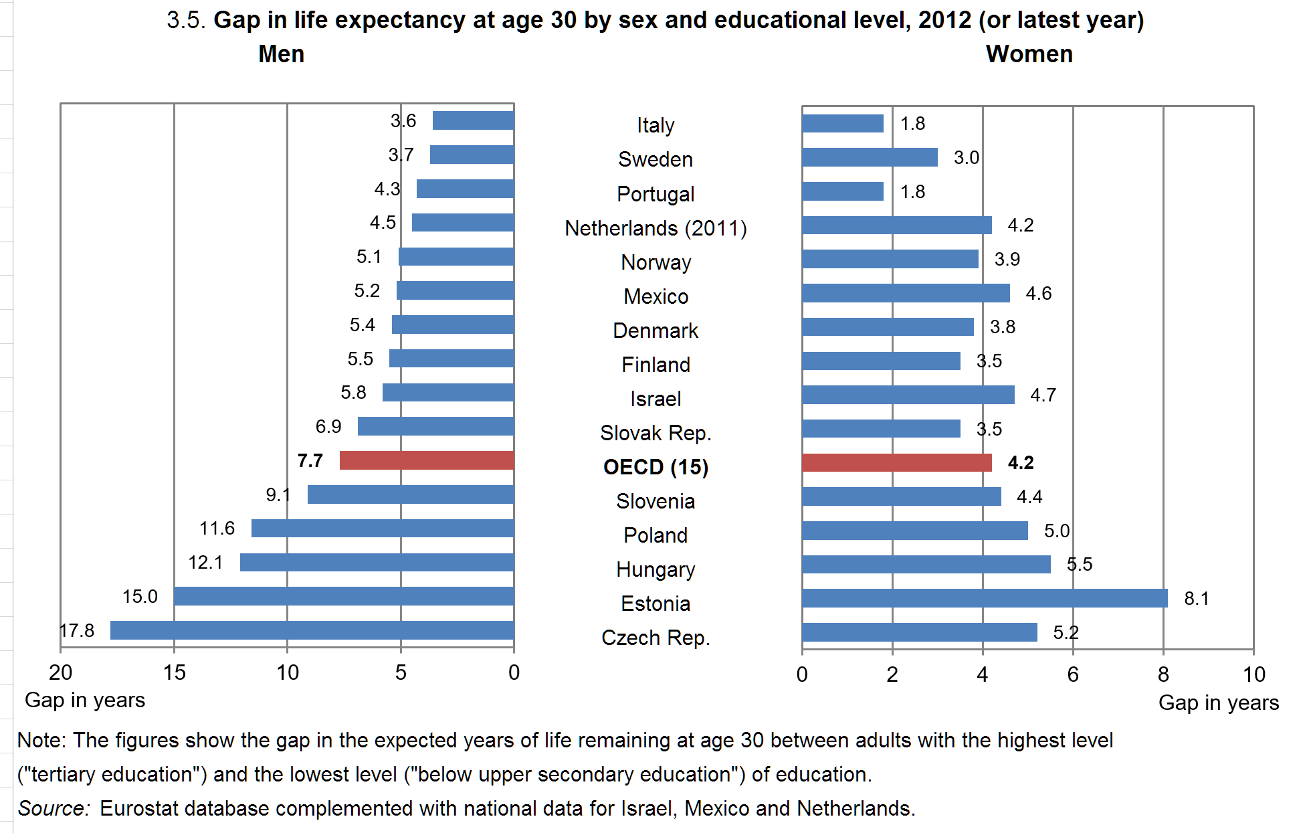
Diversity in pension system design

Slide 34
Diversity in pension system design
Solidarity & redistribution
Credited periods
Notes:
Study for UK (2015) found that over half of redistribution is redistribution across the life cycle. Lifetime income inequality is much lower than cross-sectional income inequality. Nonetheless, the tax benefit system is much less effective in reducing lifetime income inequality than inequality in the cross-section. The UK state pension reduces lifetime income inequality. (Levell et al., 2015)

Slide 35
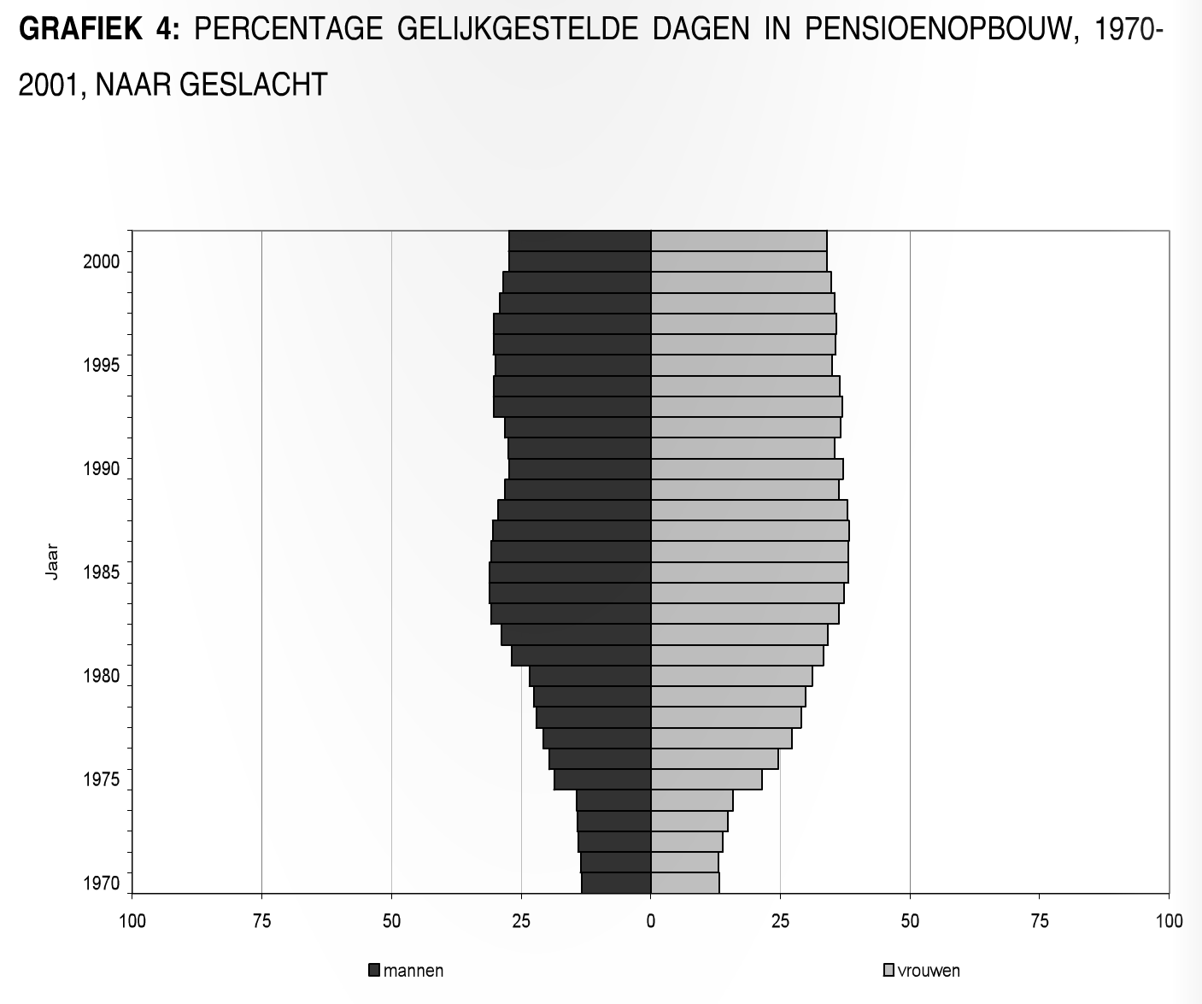
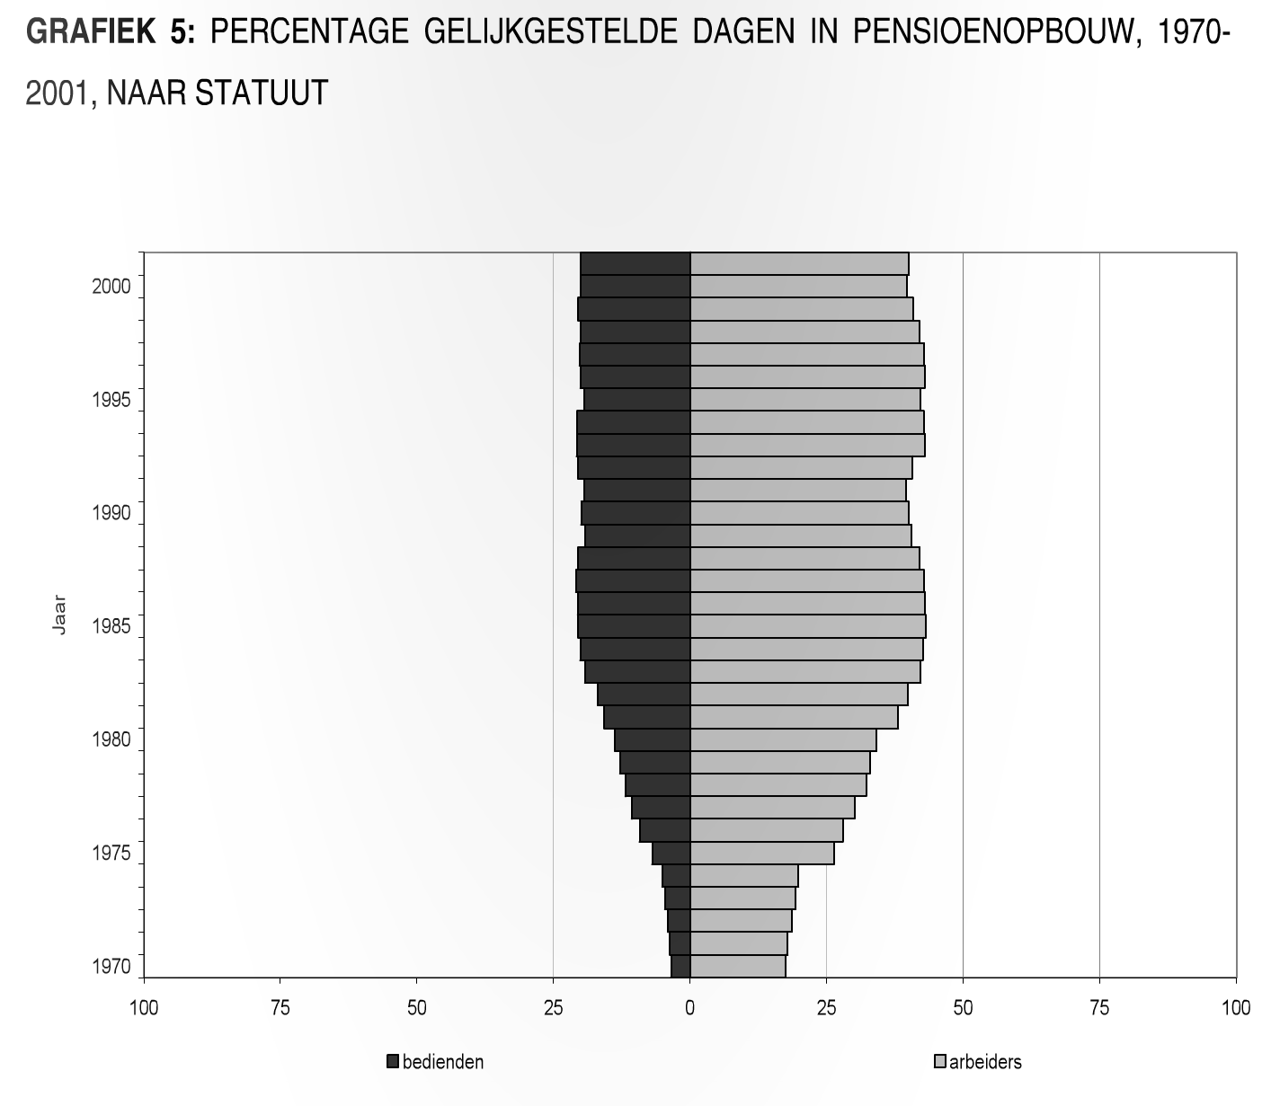
Diversity in pension system design
Relevance of credited periods in Belgium (Peeters and Larmuseau, 2005)
Notes:
Note that credited periods are awarded on the basis of decisions by the current generation, but are to be paid by future generations, that might not be entitled to these periods if pension law changes!

Slide 36
Diversity in pension system design
Solidarity & redistribution
Minimum income guarantees
Notes:
Study for UK (2015) found that over half of redistribution is redistribution across the life cycle. Lifetime income inequality is much lower than cross-sectional income inequality. Nonetheless, the tax benefit system is much less effective in reducing lifetime income inequality than inequality in the cross-section. The UK state pension reduces lifetime income inequality. (Levell et al., 2015)

Slide 37
Diversity in pension system design
A Schematic Overview of Six Different Types of Minimum Income Guarantees Targeted at Europe’s Elderly (Mid-2000s)
 | Contributory | Non-Contributory
No means or income test | Flat-rate pension IE, UK, CZ, EE, LT, LU, PL (persons born before 1949) | Basic pension DK, NL, SE (until 2003)
Pension test | Minimum pension BE, BG, CY, EE, FR, GR, HU, LU, LV, MT, PL, PT, RO (since April 2009), SI, SK (until 2003) | Conditional basic pension CY, EE, FI, SE (since 2003), UK (persons aged 80 and over)
Means or income test | Pension supplement AT, CY (since 2009), ES, GR, IT (persons insured before 1996), SI | Social pension BE, BG, DE (since 2003), ES, FI (since 2002), FR, GR, HU, IE, IT, LT, LV, MT, PT, SE (since 2003), SI, UK

Slide 38
Diversity in pension system design
Solidarity & redistribution
Indexation of benefits
Notes:
Study for UK (2015) found that over half of redistribution is redistribution across the life cycle. Lifetime income inequality is much lower than cross-sectional income inequality. Nonetheless, the tax benefit system is much less effective in reducing lifetime income inequality than inequality in the cross-section. The UK state pension reduces lifetime income inequality. (Levell et al., 2015)

Slide 39
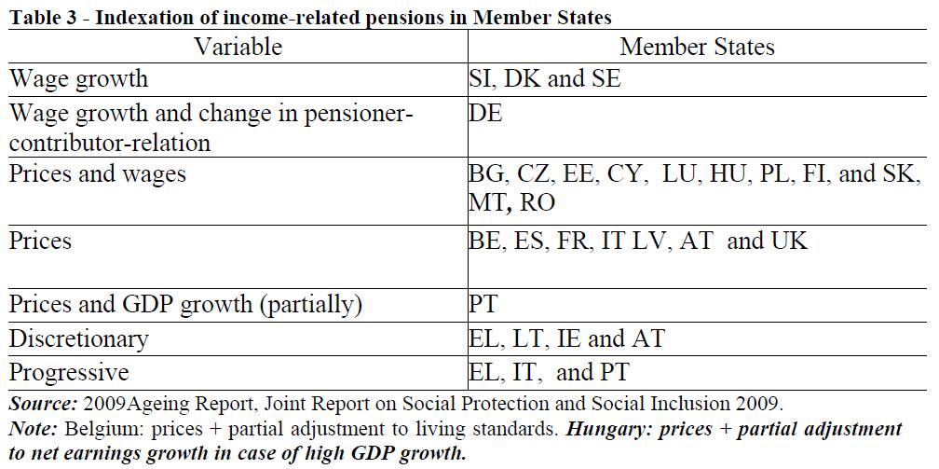
Evolution of benefit:
legal indexation rules of public old-age pensions
Source: Economic Policy Committee (AWG) and DG for Economic and Financial Affairs (2009), Pension Schemes and Pension Projections in the EU-27 Member States. 2008- 2060. Brussels, European Commission
as well as European Commission (2010) Joint Report on Pensions

Slide 40
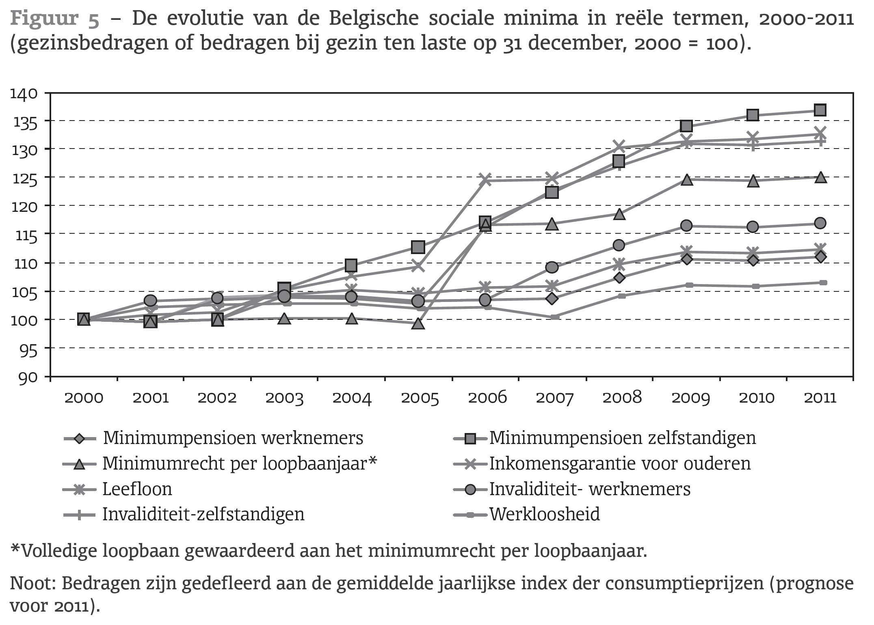
Diversity in pension system design
Source: Goedemé et al., 2012: 224

Slide 41
Diversity in pension system design
Solidarity & redistribution
‘Horizontal’ redistribution
‘Risk’ pooling
Credited periods
Reductions in social contributions
Minimum income guarantees
Indexation of benefits
Reductions in social contributions
Favourable taxation of pension income
Always combination payments and benefits
Notes:
Study for UK (2015) found that over half of redistribution is redistribution across the life cycle. Lifetime income inequality is much lower than cross-sectional income inequality. Nonetheless, the tax benefit system is much less effective in reducing lifetime income inequality than inequality in the cross-section. The UK state pension reduces lifetime income inequality. (Levell et al., 2015)

Slide 42
Diversity in pension system design
Source: Whitehouse et al., 2009: 526
Notes:
Mandatory + quasi mandatory pensions, single person, full career, starting from age 20 until legal retirement age.
the ratio of pension during retirement to earnings when working

Slide 43
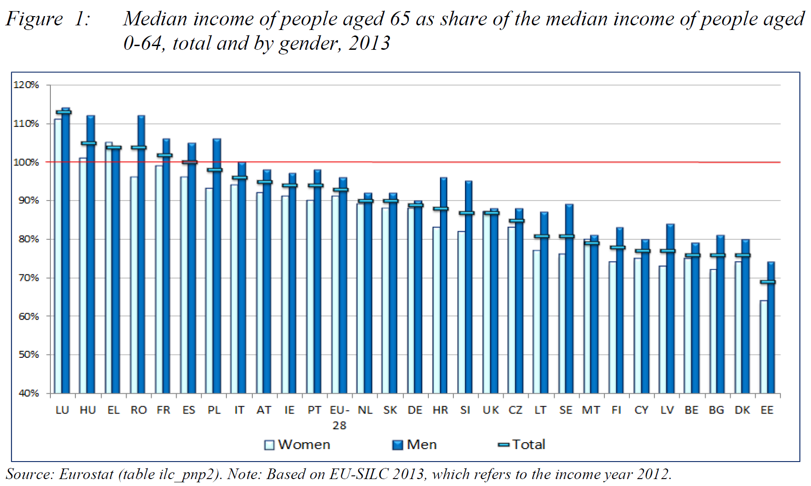
Diversity in pension system design
Source: SPC, 2015: 11)

Slide 44
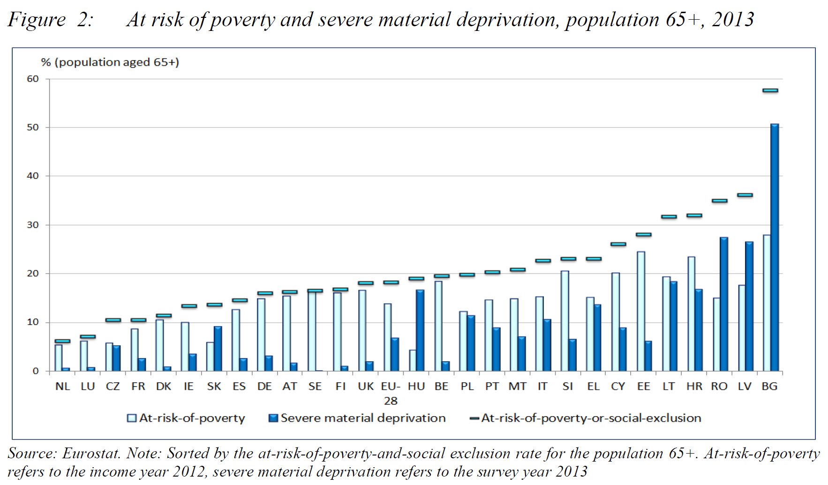
Diversity in pension system design
Source: SPC, 2015: 12)

Slide 45
Pension policy
Some basics
Why government intervention?
Huge diversity pension system design
Ageing & reforming pensions
The EU and pension policy
Conclusion

Slide 46
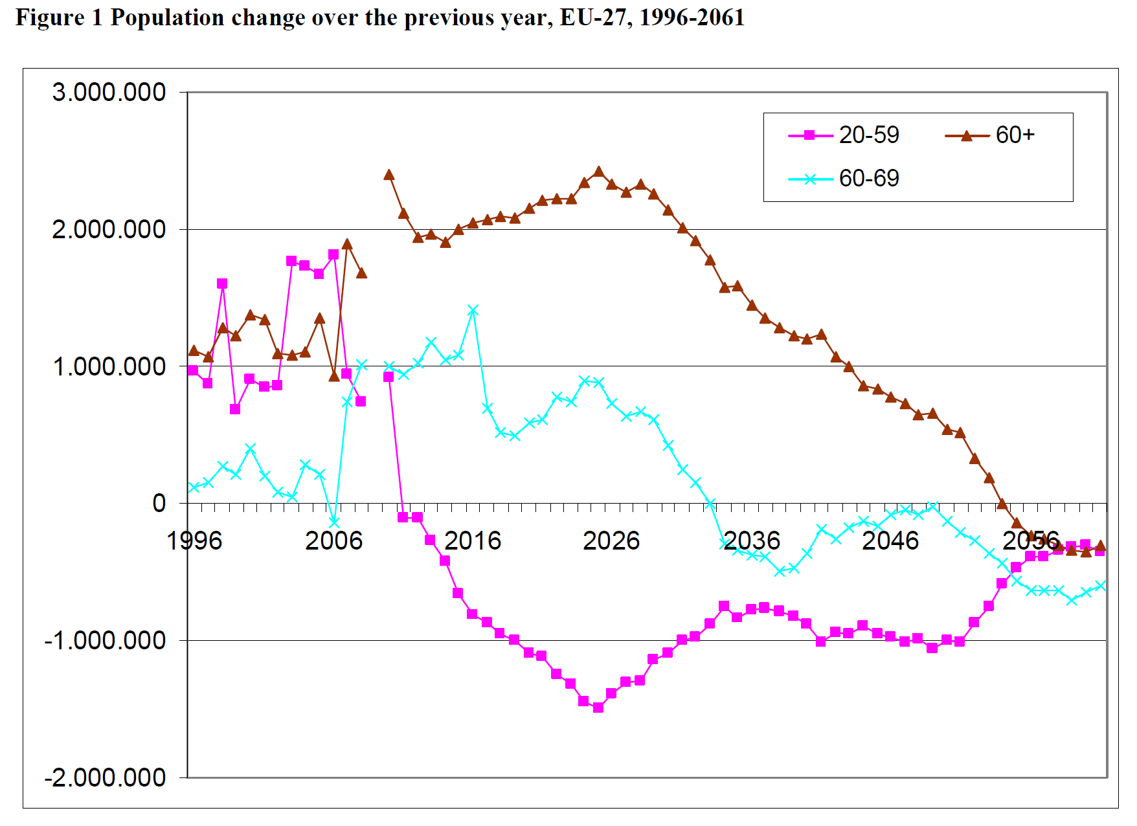
Ageing and reforming pensions
Fewer kids, longer in education, longer life expectancy, baby-boom
Source: European Commission, 2012: 1
Notes:
Longer education and longer life expectancy

Slide 47
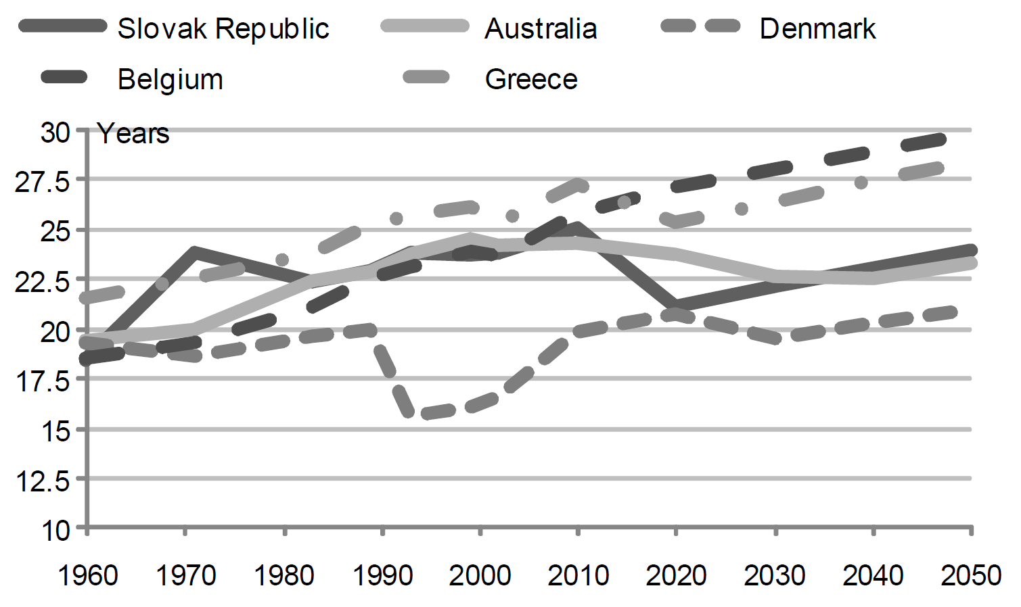
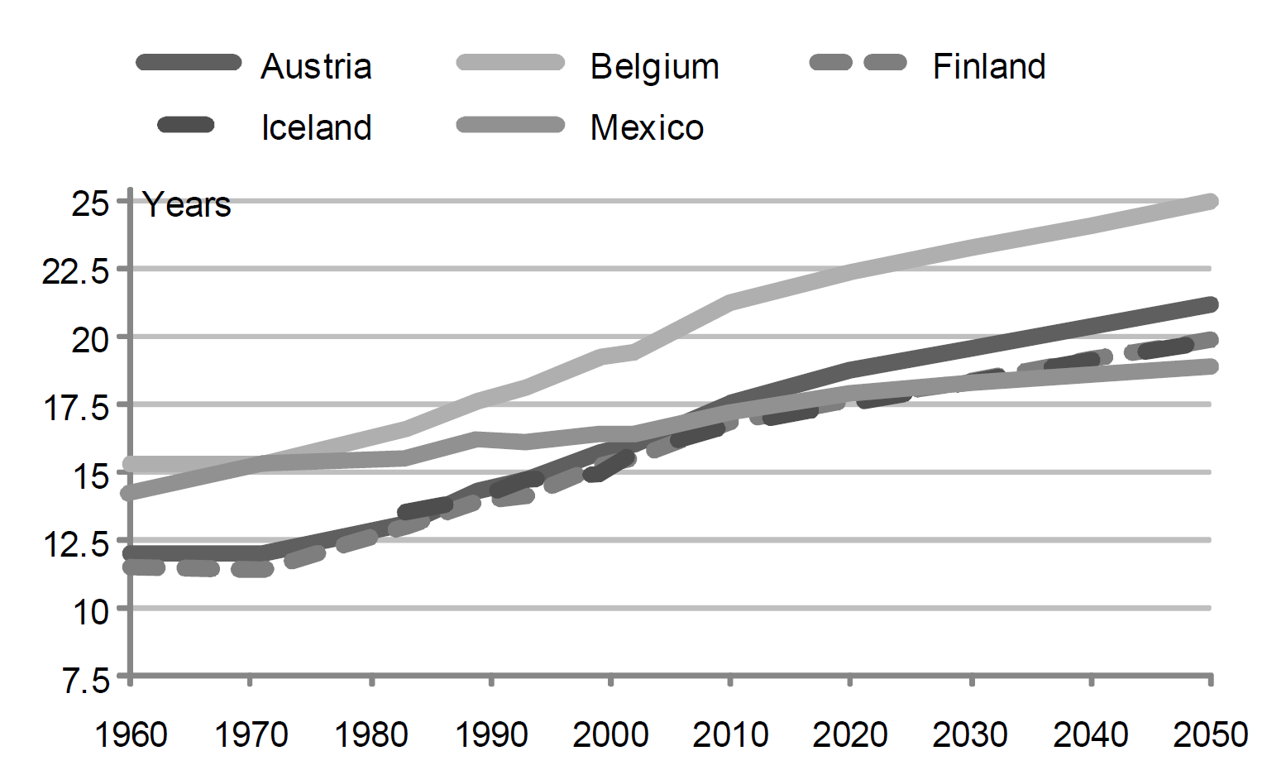
Diversity in pension system design
Life expectancy at pensionable age, men (left) and women (right).
Source: Chomik and Whitehouse, 2010.

Slide 48
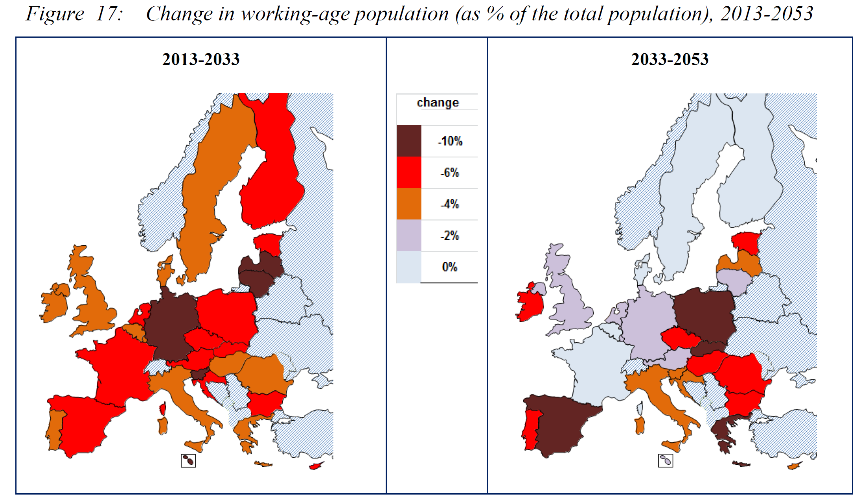
Ageing and pension reforms
Source: SPC, 2015: 26

Slide 49
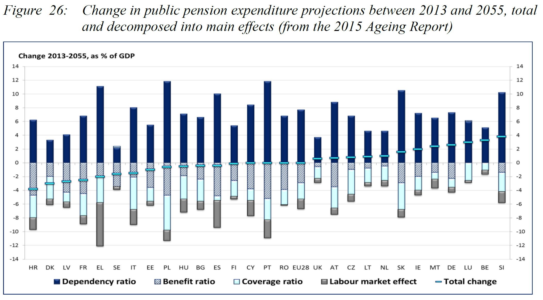
Ageing and pension reforms
Source: SPC, 2015: 35
Notes:
the demographic dependency ratio; the coverage ratio (no of
pensioners as proportion of people aged 65+); the benefit ratio (average pension as proportion
of average wage); labour market effects (i.e. aggregate impact of longer and fuller working
lives).

Slide 50
Ageing and pension reforms
What can be done?
Discussed here:
  Increase funding
  Increase retirement age

Slide 51
Ageing and pension reform
Key variables are future production and consumption
Pension policy is about dividing the future output between workers and pensioners
Options in context of ageing:
  Reduce future demand
  Increase future output
Notes:
Imagine production per worker remains constant => output falls
Solution: either reduce consumption; or increase production per worker / number of workers

Slide 52
Ageing and pension reform
Reducing future demand
  Increase contributions (reduce consumption by workers)
  Reduce benefit levels (reduce consumption by pensioners)
    Initial value
    Indexation

Slide 53
Ageing and pension reform
Increase future output
  Increase quantity and quality of capital stock
  Increase investment in labour
  Increase labour force participation
  Raise average effective retirement age
  Import labour directly
  Import labour indirectly
Notes:
Increase quantity and quality of capital stock (e.g. robots)
Increase investment in labour (e.g. education, training, labour market mobility)
Increase labour force participation (unemployment, child care facilities, …)
Raise average retirement age
Import labour directly (immigration)
Import labour indirectly (export capital to countries with younger labour force)

Slide 54
Ageing and pension reform
More pre-funding, not a solution in itself
  With falling output: inflation and/or less investment (lower rate of return)
  Funding helps insofar it contributes to higher output later
  Funding -> Saving -> investment -> output ?
  Introduction changes intergenerational distribution
  Government action with funded pensions equivalent to action with PAYG:
    Increase taxes on corporate profits (depress stock values)
    Increase taxes on pensions or consumption
    Reduce tax advantages for pension accumulations
Notes:
Equivalence with reducing public debt.

Slide 55
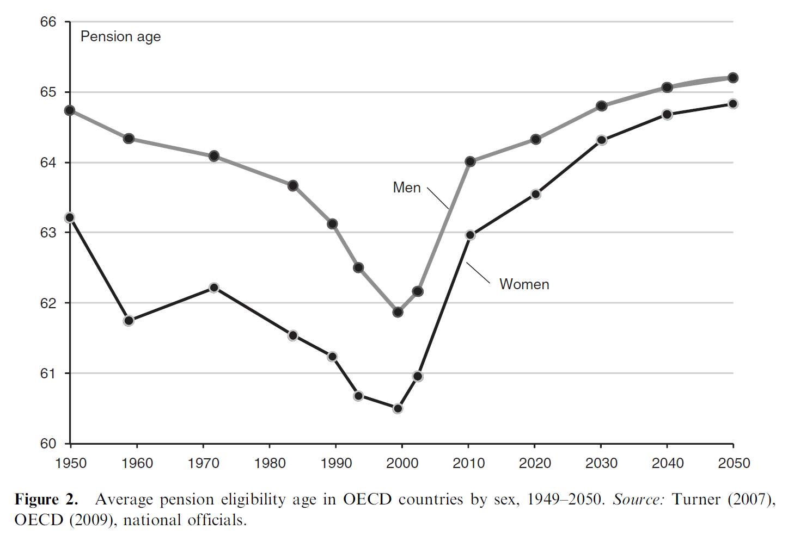
Ageing and pension reform
Increasing the effective retirement age, one of the most efficient measures
Source: Whitehouse et al., 2009: 523

Slide 56
Ageing and pension reform
Source: OECD estimates based on the results of national labour force surveys, the European Union Labour Force Survey and, for earlier years in some countries, national

Slide 57
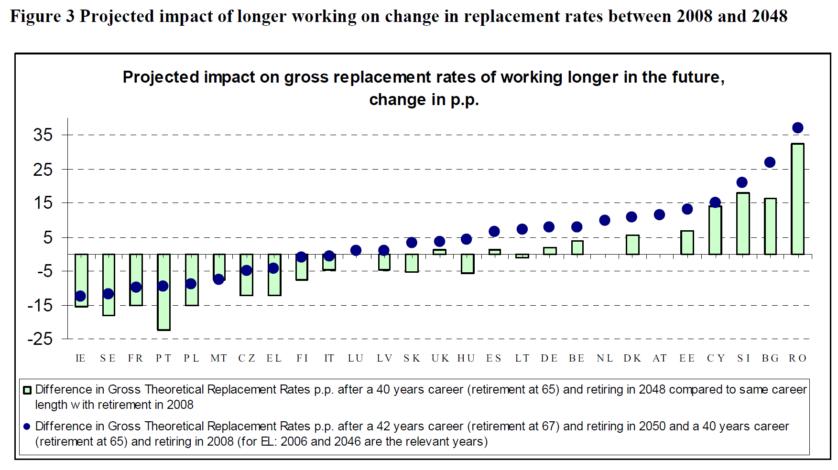
Ageing and reforming pensions
Source: European Commission, 2012: 6

Slide 58
Ageing and pension reform
Increasing effective retirement age can be very effective
  Without increasing contributions
  Or decreasing pensions
  But only from a cross-sectional perspective
  Redistributive effects can be very different from a lifetime perspective!
  Should be implemented wisely
  Feasible to take harsher working conditions and longer life expectancy of some groups into account?
http://europa.eu/!pd64nu

Slide 59
Ageing and pension reforms
Three waves of reforms (SPC, 2015):
Until 1990s: expansion of generosity
1990s-2008: medium long-term reforms
  Extending pre-funding & ‘hybridisation’ => mandatory / subsidised funded pensions
  Strengthening link between contributions & benefits
  ‘grandfather clauses’

Slide 60
Ageing and pension reforms
Three waves of reforms (SPC, 2015):
Until 1990s: expansion of generosity
1990s-2008: medium long-term reforms$
2008-…: also short term reforms
  Halt + reversal of shift to funding
  Cost containment also affecting current pensioners
  Raising pensionable ages in shorter term + linking to life
  expectancy
  Reducing pension levels and suspending indexation
  Revising taxation of pensions
  Larger role for EU

Slide 61
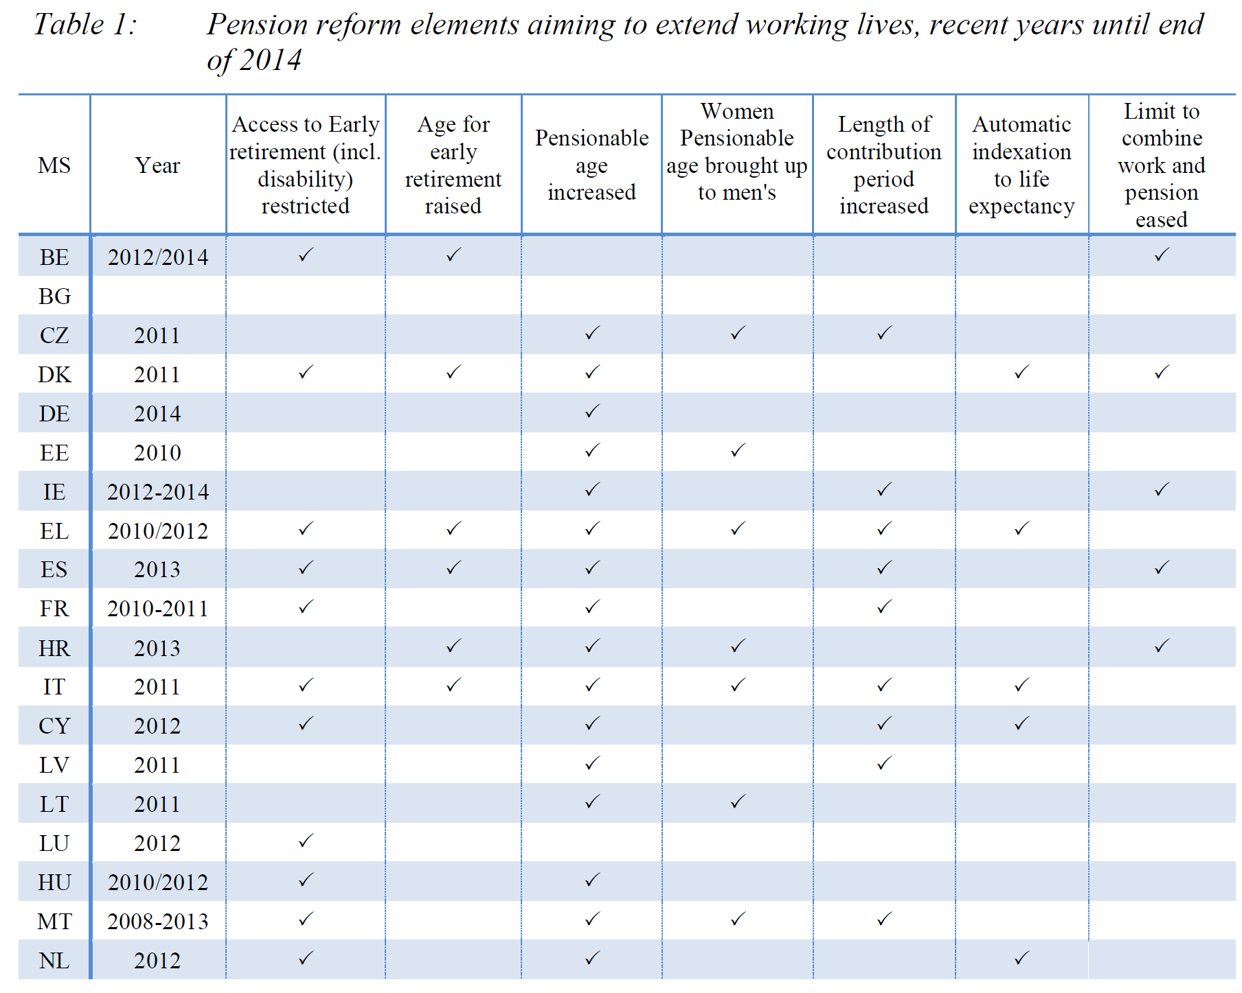

Slide 62
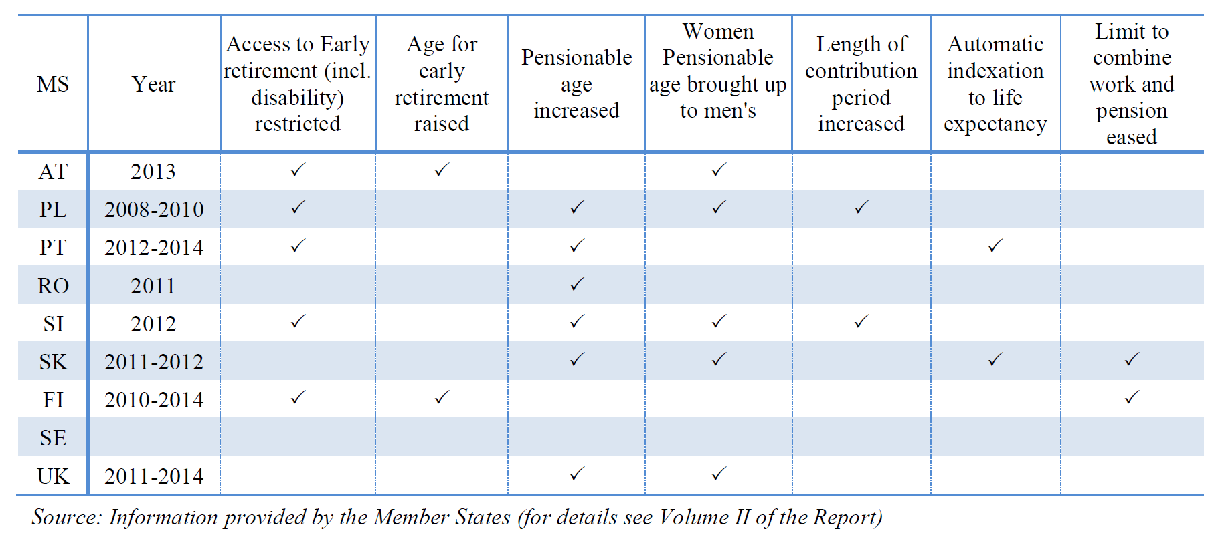
Ageing and pension reforms
SPC, 2015: 24

Slide 63
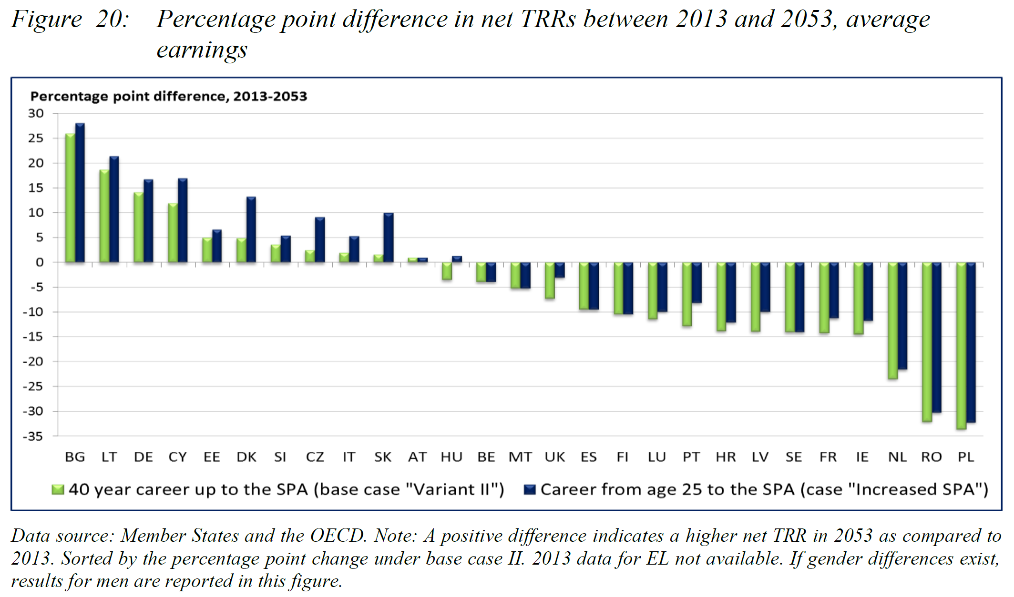
Ageing and pension reforms
Source: SPC, 2015: 29

Slide 64
Pension policy
Some basics
Why government intervention?
Huge diversity pension system design
Ageing & reforming pensions
The EU and pension policy
Conclusion

Slide 65
Role of EU
EU view on pensions
  In principle no legal competence,
    but:
    Movement of labour and social security rights within EU,
    Single market for financial services
    Budgetary concerns
    Soft law

Slide 66
Role of EU
  Social OMC since 2001 -> common objectives (2006):
    Adequate
    Sustainable
    Transparent and adapted pension systems

Slide 67
Role of EU
EU view on pensions
  Stockholm strategy (2001):
    Reducing debt at a fast pace
    Raising employment rates and productivity
    Reforming pension, health care and long-term care systems

Slide 68
Role of EU
EU view on pensions
  EC Green paper on pensions (2010)
    Adequacy and sustainability
    Balance between work and retirement
    Removing obstacles to mobility in the EU
    Safer and more transparent pensions

Slide 69
Role of EU
EU view on pensions
  EC White paper on pensions (2012)
    Pensions are ‘common concern’
    Pension adequacy report (SPC) in addition to Ageing report (EPC)

Slide 70
Role of EU
EU view on pensions
  European Semester
    More direct role for the EU
    Rise in CSRs, especially with regard to extending working life
    Linking pensionable ages to life expectancy

Slide 71
Role of EU
CSR Belgium (EC, 2012: 24):
“Take steps to improve the long-term sustainability of public finances. In line with the framework of the three-pronged EU strategy, the focus should be put on curbing age-related expenditure, notably by preventing early exit from the labour market in order to markedly increase the effective retirement age. Measures such as linking the statutory retirement age to life expectancy could be considered.”

Slide 72
Discussion
Are pension decisions democratic (if they pre-suppose considerable solidarity from future generations)
How could pension decisions become more democratic in a context of a growing electorate in retirement?
Which periods should count as credited periods?
Who should finance credited periods?
Who should finance minimum pensions?

Slide 73
Discussion
On average, women’s life expectancy at pensionable age is five year higher than men’s. Wouldn’t it be fairer to increase their retirement age compared to men’s?
What would be a fair retirement age (or minimum contribution record), given differences in (healthy) life expectancy
Should individual private pensions be subsidised?
European minimum income scheme?

Slide 74
Some points to remember
Pensions are about consumption smoothing, and poverty alleviation
Central question is how future output will be divided between those working and those not working
Important role for governments (uncertainties and shocks + lifetime poor)
Ageing is a severe challenge, but can be handled
Increasing effective retirement age can be important part of socially acceptable solution

Slide 75
References
Barr, Nicholas. 2012. Economics of the welfare state. Oxford: Oxford University Press.
Barr, Nicholas. 2002. "Reforming pensions: Myths, truths, and policy choices." International Social Security Review 55(2):3-36.
Anderson, Karen M. 2007. "The Netherlands: Political Competition in a Proportional System." Pp. 713-57 in The Handbook of West European Pension Politics, edited by Ellen M. Immergut, Karen M. Anderson, and Isabelle Schulze. Oxford: Oxford University Press.
Anderson, Karen M., Sanneke Kuipers, Isabelle Schulze, and Wendy van den Nouland. 2007. "Belgium: linguistic veto players and pension reform." Pp. 297-346 in The Handbook of West European Pension Politics, edited by Ellen M. Immergut, Karen M. Anderson, and Isabelle Schulze. Oxford: Oxford University Press.
Chomik, Rafal, and Edward Whitehouse. 2010. "Trends in Pension Eligibility Ages and Life Expectancy 1950-2050." Pp. 25 in OECD Social, Employment and Migration Working Papers. Paris: OECD.
European Commission. 2010. Joint Report on Pensions. Progress and key challenges in the delivery of adequate and sustainable pensions in Europe. Brussels: European Commission.
Goedemé, Tim, Greet De Vil, Natascha Van Mechelen, Nicole Fasquelle, and Kristel Bogaerts. 2012. "Hoogte en adequaatheid van de Belgische sociale minima in de periode 2000-2011." Pp. 215-38 in Armoede in België. jaarboek 2012, edited by Jan Vranken, Willy Lahaye, Anneline Geerts, and Catherine Coppée. Leuven: Acco.
Goedemé, Tim. 2013. "Minimum Income Protection for Europe's Elderly: What and How Much has been Guaranteed during the 2000s?" Pp. 108-36 in Minimum Income Protection in Flux, edited by Ive Marx and Kenneth Nelson. Hampshire: Palgrave Macmillan.

Slide 76
References
Natali, David. 2004. "The Hybridisation of Pension Systems Within the Enlarged EU: Recent Reforms in Old and New Members." Belgisch Tijdschrift voor Sociale Zekerheid (Belgian Review of Social Security) 46(2):349-74.
Immergut, Ellen M., and Karen M. Anderson. 2007. "Editors' Introduction: The Dynamics of Pension Politics." Pp. 1-45 in The Handbook of West European Pension Politics, edited by Ellen M. Immergut, Karen M. Anderson, and Isabelle Schulze. Oxford: Oxford University Press.
Overbye, Einar. 1997. "Mainstream Pattern, Deviant Cases: the New Zealand and Danish Pension Systems in an International Context." Journal of European Social Policy 7(2):101-17.
Peeters, Hans, and Hendrik Larmuseau. 2005. "De solidariteit van de gelijkgestelde periodes." Belgisch Tijdschrift voor Sociale Zekerheid 2005(1):97-125.
Schulze, Isabelle, and Michael Moran. 2007. "United Kingdom: Pension Politics in an Adversarial System." Pp. 49-96 in The Handbook of West European Pension Politics, edited by Ellen M. Immergut, Karen M. Anderson, and Isabelle Schulze. Oxford: Oxford University Press.
Schulze, Isabelle, and Michael Moran. 2007. "Ireland: Pensioning the 'Celtic Tiger'." Pp. 758-803 in The Handbook of West European Pension Politics, edited by Ellen M. Immergut, Karen M. Anderson, and Isabelle Schulze. Oxford: Oxford University Press.
Social Protection Committee (SPC). 2015. "The 2015 Pension Adequacy Report: current and future income adequacy in old age in the EU. Volume 1." Pp. 396. Luxembourg: Publication Office of the European Union.
Whitehouse, Edward, Anna D'Addio, Rafal Chomik, and Andrew Reilly. 2009. "Two Decades of Pension Reform: What has been Achieved and What Remains to be Done?" The Geneva Papers 34(4):515-35.

