Slide 1
Social Policy in the EU and the Role of the EU
Tim Goedemé, PhD
tim.goedeme@kuleuven.be
tim.goedeme@uantwerpen.be
Lecture 6 – 16/03/2016
With help from Lorena Zardo Trindade and Diego Collado

Slide 2
The EU and minimum income protection: Important elements of the policy conundrum
Poverty reduction and social inclusion are important policy goals
Poverty remains high (and in some countries is increasing) in EU Member States
Social assistance is the ultimate safety net to avoid poverty and social exclusion
However, in nearly all EU MS social assistance schemes are inadequate
What kind of action should the EU take?

Slide 3
The EU and minimum income protection: Important elements of the policy conundrum
Proposal for a ‘Minimum income directive’ (EAPN)
  A fundamental right to an adequate income for a dignified life, throughout the lifecycle
  Providing the means/security to engage in work and participate in society
  Prevents poverty and social exclusion and restricts long-term economic and social costs.
  Automatic stabiliser – provides an essential floor for consumption and economy
  Provides a positive hierarchy for decent/minimum wages
  European Social Model - laying the foundation for a fairer, more cohesive society

Slide 4
This lecture
Increasing minimum income protection (MIP), through an EU initiative, is confronted with a policy conundrum
  (legal basis)
  (subsidiarity)
  Strong differences in living standards & social context
  Substantial additional redistributive effort required
  A social trilemma
  A solidarity conundrum

Slide 5
This lecture
Building on:
Vandenbroucke, F., Cantillon, B., Van Mechelen, N., Goedemé, T., and Van lancker, A. (2013), 'The EU and Minimum Income Protection: Clarifying the Policy Conundrum', in Marx, I. and Nelson, K. (eds.), Minimum Income Protection in Flux, Hampshire: Palgrave Macmillan, pp. 271-317.
With updated data and insights

Slide 6
1. Strong differences in living standards
Strong differences in living standards make a decision on a common minimum standard for social assistance (or wages) very difficult
What are the prospects for the future?

Slide 7
1. Strong differences in living standards
RO
EU27
BE
LU
60% poverty threshold BE
97% of RO below poverty threshold BE
Notes:
And: we know from RB research that living on 60% of median income in RO means spending 90% of budget on adequate diet, compared to 10% in LU. => makes agreement on a single target value difficult.
What are prospects?

Slide 8
1. Strong differences in living standards
Source: Goedemé and Collado, forthcoming, update with SILC 2013 data by Lorena Zardo Trindade.

Slide 9
1. Strong differences in living standards
Poverty trends in the EU15 and the NMS (without Bulgaria, Malta and Romania) with the poverty
line expressed as a percentage of the EU‐wide median equivalent household income, EU‐SILC 2005‐2013
Source: Goedemé and Collado, forthcoming, update with SILC 2013 data by Lorena Zardo Trindade.
Notes:
Overall positive story, but not everywhere.
Corresponds also to strong decrease in between-country inequality.

Slide 10
1. Strong differences in living standards
Source: Goedemé, Trindade and Vandenbroucke, Forthcoming.

Slide 11
Results: Greece

Slide 12
Results: Poland

Slide 13
1. Strong differences in living standards
Living standards are clearly converging,
But:
  Sometimes driven by decreases in some countries
  Vast differences remain

Slide 14
2. The redistributive effort required
What is the cost of increasing all incomes to the level of the poverty threshold?
A very simple (and naïve) estimation
Notes:
Naïve: what happens to those receiving benefits (reducing work effort); to those paying for the benefit (also reduce work effort) => costs are most likely underestimated.

Slide 15
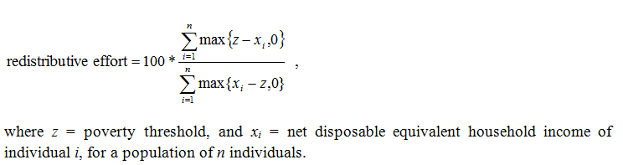
2. The redistributive effort required

Slide 16

2. The redistributive effort required
Notes:
2 problems with cost:
1/ it is very high, especially for some countries. => alternatives 40% target instead of 60%; focus on child poverty? (but what kind of stimulus + is this equitable?)
2/ Distribution of cost across countries

Slide 17
2. The redistributive effort required
Redistributive effort required to lift all households with at least one child aged <=17 to the poverty threshold, SILC 2009

Slide 18
3. A social trilemma?
Adequacy of MIP
Employment
Budgetary restraint

Slide 19
3. A Social trilemma?
Hierarchy of institutional incomes in the fabric of the welfare state (Cantillon et al., 2015b):
  → incomes of low wage earners might be = ‘glass ceiling’ of poverty reduction
minimum
wages
Social insurance benefits
Social assistance for non-working, non-insured

Slide 20
Cantillon et al.
MS differ in extent to which they achieve various goals, but few meet all three
Hypothetical household simulations:
  Adequacy of net social assistance & net minimum wage (or low wage benchmark)
  Gross minimum wage
  Gross-to-net effort
  Financial incentive
High-road, middle road, low road

Slide 21
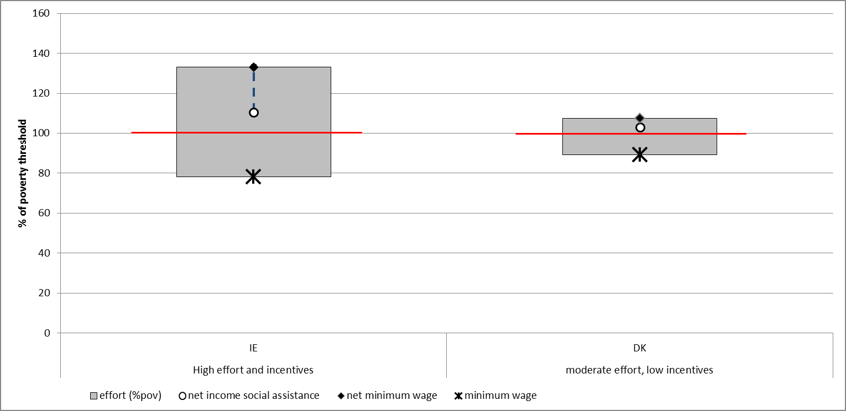
High road: Adequate minimum income protection packages in- and out-of-work
Single parent, two children, 2012. Source: CSB-MIPI / Cantillon, Marchal et al., 2015

Slide 22
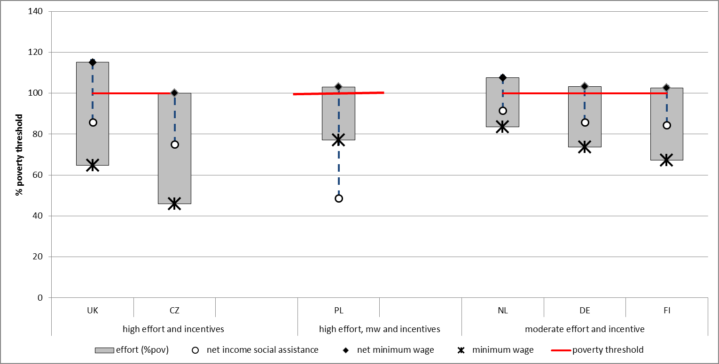
Middle road: adequate minimum income package for a working lone parent family, inadequate out-of-work protection
Single parent, two children, 2012. Source: CSB-MIPI / Cantillon, Marchal et al., 2015

Slide 23
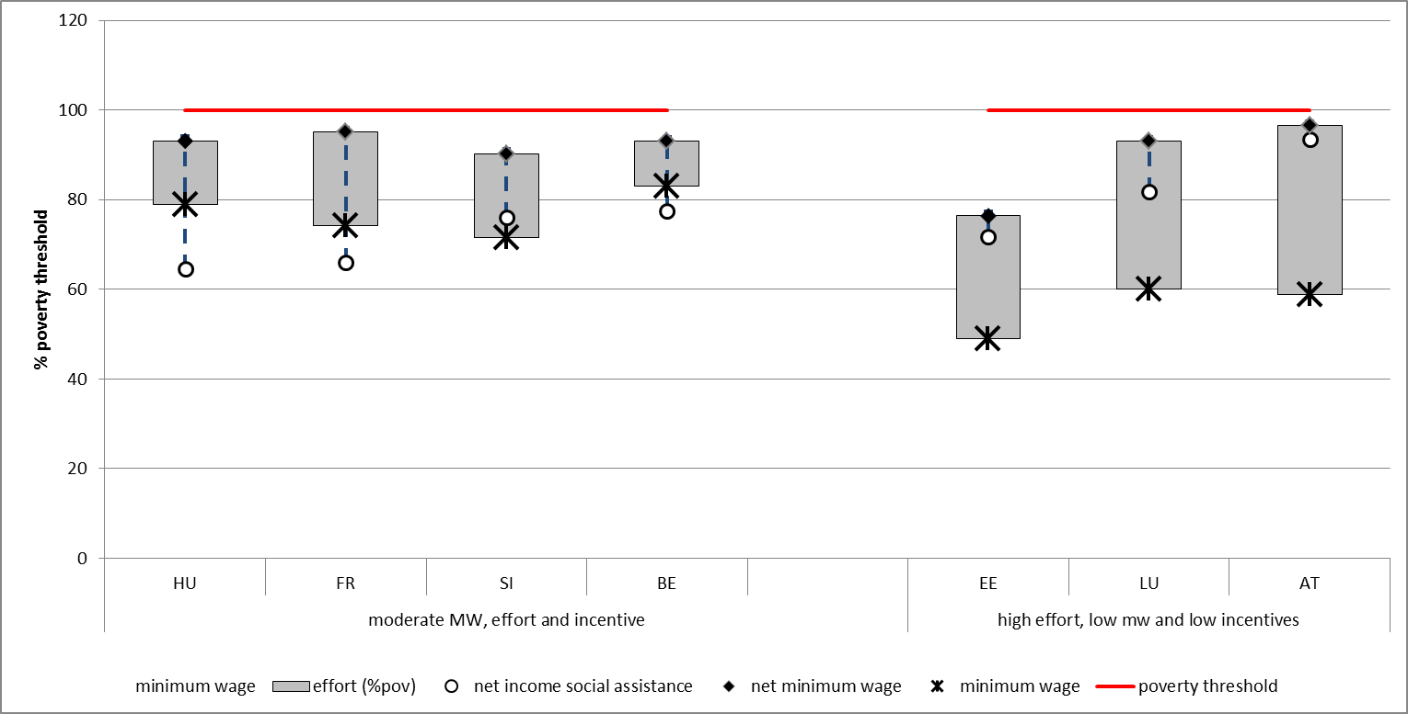
Low road: inadequate minimum income packages, both out and in work
Single parent, two children, 2012. Source: CSB-MIPI / Cantillon, Marchal et al., 2015

Slide 24
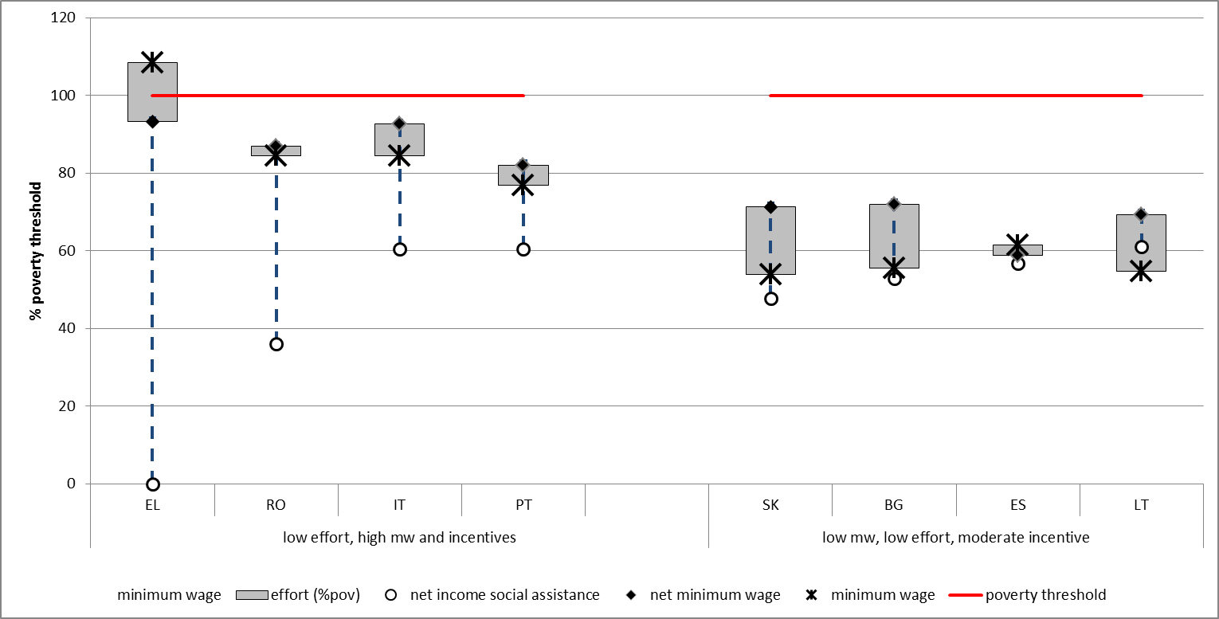
Low road: inadequate minimum income packages, both out and in work
Single parent, two children, 2012. Source: CSB-MIPI / Cantillon, Marchal et al., 2015

Slide 25
3. A Social trilemma?
Adequate minimum income protection and work incentives do not come cheap?
Increasing pressure on low gross wages?

Slide 26
3. A Social trilemma?
Adequate minimum income protection and work incentives do not come cheap?
Increasing pressure on low gross wages?
  Skill-biased technological change
  Increased global competition

Slide 27

Evolution of low gross wages vs. poverty lines (Source: Cantillon, Collado et al., 2015)

Slide 28
Did net wages follow? (Cantillon, Collado et al., 2015)

Slide 29
3. A social trilemma?
Adequate minimum income protection and work incentives do not come cheap?

Slide 30
The end of cheap talk about poverty reduction (Collado et al., forthcoming)
 | single parent + 2 children
 | Adequacy net social floor | Adequacy net wage floor | Fin. incentive to work
Denmark | 100% | 101% | 1%
Austria | 100% | 90% | -10%
Netherlands | 100% | 103% | 3%
Belgium | 100% | 100% | 0%
UK | 100% | 115% | 15%
Finland | 100% | 98% | -2%
Germany | 100% | 94% | -6%
Sweden | 100% | 119% | 19%
France | 100% | 96% | -4%
Fin. incentive to work (base line)
5%
4%
19%
20%
43%
24%
23%
57%
44%
Source: simulated net incomes and low (minimum) wages from CSB-MIPI

Slide 31
Research question
How much would be the redistributive effort of eradicating poverty without altering (much) the structure of incentives?
Methodology
  How to measure incentives to work at all? → Participation tax rates (PTR)
  Calculate cost of a hypothetical transfer:
    Employment-conditional earnings subsidies (e.g. earned income tax credit), including jobless

Slide 32
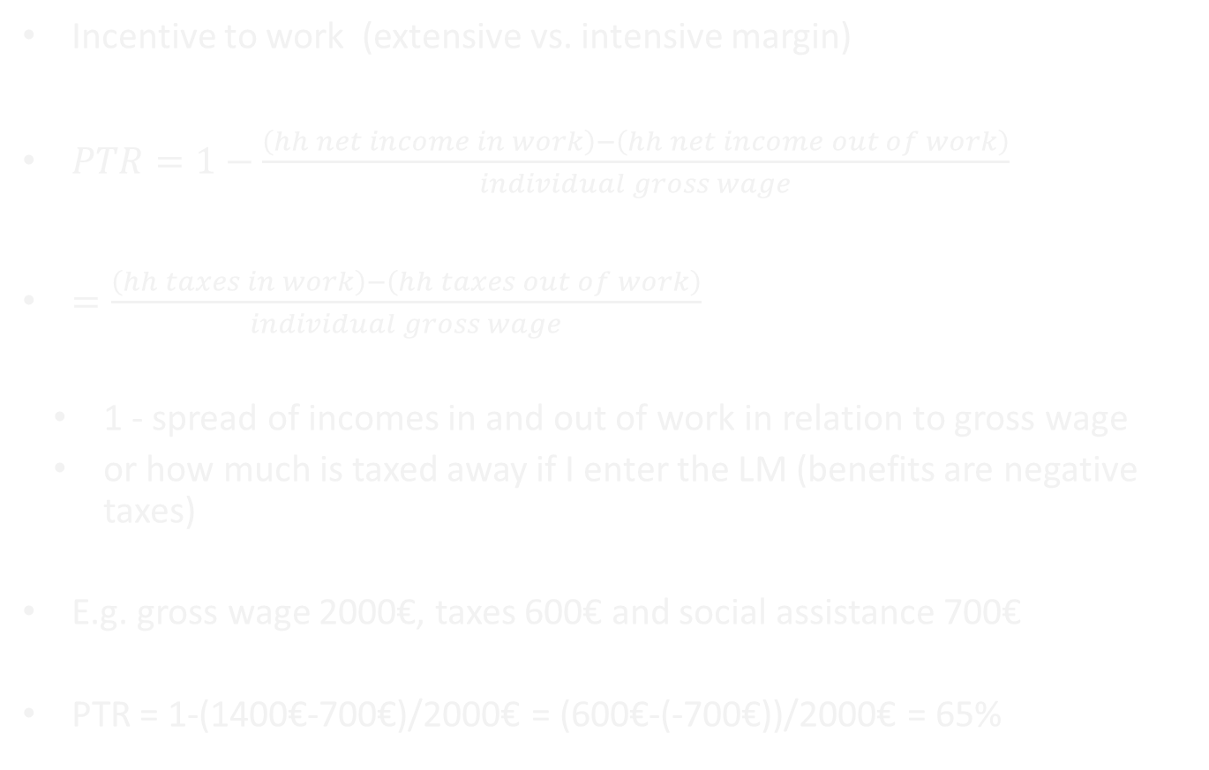
Measuring incentives: participation tax rate
Incentive to work (extensive vs. intensive margin)
$PTR=1−\frac{\left(hh net income in work\right)−\left(hh net income out of work\right)}{individual gross wage}$
$=\frac{\left(hh taxes in work\right)−\left(hh taxes out of work\right)}{individual gross wage}$
  1 - spread of incomes in and out of work in relation to gross wage
  or how much is taxed away if I enter the LM (benefits are negative taxes)
E.g. gross wage 2000€, taxes 600€ and social assistance 700€
PTR = 1-(1400€-700€)/2000€ = (600€-(-700€))/2000€ = 65%

Slide 33
Which instrument to use to simultaneously eradicate poverty and preserve work incentives?
On top of current benefits
As AROP is at household level, also new benefit
Withdrawal rate that does not change much incentives at bottom of income distribution

Slide 34
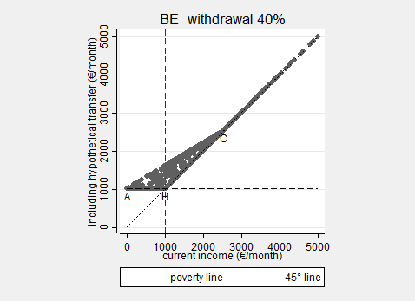
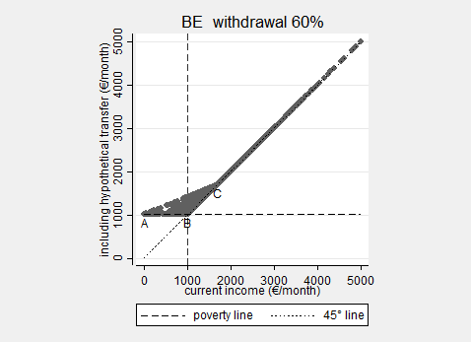
Example BE 2013

Slide 35
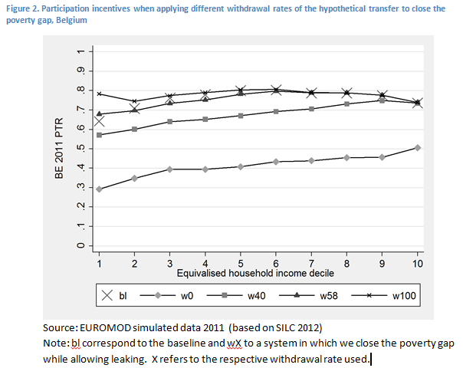
The end of cheap talk

Slide 36
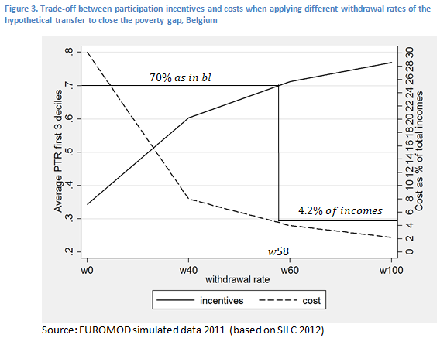
The end of cheap talk

Slide 37
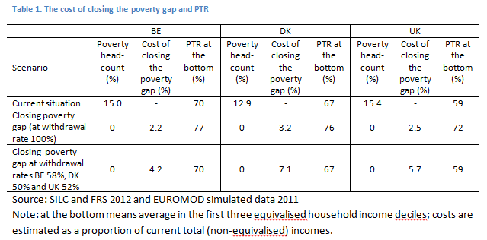
The end of cheap talk

Slide 38
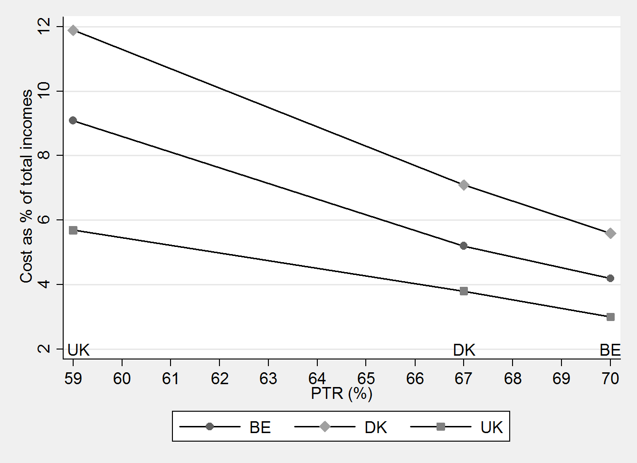
The end of cheap talk

Slide 39
The end of cheap talk
If implemented in real life through social assistance, budgetary cost and poverty effect might be lower:
  Non-take up
  Conditionalities
  Broader means test, including assets
<-> Costs might be higher, if realised by additional taxes

Slide 40
Intermediate conclusion
Strong differences in living standards pose a (diminishing) challenge
The redistributive effort is substantial, one should think about a gradual scenario
The redistributive effort is even bigger if we take financial incentives to work into account, but also other incentives matter (DK)
The hierarchy of (minimum) income protection requires a broad view on the adequacy of incomes
Pressure on low wages calls for a broader strategy

Slide 41
4. A solidarity conundrum?
Does EAPN’s proposal imply the need for pan-European solidarity?

Slide 42
4. A solidarity conundrum?
Redistributive effort 60% threshold (silc 2009), and GDP per capita in PPS (2008) (Luxembourg: 66,000 PPS, 3.5%)

Slide 43
4. A solidarity conundrum?
Whichever (relative or absolute) target: the relative burden is heavier for low-income countries
In these countries middle- and high-level incomes are low from a cross-national perspective
The policy conundrum = solidarity conundrum?

Slide 44
Income quintiles in PPS, as a percentage of the EU-wide median, EU-SILC 2014

Slide 45
4. A solidarity conundrum?
Would the minimum income directive boil down to the richer segments in the EU cynically asking some of the poorer segments to show greater solidarity – among themselves?
Does this necessitate pan-European funding?
  Should our normative benchmark be pan-European?
  What is the responsibility of national governments wrt poverty alleviation?

Slide 46
4. A solidarity conundrum?
Normative benchmark: Pan-European perspective
Intuitive appeal Lessons reference budgets Cooperation & justice Cohesion policy

Slide 47
4. A solidarity conundrum?
Normative benchmark: National perspective
Social expectations may differ strongly cross-nationally (e.g. Sen, Townsend, …) Power structures and opportunities (political and economic) national Otherwise no relevant national benchmarks? A national benchmark better fits requirement of subsidiarity & social inclusion policy A national benchmark is most relevant for national policies: current instruments are only fit for combating a national relative poverty benchmark

Slide 48
4. A solidarity conundrum?
But does it matter for cross-national solidarity?
Rather:
  (Adequate protection in poor MS is also in interest of richer MS
  Whichever benchmark: cooperation in EU may imply need for solidarity, if it is to function well)
  Irreducible evaluative dualism
  Way out: nexus solidarity and responsibility

Slide 49
4. A solidarity conundrum?
Not all welfare states are as efficient
Some redistribute much less than others do
  => additional effort required is result of low levels of redistribution
  => but what about work incentives?
Others redistribute, but not very efficiently (but careful with that argument)

Slide 50
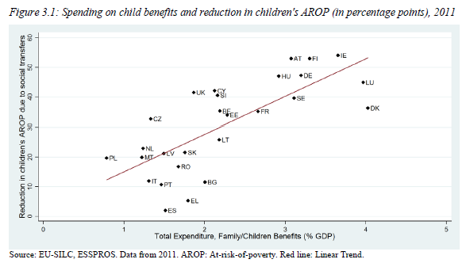
4. A solidarity conundrum?
Source: Social Protection Committee and European Commission Services, 2015: 43

Slide 51
Conclusion
A caring Europe should care for poorer member states, and demand social efficiency everywhere
Heterogeneity between MS => gradual & flexible
A broad perspective on MIP is required

Slide 52
Conclusion
Even with moderate goals: complex issue of solidarity in the EU
  Rich in poor MS are poorer than the poor in rich MS
  Additional burden relatively stronger on poorer MS
  Should this entail pan-European solidarity?

Slide 53
Conclusion
Solidarity – responsibility nexus
  Externalising burden of redistribution and solidarity on richer MS?
  => pan-European solidarity requires ‘efficient internal solidarity’
Emphasis on upward convergence (cohesion policy)
More generous structural funds?
While including conditionality of improving quality & internal efficiency of welfare state?
Give Europe 2020 strategy for social inclusion real bite

Slide 54
Note on group task
Write a brief position paper on the Proposal for a Framework Directive on Minimum Income.
  Ultimate deadline: 6 May 2016 => 13 May 2016
11 May 2016: Debate => 18 May 2016
President: Beau Van Dooren
Next week: no lecture!

Slide 55
References
Vandenbroucke, F., Cantillon, B., Van Mechelen, N., Goedemé, T., and Van lancker, A. (2013), 'The EU and Minimum Income Protection: Clarifying the Policy Conundrum', in Marx, I. and Nelson, K. (eds.), Minimum Income Protection in Flux, Hampshire: Palgrave Macmillan, pp. 271-317.
Cantillon, B., Collado, D., and Van Mechelen, N. (2015), The end of decent social protection for the poor? The dynamics of low wages, minimum income packages and median household incomes, ImPRovE Working Paper, No. 15/03, Antwerp: Herman Deleeck Centre for Social Policy - University of Antwerp, 29p.
Cantillon, B., Marchal, S., and Luigjes, C. (2015), Decent incomes for the poor: which role for Europe?, ImPRovE WP 15/20, Antwerp: Herman Deleeck Centre for Social Policy - University of Antwerp, 41p.
Collado D., Cantillon B., Van den Bosch K., Goedemé T, & Vandelannoote D. (forthcoming) ‘The end of cheap talk about poverty reduction: The cost of closing the poverty gap while maintaining work incentives’ in Cantillon, Goedemé and Hills (eds.) Improving Poverty Reduction in Europe: Lessons from the Past, Scenarios for the Future, Oxford: Oxford University Press.
Goedemé, T., and Collado, D. (forthcoming), 'The EU convergence machine at work. To the benefit of the EU’s poorest citizens?' in Journal of Common Market Studies.
Goedemé, T., Zardo Trindade, L., Vandenbroucke, F. (forthcoming), A pan-European perspective on low-income dynamics in the EU in Cantillon, Goedemé and Hills (eds.) Improving Poverty Reduction in Europe: Lessons from the Past, Scenarios for the Future, Oxford: Oxford University Press.
Social Protection Committee and the European Commission Services (2015), Social Protection Systems in the EU: Financing Arrangements and the Effectiveness and Efficiency of Resource Allocation, Luxembourg: Publications Office of the European Union, 177p.

