Slide 1
Variance estimation for complex survey data and microsimulation
Tim Goedemé
Lorena Zardo Trindade
Herman Deleeck Centre for Social Policy
18 January 2018
EUROMOD Winter School, University of Antwerp

Slide 2
Conclusion
Statistics & samples are a powerful tool
  Need limited number of observations
  Point estimate and estimate of precision
  However, without an estimate of its precision, a point estimate is pointless…
… at least for evidence-based policy-making
Notes:
In this presentation I focus on random error only.
Of course there is also bias and non-random error.
However, often the impact of this bias is much harder to estimate.
Therefore, the mere fact of its existence should be no excuse for not to calculate the random error.
Furthermore, if we present consistently standard errors and confidence intervals, users will be come also more cautious regarding non-random errors.

Slide 3
Requirements
Estimating the sampling variance requires:
  Sound sample designs
  Good documentation of the sample (design)
  Access to high-quality microdata with sufficient information on weighting, imputation and sample design
  Adequate and consistent sample design variables
  Adequate software, estimation methods, skills and expertise

Slide 4
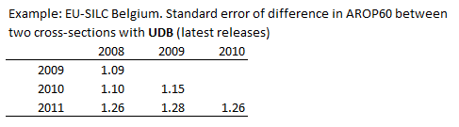
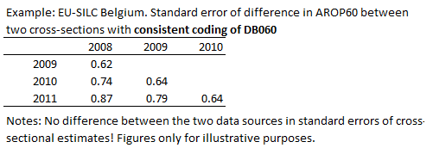
Requirements
Standard error of difference is much smaller with consistent SD variables.
Difference with 2011: the longer the time-span, the weaker the covariance (and the larger the standard error) will be

Slide 5
Communication
To researchers
To policy-makers and politicians
To the wider public
Improve awareness of both sampling and non-sampling errors

Slide 6
Communication
Measures of statistical reliability
Confidence interval > standard error
Standard error > degrees of freedom
Degrees of freedom > number of observations

Slide 7
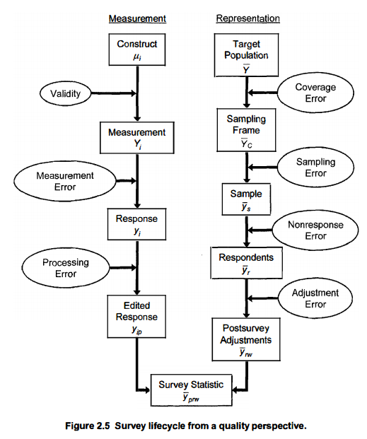
Mode of data collection
Mode of data collection
Grooves et al., 2009, p. 48
Computational error
Computational error

Slide 8
Comparability of income variables
MetaSILC 2015: An assessment of the content and cross-country comparability of the EU-SILC benefit variables
EU-SILC 2015 (and smaller database for 2010)
Funding: Net-SILC 3

Slide 9
MetaSILC
Knowledge of content (aggregation) and comparability of income variables is key
Description of target variables in Doc065 & Quality reports not sufficiently detailed for:
  Identifying exact classification of all income components in all countries
  Evaluating level of cross-country comparability (‘correct’ classification) depends also on question)

Slide 10
Survey
Online questionnaire among NSIs in 2 rounds
Questions on all 34 income variables
For each of the income components
    official name (national language) and the equivalent name in English
    the target variable code and name
    the source of the income information used (register data, questionnaire, imputation)
    information on gross-net collection
    changes between wave 2010 and wave 2015
    changes planned for future waves
    additional questions on data processing of specific variables (HY030, PY050, PY021)
Notes:
The database allows researchers to identify which income components are covered in EU-SILC and how they have been classified into the EU-SILC target variables
Briefly talk about the questionnaire process …., then ask:
What is the best way to collect the data and increase country participation?
%%%%%%%%%%%%%%%%
Main source
Separate question
Part of a broader question
Fully imputed
Register data
Other
Gross or net collected
Gross
Net of PIT
Net of SC
Net of PIT and SC
Gross and Net of PIT
Gross and Net of SC
Gross and Net of PIT and SC
Other

Slide 11
MetaSILC
Excel database
Detailed report
Summary paper
Available: end 2018

Slide 12
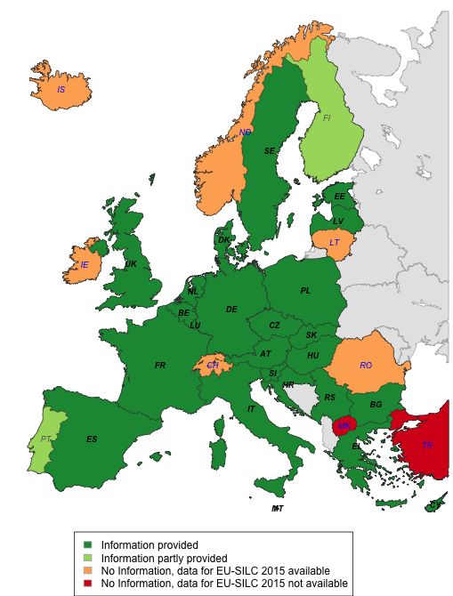
Database
Excel file with information on 26 countries
The exact composition of all income variables of EU-SILC cross-sectional 2015 wave
    34 variables, over 2000 income components
Latvia, Poland and Sweden
    Income from benefits with information only on “mixed components”
Notes:
What is the best way to collect the data and increase country participation?
How to best present the data? Excel? Other?

Slide 13
Findings
  Different levels of aggregation
  Most survey data, but significant amount of register
  Net-to-gross procedures are not consistent across countries
  Comparability issues across time
  Comparability issues across countries
  Difference between information in MetaSILC 2015 and other sources (Euromod Reports, MISSOC, Quality reports)

Slide 14
MetaSILC
Net-SILC 3 (2016-2020)
  + information on health, housing and production for own consumption
  + outlier treatment; imputation

Slide 15
Conclusion
The sampling variance is an important challenge to indicators for evidence-based policy-making
Increases awareness of both sampling and non-sampling errors

Slide 16
Conclusion
Key messages
If estimates are based on samples -> estimate and report SEs, CIs & p-values
Always take as much as possible account of sample design when estimating SEs, CIs & p-values
Never delete observations from the dataset
Never simply compare confidence intervals
Notes:
+ without an estimate of its precision, a point estimate is pointless!

Slide 17

Notes:
Using a sample to observe the world around us, is in many ways similar to watching the world around us on the basis of … a picture.
First of all, the more you zoom in on a detail, the more blurred the picture gets. The same is most of the time true for a sample estimate: zooming in on a specific subpopulation does not necessarily result in gaining much more insight into the details of the world around us, because our estimate will be less precise than for a larger subgroup.
Second, for a picture, the quality of the method for taking the picture is crucial for the quality of the picture itself: the higher the resolution, the sharper the image will be. The same is true for sample estimates: the better the sample design ensures that all parts of the population are represented in the survey, the more precise the sample estimates will be.
However, there is an important difference between using a picture for observing the world and using a sample for telling us how this world looks like: In the case of a picture it is easy to observe the precision of the image we get. This is not the case for a sample estimate: in that case there is only one way to find out the precision, that is: to calculate the sampling variance.
And it is precisely because we cannot directly observe the precision of a sample estimate, that without an estimate of its precision, a point estimate is pointless.

Slide 18
Literature
Goedemé, T. (2013) ‘How much confidence can we have in EU-SILC?’, Social indicators research, 110(1): 89-110, doi:10.1007/s11205-011-9918-2
Heeringa, S. G., West, B. T. and Berglund, P. A. (2010), Applied Survey Data Analysis, Boca Raton: Chapman & Hall/CRC, 467p.
Wolter, K. M. (2007), Introduction to Variance Estimation, New York: Springer, 447p.
https://timgoedeme.com/eu-silc-standard-errors/.

Slide 19
Resources
Background materials
Handouts
Do-files & exercises
https://timgoedeme.com/eu-silc-standard-errors/ (papers, do-files, csv-files)
Heeringa, S. G., West, B. T., & Berglund, P. A. (2010). Applied Survey Data Analysis. Boca Raton: Chapman & Hall/CRC

Slide 20
Contact details
Tim.Goedeme@uantwerpen.be
Lorena.ZardoTrindade@uantwerpen.be

